Slide 1

Science Information Literacy Instruction across the Undergraduate Curriculum
Eric Snajdr
Indiana University – Purdue University, Indianapolis
The 5th Annual True North Science Bootcamp 2019
Ottawa, Canada
May 31, 2019
Notes:
Eric Snajdr
Science librarian
Liaison to Department of Chemistry and Chemical Biology
Liaison to Department of Department of Psychology
Liaison to Program of Forensic Science

Slide 2

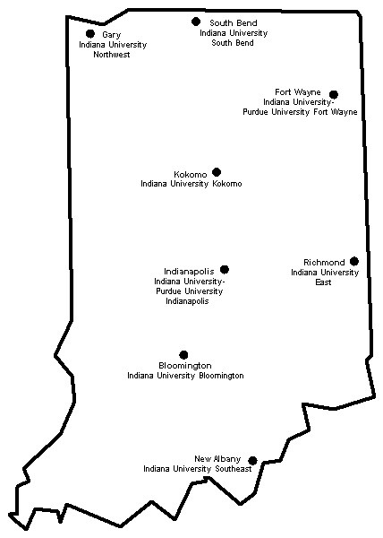
Indiana University system
Notes:
Overview of the Indiana University system
7 campuses
Cost sharing of some resources
“Request Delivery” System

Slide 3
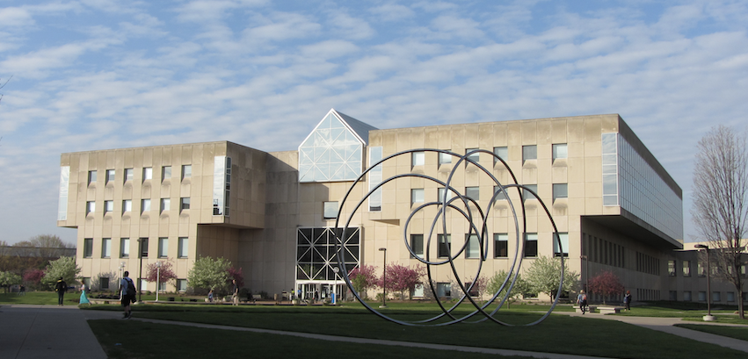
Indiana University-Purdue University, Indianapolis (IUPUI)
Urban research and academic health science university
17 degree granting schools
29,000 students (21,600 undergraduates)
Notes:
University Library
Main library on campus
1 of 5 libraries on campus. Also have Medical, Dental, Law, Art libraries

Slide 4
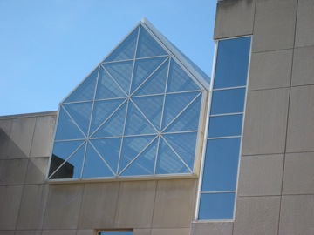
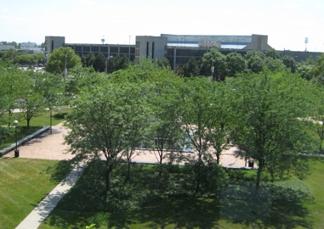
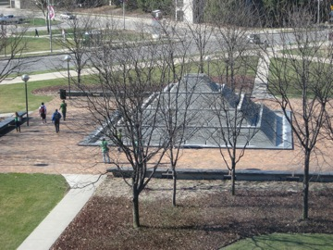
School of Science, IUPUI
3,000 students (2,500 undergraduates)
Departments
Biology
Chemistry & Chemical Biology
Computer & Information Sciences
Earth Sciences
Mathematical Sciences
Physics
Psychology
Notes:
This presentation will address undergraduate programs in Chem and Psychology as examples

Slide 5
Curriculum mapping of information skills
Integrating Information Literacy (IL) instruction at key points in a degree program

Slide 6
Why?
Proactive
Wholistic - building students’ IL skills at key points as they move through their degree
Student centered
Notes:
A few reasons….
Proactive
Instead of waiting for faculty to reach out to you for instruction, you can approach them with logical, comprehensive plan
Wholistic - building students’ IL skills at key points as they move through their degree
Often just a one shot (in isolation of other courses)
Instead, more purposeful – building skills at key points when needed
Student centered –
More meaningful/relevant for students, delivers information skills when needed for coursework, and at the appropriate time

Slide 7
How?

Slide 8
Examine curriculum
Degree maps
Identify key courses for IL instruction
Examine IL standards and competencies
Meet, discuss, plan with Faculty
Department Chair
Curriculum Committee
Key teaching faculty
Create roadmap to scaffold into curriculum
For each course identified, develop
  Learning outcomes
  Assessments
  Teaching Methods
Notes:
Examine curriculum - Take a look at the big picture, What courses are students required to take in order to obtain their degrees
Investigate what courses make sense for IL instruction, for example, intro course – orientation to library services, spaces, resources, Courses w/ research component - paper, presentation, poster, needing to cite sources
Relationships are key, good relationships with faculty greatly increase chance of success. Variety of avenues for this. For example, Department Chair, Curriculum Committee, key teaching faculty.

Slide 9
Example – Chemistry, Bachelor of Science
SCI-I 120 Windows on Science (First Year Seminar)
CHEM-C 294 Intro to Cornerstone in Chemistry
CHEM-C 344 Organic Chemistry Laboratory
CHEM 494 Capstone in Chemistry
Notes:
Let’s look at an example. Chemistry, Bachelor of Science degree students at IUPUI
I identified 4 courses as logical candidates…

Slide 10
Example – Chemistry, Bachelor of Science
SCI-I 120 Windows on Science (First Year Seminar)
Intro to science and strategies for success as science major
CHEM-C 294 Intro to Cornerstone in Chemistry
CHEM-C 344 Organic Chemistry Laboratory
CHEM 494 Capstone in Chemistry
Notes:
SCI-I 120 Windows on Science (First Year Seminar)
Intro to science and strategies for success as science major
Key avenue for providing orientation to library services, spaces, resources
Have a mini research project requiring science news articles
How to cite sources

Slide 11
Example – Chemistry, Bachelor of Science
SCI-I 120 Windows on Science (First Year Seminar)
Intro to science and strategies for success as science major
CHEM-C 294 Intro to Cornerstone in Chemistry
Covers intro to science communication
CHEM-C 344 Organic Chemistry Laboratory
CHEM 494 Capstone in Chemistry
Notes:
CHEM-C 294 Intro to Cornerstone in Chemistry
Covers intro to science communication
A portion of this class introduces students to the primary literature
Examine parts of a scientific paper
Have to locate one on their own and summarize it

Slide 12
Example – Chemistry, Bachelor of Science
SCI-I 120 Windows on Science (First Year Seminar)
Intro to science and strategies for success as science major
CHEM-C 294 Intro to Cornerstone in Chemistry
Covers intro to science communication
CHEM-C 344 Organic Chemistry Laboratory
Chemical information in the lab setting
CHEM 494 Capstone in Chemistry
Notes:
CHEM-C 344 Organic Chemistry Laboratory
required of Chemistry majors, where students learn advanced laboratory techniques of organic chemistry
Course involves laboratory emphasis on isolation, and identification of organic compounds, spectroscopic methods of compound identification, qualitative organic analysis, multistep synthesis and reaction mechanisms.
Students at this level now have a grasp of chemical terminology and processes such that it affords a prime opportunity for introducing chemistry specific information skills into their laboratory research.

Slide 13
Example – Chemistry, Bachelor of Science
SCI-I 120 Windows on Science (First Year Seminar)
Intro to science and strategies for success as science major
CHEM-C 294 Intro to Cornerstone in Chemistry
Covers intro to science communication
CHEM-C 344 Organic Chemistry Laboratory
Chemical information in the lab setting
CHEM 494 Capstone in Chemistry
Independent research projects
Notes:
CHEM 494 Capstone in Chemistry
Independent research projects
Advanced search strategies to locate relevant literature on topic

Slide 14
Information Literacy guidelines and standards
Chemical Information Skills, Committee on Professional Training, Undergraduate Professional Education in Chemistry. American Chemical Society
Information Competencies for Chemistry Undergraduates: the elements of information literacy. Special Libraries Association, Chemistry Division and American Chemical Society, Division of Chemical Information
Framework for Information Literacy for Higher Education. American Library Association/Association of College and Research Libraries
Information Literacy Standards for Science and Engineering/Technology. American Library Association/Association of College and Research Libraries/Science and Technology Section Task Force on Information Literacy for Science and Technology
Notes:
Several sets of IL guidelines/standards to consider

Slide 15
Information Literacy guidelines and standards
Chemical Information Skills, Committee on Professional Training, Undergraduate Professional Education in Chemistry. American Chemical Society
Information Competencies for Chemistry Undergraduates: the elements of information literacy. Special Libraries Association, Chemistry Division and American Chemical Society, Division of Chemical Information
Framework for Information Literacy for Higher Education. American Library Association/Association of College and Research Libraries
Information Literacy Standards for Science and Engineering/Technology. American Library Association/Association of College and Research Libraries/Science and Technology Section Task Force on Information Literacy for Science and Technology
Notes:
For this presentation, let’s focus on this one.

Slide 16
American Chemical Society - Chemical Information Skills
Efficiently locate chemical and physical properties of substances, including spectra.
Efficiently locate references for the detection, characterization, or reactions, including syntheses, of desired compounds or classes of compounds.
Be able to obtain information on a substance through a variety of searching strategies, including structure
searching, and searching by molecular formula and name.
Identify key references and use citation searching of articles to locate more current articles on the topic of interest.
Complete a comprehensive subject search.
Compile a complete bibliography of an author's publications.
Locate recent review articles on a subject.
Know the importance of patents and be able to search for patents on a subject.
Use a bibliographic program to organize information and prepare a scientific paper.
Students need to develop the ability to determine the quality of the information obtained. Students should especially learn how to evaluate the validity of on-line sources
Notes:
It is impossible for a student to learn all of this in a one shot, or even two instructional sessions

Slide 17
American Chemical Society - Chemical Information Skills
300
Efficiently locate chemical and physical properties of substances, including spectra.
Efficiently locate references for the detection, characterization, or reactions, including syntheses, of desired compounds or classes of compounds.
Be able to obtain information on a substance through a variety of searching strategies, including structure
searching, and searching by molecular formula and name.
Identify key references and use citation searching of articles to locate more current articles on the topic of interest.
Complete a comprehensive subject search.
Compile a complete bibliography of an author's publications.
Locate recent review articles on a subject.
Know the importance of patents and be able to search for patents on a subject.
Use a bibliographic program to organize information and prepare a scientific paper.
Students need to develop the ability to determine the quality of the information obtained. Students should especially learn how to evaluate the validity of on-line sources
300
300
300
200
200/400
300
400
300
400
100/300
Notes:
Therefore, think about how best to divide it up logical places in curriculum

Slide 18
Course title/number: Organic Chemistry Laboratory / CHEM-C 344
Learning Outcomes
Library Day 1 (2 hr. session)
Students will be able to use the name of a chemical substance, in order to locate alternative names and the CAS Registry number for the substance in the SciFinder database.
Students will be able to use the name of a chemical substance, in order to locate analytical data (e.g. melting point, boiling point) using SciFinder.
Students will be able to use the CAS Registry number of a compound, in order locate spectral data (C or HNMR, and IR) in the Spectral Database for Organic Compounds.
Using the author search feature in SciFinder, students will be able to obtain the Full Text for the 2 research articles for an assigned author.
Students will be able to identify and list the basic elements of a journal article citation.
Overall structure of curricular planning adapted from “Meet Us On the Corner of Intentional and Strategic” workshop presented at ACRL 04.12.13 by Steven Hoover (Syracuse), Jennifer Fabbi, Anne Zald, Erin Rinto (UNLV)
Notes:
Here is an example of one course, Organic Chemistry Laboratory / CHEM-C 344
The class has two sessions in the library per semester
Here are learning outcomes for Day 1

Slide 19
Course title/number: Organic Chemistry Laboratory / CHEM-C 344
Learning Outcomes
Library Day 2 (2 hr. session)
Using a chemical structure, students will be able to draw the structure in Reaxys and conduct substructure searching and an exact structure search using this database.
Students will be able to locate journal articles discussing the synthesis of a chemical compound in Reaxys.
Students will be able to locate journal articles discussing the use of a reagent in Reaxys.
Students will be able to cite sources using the American Chemical Society citation style.
Overall structure of curricular planning adapted from “Meet Us On the Corner of Intentional and Strategic” workshop presented at ACRL 04.12.13 by Steven Hoover (Syracuse), Jennifer Fabbi, Anne Zald, Erin Rinto (UNLV)
Notes:
And here are learning outcomes for Day 2

Slide 20
Course title/number: Organic Chemistry Laboratory / CHEM-C 344
Assessments
Library Day 1
Library Assignment “Introduction to Techniques in Chemical Information” (Graded by Teaching Assistants using grading rubric)
https://iupui.libguides.com/ld.php?content_id=24723909
https://iupui.libguides.com/ld.php?content_id=24741130
Library Day 2 (several weeks beyond)
Library Assignment “Introduction to Techniques in Chemical Information – Part 2 ” (Graded by Teaching Assistants using grading rubric)
https://iupui.libguides.com/ld.php?content_id=44334914
https://iupui.libguides.com/ld.php?content_id=44334923
Final Exam for course
Items from the library sessions are included for the course final exam.
Overall structure of curricular planning adapted from “Meet Us On the Corner of Intentional and Strategic” workshop presented at ACRL 04.12.13 by Steven Hoover (Syracuse), Jennifer Fabbi, Anne Zald, Erin Rinto (UNLV)
Notes:
Here is a snapshot of some of the assessments

Slide 21
Course title/number: Organic Chemistry Laboratory / CHEM-C 344
Teaching Methods
Library Day 1
Brief lecture with discussion
Demonstration
Hands-on exercises
Library Day 2
Brief lecture with discussion
Demonstration
Hands-on exercises
Overall structure of curricular planning adapted from “Meet Us On the Corner of Intentional and Strategic” workshop presented at ACRL 04.12.13 by Steven Hoover (Syracuse), Jennifer Fabbi, Anne Zald, Erin Rinto (UNLV)

Slide 22
Example – Chemistry, Bachelor of Science
SCI-I 120 Windows on Science (First Year Seminar)
  1 class visit - 1 hour 50 and minute session
CHEM-C 294 Intro to Cornerstone in Chemistry
  2 class visits - 45 min. and 1 hour and 30 min.
CHEM-C 344 Organic Chemistry Laboratory
  2 class visits, each 2 hours
CHEM 494 Capstone in Chemistry
  No class visit, individual appointments with students
Notes:
6 classroom hours of library instruction with every Chemistry major

Slide 23
Example – Psychology, Bachelor of Science
SCI-I 120 Windows on Science (First Year Seminar)
PSY 203 Ethics and Diversity in Psychology PSY-B 203
PSY 311 Research Methods in Psychology
PSY 433 Capstone Laboratory in Psychology PSY-B433
Notes:
Here is a brief look at curricular mapping for Psychology, Bachelor of Science

Slide 24
Example – Psychology, Bachelor of Science
SCI-I 120 Windows on Science (First Year Seminar)
Intro to science and strategies for success as science major
PSY 203 Ethics and Diversity in Psychology PSY-B 203
PSY 311 Research Methods in Psychology
PSY 433 Capstone Laboratory in Psychology PSY-B433
Notes:
Key avenue for providing orientation to library services, spaces, resources
Students conduct basic research on a career of choice
Intro to searching general database, intro to evaluating sources.

Slide 25
Example – Psychology, Bachelor of Science
SCI-I 120 Windows on Science (First Year Seminar)
Intro to science and strategies for success as science major
PSY 203 Ethics and Diversity in Psychology PSY-B 203
Key avenue for focusing on issues in citation/plagiarism
PSY 311 Research Methods in Psychology
PSY 433 Capstone Laboratory in Psychology PSY-B433

Slide 26
Example – Psychology, Bachelor of Science
SCI-I 120 Windows on Science (First Year Seminar)
Intro to science and strategies for success as science major
PSY 203 Ethics and Diversity in Psychology PSY-B 203
Key avenue for focusing on issues in citation/plagiarism
PSY 311 Research Methods in Psychology
Research design – key avenue for teaching literature search
PSY 433 Capstone Laboratory in Psychology PSY-B433
Notes:
At the 300 level students learn to conduct search strategies in discipline specific databases (PsycINFO, PsycTESTS) for a variety of projects.

Slide 27
Example – Psychology, Bachelor of Science
SCI-I 120 Windows on Science (First Year Seminar)
Intro to science and strategies for success as science major
PSY 203 Ethics and Diversity in Psychology PSY-B 203
Key avenue for focusing on issues in citation/plagiarism
PSY 311 Research Methods in Psychology
Research design – key avenue for teaching literature search
PSY 433 Capstone Laboratory in Psychology PSY-B433
Independent research projects
Notes:
At the capstone level, students learn advanced search strategies for their independent research.

Slide 28
Challenges
Faculty buy in
May result in higher instruction load
Takes considerable time to plan
Notes:
Faculty buy in
Even if you get everyone on board faculty may move or rotate courses they teach
May result in higher instruction load
Not everyone likes to teach, or has time to teach
Takes considerable time to plan

Slide 29
Many Benefits
Makes learning more relevant
More meaningful assignments
Delivers library instruction at specific points of need
Notes:
Students learn best when what they are learning has meaning to them. The more we can tap into this the more we can increase the chance that material learned is retained in long term memory. The curricular approach works toward this goal delivering library instruction at the point of need.
Breaking up information literacy instruction across a degree program helps me to have more focus as a teacher. Instead of feeling like I have to cram too much material into a one-shot session, the curricular approach allows for a gradual, purposeful, meaningful approach. This allows students to build upon their information skills at appropriate points throughout the years as they pursue their major. This enhances the student experience as well as their ability to master science information skills.

Slide 30
Thank you!
Eric Snajdr
Associate Science Librarian
Indiana University – Purdue University, Indianapolis
esnajdr@iupui.edu

