Slide 1
SCHOOL OF SOCIAL WORK
Recovery from Problem Gambling: A Machine Learning Approach
Saahoon Hong, Betty Walton, & Hea-Won Kim
Indiana University School of Social Work
State Epidemiological Outcomes Workgroup (SEOW) 2022

Slide 2
Recovery from Problem Gambling
AGENDA
2. Problem Gambling Recovery Model
3. Q & A

Slide 3
Indiana Study: Recovery From Problem Gambling

Slide 4
All forms of legal/illegal, organized, and social gambling, PLUS…..
Individual has problems with gambling that impact his/her functioning and/or wellbeing…. Or….
Individual has problems with gambling that dramatically impacts his/her life and make functioning difficult or impossible in at least one life domain.
What is Problem Gambling?

Slide 5
What is Recovery from Problem Gambling?
Clinically improved when actionable ratings changed to non-actionable ratings

Slide 6
Research Question
To examine and identify intersections of the first wave of the COViD-19 pandemic, recovery from problem gambling, and behavioral health needs.

Slide 7
Methods
ANSA
Adults with problem gambling
Machine Learning Algorithm

Slide 8
Adults aged 18 and above who participated in the Midwestern state-funded mental health service (n=29,267) in the calendar year of either 2019 or 2020.
654 adults experienced Problem Gambling.
Participants

Slide 9
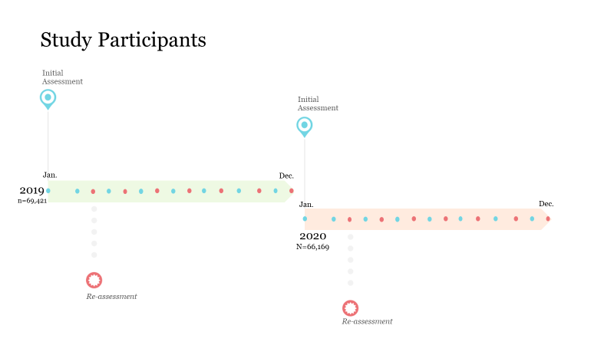

Slide 10
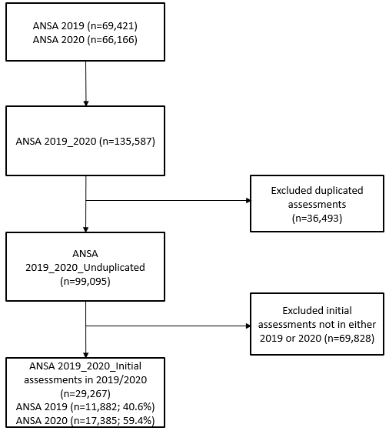
Flowchart of the dataset development

Slide 11
The Adult Needs and Strengths Assessment (ANSA) items in the six domains: (1) strengths, (2) life functioning, (3) cultural factors, (4) caregiver needs and resources, (5) behavioral health needs, and (6) risk behaviors.
What is ANSA?

Slide 12
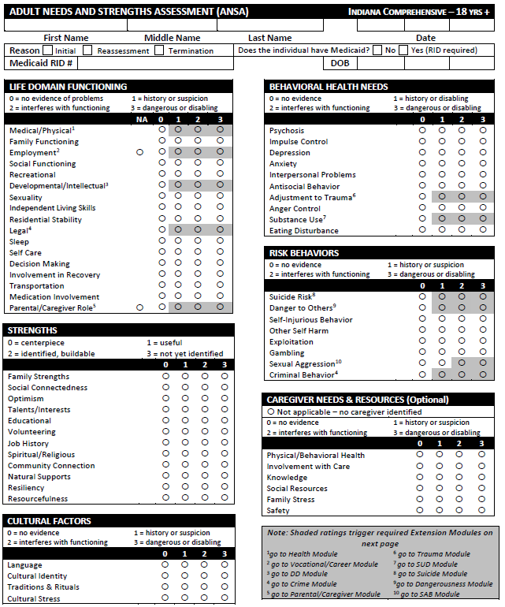
What is ANSA?

Slide 13

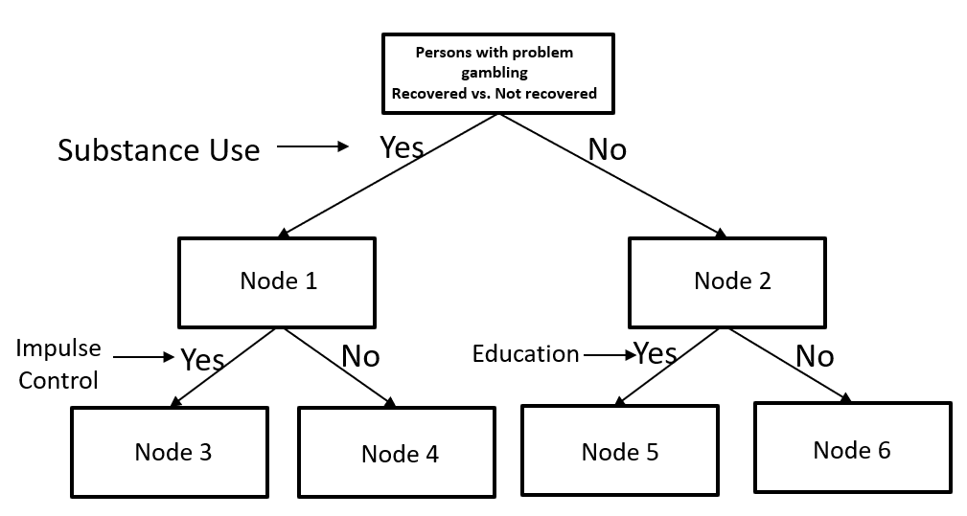
Analysis: A Decision Tree Model (CHAID)

Slide 14
Machine Learning Approach
Analysis
Progressive use of machine learning aims to detect and monitor different mental health states and identify between the target response and a set of input features of interest (i.e., Garcia-Ceja et al., 2018; Tate et al., 2020).

Slide 15
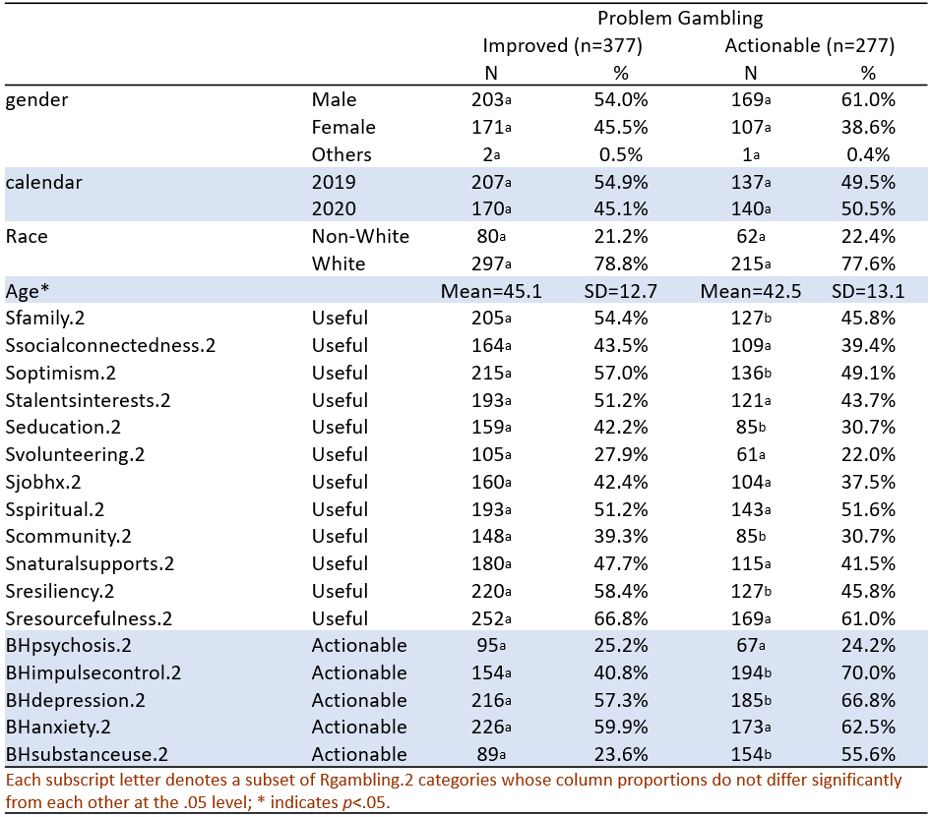

Slide 16
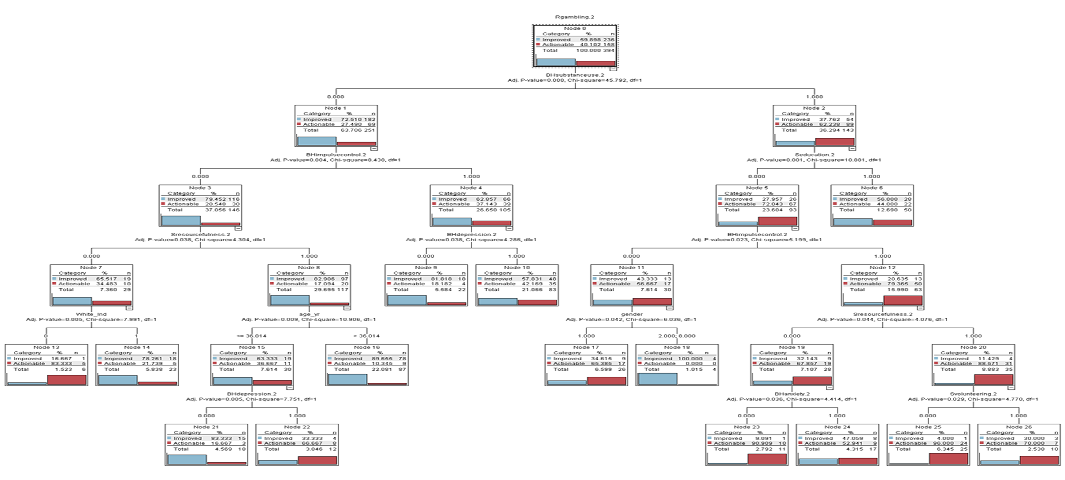

Slide 17
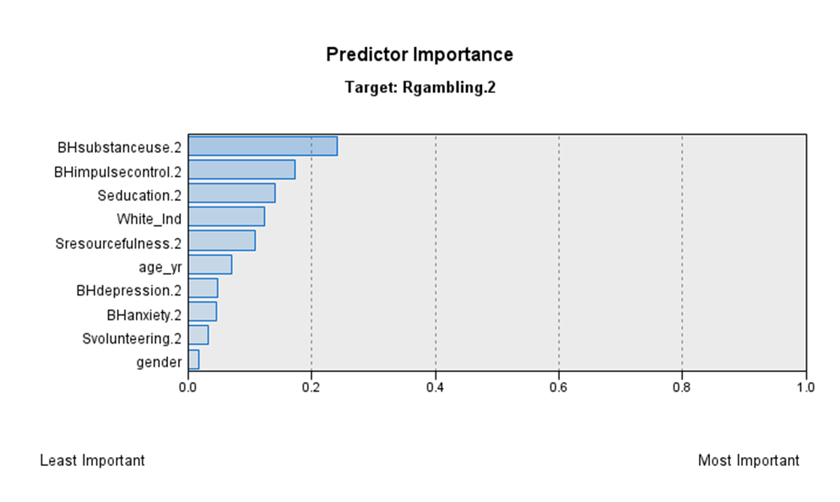
Results

Slide 18
Adults were more likely to improve problem gambling when they stayed absent from substance use and did not struggle with impulse control and depression. Resourcefulness was a critical strength item for this group's improvement.
Struggling with substance use, impulse control, education, and resourcefulness was the significant barriers to improvement from problem gambling.
Results

Slide 19
Problem Gambling Recovery Model

Slide 20
Problem Gambling Recovery Model (Hong et al., 2022)
Identify Risk Factors: substance use, impulse control, non-White, age, depression.
Respond to Behavioral Health Needs
Strength-Based Approach: Resourcefulness, Education.
Monitor Care/Treatment for Co-Occurring Disorders
PG Treatment Services for younger adults, people of color, and men.

Slide 21
Implications for Practice
Identifying behavioral health needs and strengths among adults with PG
1
Addressing an array of intersections of PG and behavioral health needs and strengths
2
Providing a care plan following by TCOM philosophy
3
Monitoring and Resolving behavioral health needs by a strength-based approach
4

Slide 22
Staying absent from substance use, actionable needs on impulse control, and depression were primary predictors that led to gambling addiction recovery
The machine learning-based gambling addiction recovery model
A basis for developing a gambling addiction recovery model
Conclusions

Slide 23


Acknowledgement
This study was developed through a collaborative effort
by the
IU School of Social Work, IU Racial Justice Research Fund, and DMHA.

Slide 24


Slide 25
Contact Information
Saahoon Hong, Ph.D.
Assistant Research Professor
Indiana University School of Social Work
saahong@iu.edu
Betty Walton, Ph.D.
Associate Research Professor
Indiana University School of Social Work
beawalto@iu.edu
Hea-Won Kim, PhD
Associate Professor
Indiana University School of Social Work
heakim@iupui.edu
INDIANA UNIVERSITY SCHOOL OF SOCIAL WORK

