Slide 1
Using business analytics to support our values

Slide 2

Katharine Macy
Collection Assessment Librarian
Subject Liaison to Business & Economics
IUPUI University Library
macyk@iupui.edu
ORCID ID: 0000-0002-6283-7143
Notes:
Good Morning. My name is Katharine Macy, I have spent the last four years at University Library at IUPUI as a subject liaison to business, then I picked up economics, and most recently was appointed half time as the collection assessment librarian. A little bit more about myself. This is my second career. My first career was as an business analyst in the private sector, which included earning an MBA and working in marketing, operations, and finance. For me, assessment has always been critical to my work flows. It’s how I improve, and how I get to “be lazy” which always gets me a strong side eye from those who know me. That is because when I work to innovate I lean toward assessment every step of the way, so I may figure out the best way to achieve my goals, freeing up my time to work on all the other things I wish to accomplish. Assessment does not get in the way of doing my work, instead it provides me freedom. It allows me to determine what to stop doing, and helps me recognize what works as I iterate.
Enough about me. Today I want to share with frameworks, tools, and analytics gained from business and management, which can enable academic libraries to achieve their goals and promote our values. How these assessment and project management techniques allow us to create a culture of sustainability, innovation, and learning.

Slide 3
Library Context & Values
1
Grounding values driven assessment
Notes:
But first I want to set up context and values so we can create assessment grounded in those values.

Slide 4
6%
3%
52.7%
Projected annual increase for journal content
(Library Journal 2018)
5-YR CAGR of Collection Budgets, a significant gap! (Association of Research Libraries 2011-2016)
Portion of library budget spent on electronic materials at academic institutions.
(Almanac 2018)
Notes:
First off. Scholarly communications are a mess and we are feeling incredible budget pressures. The projected annual increase of journal content is 6%, whereas collection budgets are only increasing 3% annually. That is quite a gap and it’s resulting in cuts. Meanwhile more and more content is being made available through electronic means. According to the Chronicle for Higher Education 52.7% of the budget is spent on electronic materials.

Slide 5
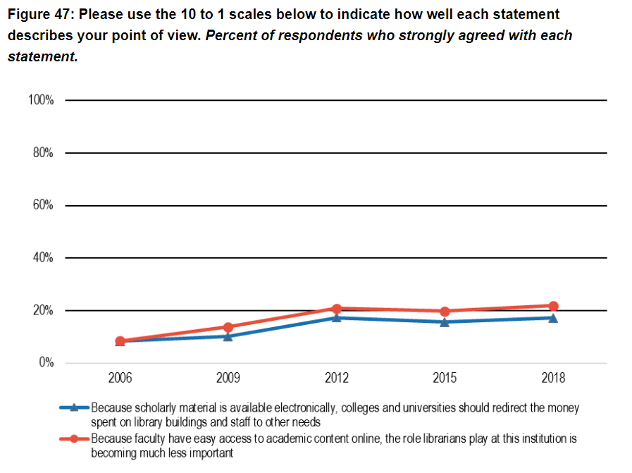
Ithaka S&R
(Ithaka S+R US Faculty Survey 2018)
Notes:
The2018 Ithaka Faculty Survey indicates that with the increase of electronic materials online, an increasing number of faculty think academic library budget money should be diverted to other academic needs outside the library and that the roles of librarians is less important, because they view our roles as primarily about buying collections.

Slide 6
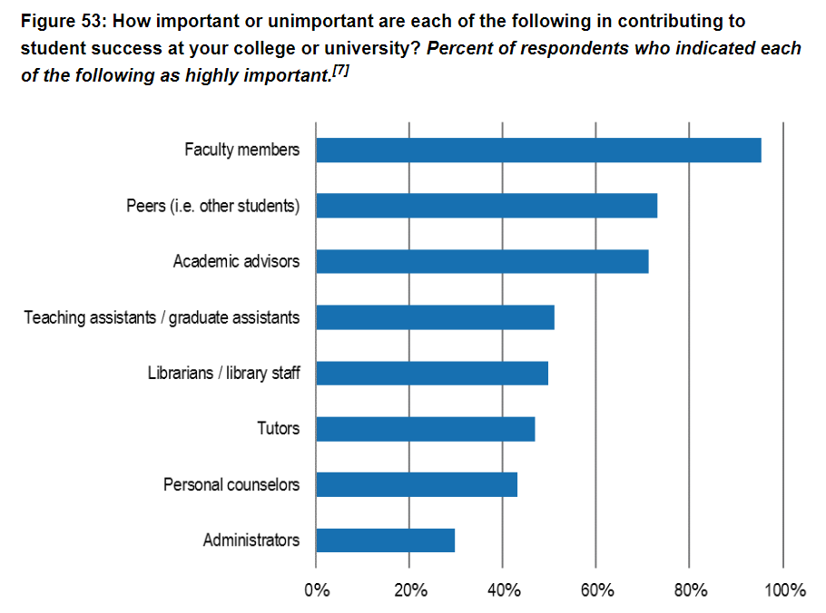
(Ithaka S+R US Faculty Survey 2018)
Notes:
This is seen again when faculty were asked to rate how important librarians were for student success. We have a perception issue, where faculty do not understand all the value the library provides to their communities. We can help resolve this through using assessment paired with stories that appeal to emotion, and by tying our work back to values important to our institutional context within our communications.

Slide 7
ALA Core Values of Librarianship
Access
Confidentiality/Privacy
Democracy
Diversity
Education & Lifelong learning
Intellectual Freedom
Public Good
Preservation
Professionalism
Service
Social Responsibility
Sustainability
http://www.ala.org/advocacy/intfreedom/corevalues
Notes:
Speaking of values, today I’m going to focus on using the core values of librarianship as outlined by the American Library Association. However, it may be better to ground yourself in values from your individual institutional context. For instance a huge value that we consider at IUPUI is student success.

Slide 8
Values driven goal setting process
I want to…
[Describe what you want to accomplish]
In order to…
[Outline what the outcomes]
I don’t want to…
[List the behaviors/actions you want to stop doing because it gets in the way of living to your values and achieving goals]
Values: [What values does this action/goal support]
Notes:
Considering context for academic libraries and our institutions, we can create values driven goals. This is needed because without clear goals, meaningful assessment isn’t possible. My process creating goals that are driven by values is to first
Describe what I hope to accomplish (action/goal)
Outline my Desired outcomes
List the behaviors/actions I want to stop doing because it gets in the way by fighting against the goal or not supporting our values. – Thinking through this is extremely helpful in considering how a program can be assessed outside traditional measures. Are we able to do less of something in a meaningful way? It also provides clarity in vision, goals, and expectations.
Lastly check for alignment with values.

Slide 9
Values driven goal setting example 1
I want to…
Purchase resources keeping in mind the value that an individual resource provides for the library’s entire collection which serves a diverse community.
In order to…
Fill gaps
Cancel unused resources
Plan upfront and honest conversations with vendors
I don’t want to…
Purchase duplicate content
Cancel resources that are used
Make rushed decisions
Buy resources as a one-off
Values: Access, Professionalism, Service, Sustainability
Notes:
My first example of values driven goal setting:
I want to purchase resources keeping in mind the value that an individual resource provides for the library’s entire collection which serves a diverse community.
In order to identify and fill gaps, cancel unused resources to free up funds, plan upfront and honest conversations with my vendors as we work to build a sustainable relationship.
I don’t want to continue purchasing duplicate content, have to cancel used resources because of budget shortfalls, make rushed decisions without understand the true value of the resource beyond $/use, or buy resources as a one-off when there are needed resources that would serve more users.
This goal is grounded in the values of access, professionalism, service, and sustainability.

Slide 10
Values driven goal setting example 2
I want to…
Support the creation and maintenance of open infrastructure by providing resources (financial, labor, etc.)
In order to…
Ensure equitable access to information.
Support scholarship globally.
Manage collections sustainably.
Ensure our faculty’s scholarship is accessible.
I don’t want to…
Spend all collection resources on closed journal system.
Limit access to our institution’s scholarship.
Values: Access, Democracy, Diversity, Public Good, Social Responsibility, Sustainability
Notes:
Here is another example:
I want to support the creation and maintenance of open infrastructure by providing resources (financial, labor, etc.)
In order to ensure equitable access to information, support global scholarship, manage my collections sustainably, and ensure our faculty’s scholarship is accessible to all.
I don’t want to spend all our collection resources on closed journal system, limit access to our institution’s scholarship.
This is grounded in values of access, democracy, diversity, public good, social responsibility, and sustainability

Slide 11
Values driven goal setting example 3
I want to…
Promote library services to ensure student success.
In order to…
Create an information literate population that develops skills for lifelong learning.
Increase presence of librarians in curriculum.
Help faculty & administration. understand the value the library provides outside of collections.
I don’t want to…
Focus solely on collections when conducting outreach with faculty.
Rely on the status quo for providing faculty support.
Values: Education & Lifelong Learners, Service, Professionalism, Democracy, Social Responsibility
Notes:
One final example:
I want to promote library services to ensure student success
In order to create an information literate population that develops skills for lifelong learning, increase the presence of librarians in the curriculum, and help faculty & administration understand the value the library provides outside of collection management.
I don’t want to focus solely on collections when conducting outreach with faculty, rely on the status quo for providing faculty support (e.g. existing instruction presence, need to refresh curriculum maps, used the same canned messages at the beginning of the term).
Grounded in the values of education & lifelong learners, service, professionalism, democracy, and social responsibility.

Slide 12
Values driven assessment planning
Action
Outcome
Metric
How can you measure outcome success/failure directly?
How about indirectly?
Notes:
Values driven assessment planning is about looking at what actions we want to take, desired outcomes, and determining metrics.
How do we measure outcomes to determine success or failure directly?
Direct metrics are often lagging. Example:
Cost/Use for collections.
Summative assessment in library instruction.
How can you measure outcomes indirectly?
These can be leading indicators – often through measure progress and activity to move in the direction of the goal/objective. Examples:
Gathering and reviewing syllabi in curriculum mapping.
Formative assessment in the classroom that enables contingent teaching to make the classroom experience more effective.
The number of faculty you assist with publishing in open access journals or in depositing work into your IR
While I do not advocate measuring activity for activities sake, measuring activity that helps promote movement toward desired outcomes can be helpful. Eventually you want to be able to look at whether you are achieving success via direct metrics and if the activity is not resulting in expected results it’s time to reexamine work flows and initiatives.

Slide 13
Business Analytics
2
Decision support for our values
Notes:
Now I’m going to take you through some commonly used business analytics techniques that can provide decision support for our values.

Slide 14
Business analysis to support collections
Price Sensitivity
How sensitive are we to price increases? Helps us understand ability to navigate changes within collection to meet user needs. Critical for holistic collection assessment.
Stakeholder Analysis
Determine user needs for research, teaching, and learning.
Notes:
The two major analysis techniques I’m reviewing are determining price sensitivity and stakeholder analysis. However additional techniques and tools will be scattered through out. First I’m going to discuss analyzing price sensitivity for conducting holistic collection assessment. Then I will discuss how stakeholder analysis can help us address research, teaching, and learning needs of our communities.

Slide 15
Holistic collection assessment is an analysis process that enables individuals making collection management decisions to quickly determine the value of an individual resource within the context of a subject specific collection and/or within the entire library’s collection.
Notes:
To set the stage: Holistic collection assessment is an analysis process that enables individuals making collection management decisions to quickly determine the value of an individual resource within the context of a specific collection and/or within the entire library’s collection. This is a process I am developing at IUPUI.

Slide 16
Metrics
Average annual price increase/decrease indicates price sensitivity over the last 5 years. Higher average price increases are indicative of showing less price sensitivity toward a resource.
The other metrics reveal
why.
Price history
  6 years of data is ideal
  Calculate 5-year & 3-year Average Annual % Inc/Dec
Use history
Cost/Use
  Use to spot trends
Portion of spend
  Pareto analysis of resource costs
Content coverage
  Unique attributes
  Duplication
  Competitive resources/ substitutes
Consortia status
Multi-year contract agreements
Notes:
The first key metric I need to collect is price history going back at least 6 years. This allows for the calculation of the 5-year and 3-year average annual percentage increase or decrease. Higher average prices increases indicate that we are more insensitive to the price of that particular resource.
The remaining metrics we collect in order to understand our level of price sensitivity. This metrics include:
Use history, cost/use (helpful in trendspotting), the portion of the spend a resource uses (helpful in conducting a Pareto analysis), content coverage to reveal unique attributes, duplication, and competitive resources and substitutes, consortia status, and multi-year contract agreements.

Slide 17
Price Sensitivity
The extent to which buyers are sensitive to price increases.
Porter, M. E. (2008), “The five competitive forces that shape strategy”, Harvard Business Review, Vol. 86 No. 1, pp. 78–93.
Notes:
Just to review price sensitivity is the extent to which buyers are sensitive to price increases. When price increases are very high and you still buy the product you are insensitive. For a long time academic libraries have behaved in this manner while cutting staff and services to keep up with the high increases in scholarly journals.

Slide 18
Four factors that influence price sensitivity
proportion of total cost
the level of differentiation between products
the importance of a product/service to the buyer for offering a quality service or product to their own customers
the level of competition between end users
Porter, M. E. (2008), “The five competitive forces that shape strategy”, Harvard Business Review, Vol. 86 No. 1, pp. 78–93.
Notes:
There are four factors that influence price sensitivity, which I will go into more detail in the subsequent slides.

Slide 19
Metrics to determine price sensitivity factors
Price sensitivity factor | Metric
Proportion of total cost | Portion of spend
The level of differentiation between products | Content coverage (i.e. overlaps, uniqueness)
The importance of product/service to the buyer for offering a quality service or product to their own customers | Cost per use Cost per citation Stakeholder use in research or teaching (curriculum) Uniqueness within the collection Consortia agreements
The level of competition among end users (customers) | Competitive products Substitutes
Notes:
The first factor is the proportion of total cost this can be determined by understanding a resource’s portion of the total collection spend.
The second factor is the level of differentiation between products. This is where understanding a resources content coverage, how it overlaps or is unique, is helpful.
The third factor is the importance of a product/service to the buyer for offering a quality service or product to their own customers. So this is about how important is the resource we are buying for us to be able to serve our patrons. Metrics that helps us understand this factor are cost/use, cost per citation, stakeholder use in research or teaching (curriculum), uniqueness within the collection or in the world (archives), and consortia agreements.
The final factor is the level of competition among end users (customers). This is the hardest one for many to wrap their arms around. A good example is the encyclopedia market. A competitive product from recent years is Wikipedia, which is gaining our users attention and completely diverting users from using library services for this type of information. Another example is users getting news information from Twitter or Facebook as opposed to traditional sources. Understanding competitive products and substitutes that our patrons may use in or outside the library to meet an information need helps us understand this factor.

Slide 20
Data sources
Data Gathered | Source
Historical cost (at least 6 years) | ILS Internal budget reports
Historical use data (at least 6 years) | Historical tracking spreadsheet Archived original usage reports from vendors
LibGuide clicks | LibGuides statistics (Springshare)
Overlap analysis | Serials Solutions
Resource content | Library website LibGuides
Portion of spend (Pareto analysis) | Internal Budget Reports
Consortia agreements | ILS
Notes:
This is an outline of all the sources we are using for gathering data to understand price sensitivity at IUPUI University Library. Much of the data I’m bringing into the analysis are from different systems and is very messy to clean up.

Slide 21
Analysis tools & software
Currently managed using spreadsheet software (MS Excel), which offers the following
Text to Columns
Removing Duplicates
Pivot Tables
Conditional Formatting
Alternate software that may be used includes Google Sheets and Open Refine.
Notes:
Currently I’m creating and maintaining our collection analysis using MS Excel because it offers several data analysis tools I find useful: text to columns, removing duplicates, Pivot Tables, and conditional formatting.
There is open software options available with similar capabilities such as Google Sheets and Open Refine.

Slide 22
Challenge | How to address… | Enables
Different data sources | Determine unique identifiers ISSN/ISBN PO Number | Using vlookups when joining data in analysis spreadsheet
Title Changes in System/ Spreadsheets | Unique identifiers may need to be added to data downloads/ spreadsheets if missing Create spreadsheet with unique identifier and current title Add column to historical data sheets called current title and use vlookup to add current title. | Summarizing historical data quickly using tools such as pivot tables
Challenges faced in analysis & mitigation strategies
Notes:
As I join our data in different systems to understand how sensitive we are, I’ve encountered a number of challenges. The next three slides outline those challenges and our mitigation strategies. I’m not going to go through them in detail right now, but you can refer back to the slide deck if you need help trouble shooting challenges and don’t hesitate to reach out to me.
The main challenges we have in this project are
Different data sources
Title changes in systems/spreadsheets
Human created spreadsheet (particularly for use data)
Use data is not available
Resource cost is allocated over several budget lines in multiple reports

Slide 23
Challenge | How to address… | Enables
Human created spreadsheets (particularly use tracking) | Separate numbers from text into different columns i.e. 450 downloads would become 450 | downloads numerical date in “use” column” and text in “use type” column | Easy value calculations such as cost/use Graphing data Spotting numerical trends and potential errors Creating pivot tables!
Use data is not available | Use research guide or website clicks as a proxy. | Comparing similar databases with use statistics to approximate use.
Challenges faced in analysis & mitigation strategies

Slide 24
Challenge | How to address… | Enables
Resource cost allocated over multiple budgets in spreadsheets and reports | Pivot tables to summarize cost of resource | Accurate calculations of cost/use (less human error) Quick consolidation of all data for a resource
Challenges faced in analysis & mitigation strategies

Slide 25
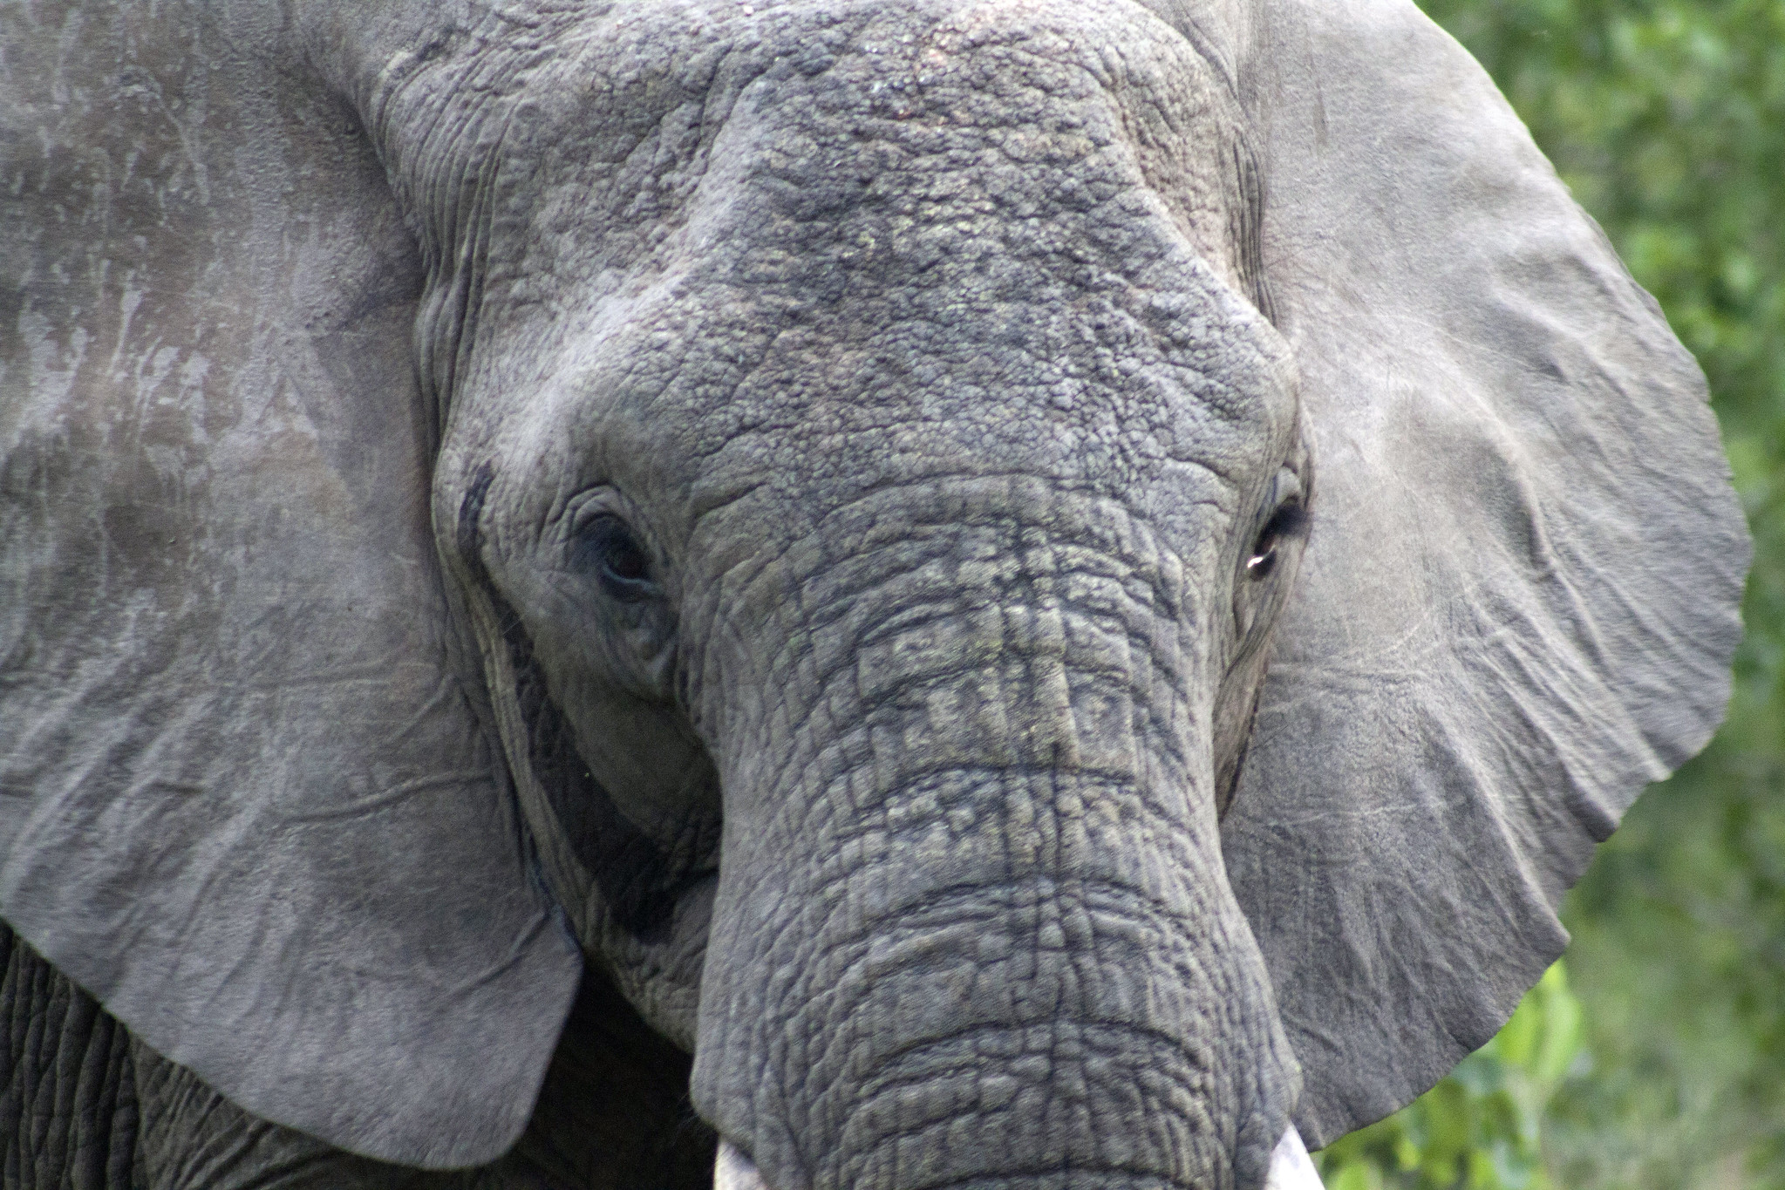
Setting priorities for deeper review
Use Pareto analysis to determine resources with greatest potential for impact
Determine which resources have the highest cost/use
Determine which resources have an average annual price increase above a certain level (e.g. 5%)
Consider whether consortia relationships are involved
Look to document content, specifically uniqueness, overlaps, and competitive products, and patron use.
A template available for helping in setting priorities is available at: http://hdl.handle.net/1805/12032
Elephant1 by flowcomm
Notes:
A big concern I hear expressed is that there are too many resources and gathering all that data is too time consuming. And I have to say that I agree with you. We don’t have time to look at every resource.
However, we can use a technique call Pareto analysis in order to determine where to focus efforts. This is basically the 80/20 rule. 20 percent of our resources by count, contribute to 80 percent of our total collection spend. Determining which resources are in that top 20 percent helps us determine where changes have the most potential for impact. Once you’ve done this you can further whittle down the list by looking at resources with the highest cost/use, that have average annual price increases above a certain level like 5%, and lastly whether a consortia relationship is involved (which may help or hinder action). For resources you flag look to dive deep in documenting content as well as how our patrons use the resources.
I’ve posted a template to help you do this analysis in IUPUI Scholarworks.

Slide 26
Pareto analysis aka 80/20 rule
Determine 20% of your resources (by count) that will account for 80% of your spend. Using a flag to indicate those resources, allows us to prioritize efforts that will have highest impact.
Resource | Cost | Cumulative Spend | % Cumulative Spend | Pareto Flag
Resource 1 | 20,000 | 20,000 | 19% | Y
Resource 2 | 19,500 | 39,500 | 38% | Y
Resource 3 | 16,000 | 55,500 | 54% | Y
Resource 4 | 15,000 | 70,500 | 68% | Y
Resource 5 | 12,000 | 82,500 | 80% | Y
Resource 6 | 10,000 | 92,500 | 90% | N
. | . | . | . | .
. | . | . | . | .
. | . | . | . | .
Resource 25 | 500 | 103,000 | 100% | N
Notes:
Here is an example of how Pareto analysis works. I’ve listed my resources sorted by costs. I calculate the cumulative spend and the % cumulative spend. I then flag the resources in the first 80%.

Slide 27
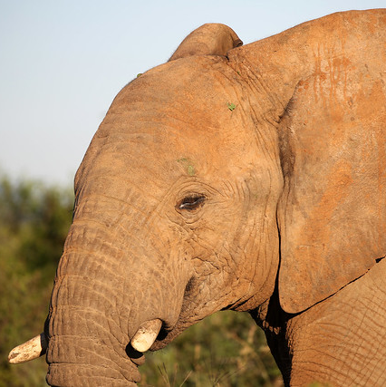
One bite at a time…
Once documented, move to the next level of resources, perhaps the count of resources that contribute the next 10% of the total spend or resources that were part of the first 80% but had lower cost/use or average annual price increases.
Mosetlha, Madikwe Game Reserve, South Africa by flowcomm
Notes:
Once you’ve documented the first items, move to the next level of resources depending on your goals. Maybe it’s the next 10% of the spend. Or it’s items with lower cost/use or average annual price increases in the first 80%. This is how you eat the elephant one bite at a time.
At IUPUI we have been working on the deeper dives through out this year, setting goals for each quarter. By the end of 2019 all of the databases/journals that are part of the first 80% will be documented at this deeper level that allows us to understand how these resources fit within the entire collection.
This information is feeding into what we call the Collection Scorecard.

Slide 28
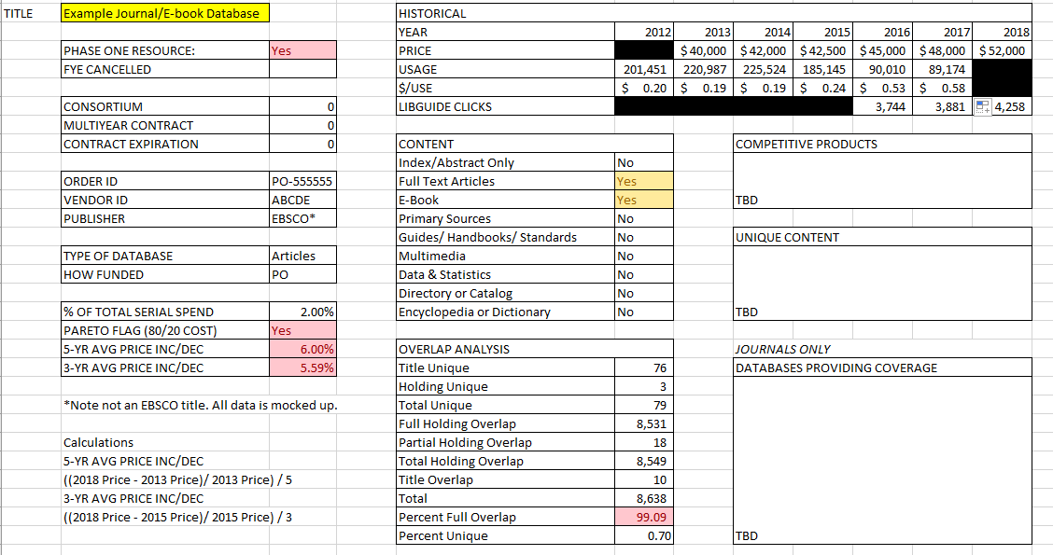
Collection Scorecard 1.0
Notes:
This is a mock up of the one page snapshot that summarizes quantitative and qualitative data and allows the collection working group and subject liaisons to get a clear picture on a resource. This scorecard facilitates collection decisions, conversations with faculty, and strategizing our negotiations with vendors.
To summarize so far: We have talked about analyzing price sensitivity, using pareto analysis, and visualizing data gathered via scorecards.

Slide 29
Stakeholder Analysis
Of faculty, students, staff, and community
Notes:
Now we are going to transition and discuss how stakeholder analysis can help with all types of projects within libraries. Stakeholder analysis helps us understand how our users measure success, what their needs are, and how we can better communicate and meet those needs.

Slide 30
Stakeholder map
Research Faculty
How can the library best meet their resource needs?
Students
What are their goals and desired outcomes?
What library services could be provided to assist?
Library
Adjunct Faculty
University
Admin
How can the library become their partner in success?
What information needs do they have?
Community
Notes:
I’ve created a sample stakeholder map for a library with students, research faculty, adjunct faculty, Community, and university administration. Faculty probably should be further broken out to Tenure/TT vs Clinical but you get the point. You want to identify all the different groups that have different needs and priorities.
Then answer the following questions:
What are their goals and desired outcomes?
What information needs do they have?
How can the library best meet their resource needs?
What library services could be provided to assist them in meeting their goals?
How can the library become their partner in success?
It really about meeting them where they are at and addressing their pain points. We want to do this in a way that also supports our values and creates a sustainable service platform.
Creating stakeholder maps requires the input of others within your organization. You can look at the stakeholder map and figure out who within your organization can help you gather the necessary information
For instance, the creation of holistic collection assessment and a useful collection scorecard requires the assistance of our subject liaisons

Slide 31
Subject liaison expertise is critical for success
Start with the low hanging fruit.
What resources are used in current library instruction?
Are there resources offered that aren’t listed on guides?
Does either seem correlated to use?
Notes:
They are in fact critical for our success.
The first step was starting with the low hanging fruit. What resources are currently used in library instruction. Are there resources offered that aren’t listed on the guides? Do either of these actions seem to correlate with use?

Slide 32
Subject liaison expertise is critical for success
Review curriculum maps, syllabi and signature assignments
What are the information needs as indicated by the curriculum?
What resources meet those needs?
Notes:
Then as part of the project we ask subject liaison to help inform us of how faculty are using resources in teaching? They are able to do this through reviewing curriculum maps, syllabi, and signature assignments. What are the information needs as indicated by the curriculum? What resources meet those needs?

Slide 33
Subject liaison expertise is critical for success
Outreach to faculty
Targeted faculty surveys about resources
Faculty meetings (1:1 and departmental)
What resources are faculty using for
Research
Teaching
Notes:
Lastly they conduct our outreach to understand research and teaching needs of faculty in the schools they support.

Slide 34
Closing the loop
3
For decision making
Notes:
It’s time for us to close the loop so we can understand how this can help us make decisions.

Slide 35
Business tools for fostering growth mindset
Must occur in safe environment where the teams understand that this is about learning and not personal performance
Creates a culture of learning & empowerment
Helps everyone communicate progress and value
Provides opportunity to create archive of institutional knowledge
Correction of Error
Report that captures progress (metrics), what went well, what went wrong.
Reflect on why things went well.
Allows individuals and teams to think through missteps and struggles to determine:
  How to prevent (internal processes)
  How to manage (outside forces)
EBIs (Even Better Ifs) – Habit that reframes feedback
Notes:
Here are a final couple tools that I think are useful for program assessment and cultivating a growth mindset.
The Correction of Error report, is process and report that provides feedback during and as a post mortem on projects and initiatives. I feel like “correction of error” is a misnomer. Because it’s really a reflection exercise. The report captures key leading and lagging metrics, what went particularly well and what may have gone wrong. It’s full of qualitative and quantitative data. Individuals or teams reflect on why things were successful – was it due to certain processes, policies, actions? It allows individuals and teams to think through missteps and struggles to determine possible ways to prevent the occurrence in the future for internal process, or determine better ways to manage problems caused by some sort of external force outside of the team’s control.
The key part of a correction of error is that it must occur in a safe environment where teams know that this is about learning and not personal performance. Failure is okay as long as everyone learns from it so the team and organization moves forward.
This can be used to create a culture of learning & empowerment. It gets everyone on the same page so they can communicate progress and value they are creating within their work.
It also provides the opportunity for organizations to create an archive of institutional knowledge, which is invaluable.
A final technique that I really like that Price Waterhouse Coopers introduced me to is using EBIs Even Better Ifs. – This is where at the end of the meeting or a report, people respond to “This would be even better if…” It helps reframe feedback in a constructive manner. People expect and know it’s not about personal criticism but about growth and improvement. In meetings EBIs can be captured in minutes.
These tools and techniques are about being able to continuously take in feedback and information so processes can be improved overtime. Our organization grows, and is able to focus on meaningful work. It’s very self actualizing.

Slide 36
Final thoughts
Goal setting process is critical to ensure success.
Indirect measures can act as leading indicators as you wait to for more traditional metrics which may take time to gather.
Grounding goals in values helps create buy-in through communicating vision.
Libraries should look to other disciplines for expertise
  Business analytical tools can enable planning, execution, and outcome assessment
  What other disciplines might provide valuable insight?
Notes:
Just some final thoughts
The goal setting process is critical to ensure success, because meaningful assessment is impossible without it.
Indirect measures such as activity can act as leading indicators as you wait to for more traditional direct metrics which often lag.
Grounding goals in values helps create buy-in through communicating vision to external and internal stakeholders. Connecting our values to meeting a stakeholder need can be powerful as we navigate the politics within our institutions as well as inspire our colleagues.
Libraries should look to other disciplines for expertise
Today I talked about how business analytical tools can enable planning, execution, and outcome assessment. It can helps us iterate and be entrepreneurial in spirit.
I ask you what disciplines might provide valuable insight to our assessment practice?

Slide 37
References
Almanac. (2018). “Library Spending, by Sector, 2015-16.” The Chronical of Higher Education, available at: http://www.chronicle.com/article/Library-Spending-by-Sector/244160 (accessed 17 October 2018)
Association of Research Libraries. (2016). “Library Investment Index.” Retrieved from https://www.arlstatistics.org/analytics (accessed 17 October 2018)
Blankstein, M., & Wolff-Eisenberg, C. (2019, April 12). Ithaka S+R US Faculty Survey 2018. https://doi.org/10.18665/sr.311199
Bosch, S., Albee, B., & Henderson, K. (2018). Death by 1,000 cuts. Library Journal, 143(7), 28. Retrieved from ABI/INFORM Collection (ProQuest) (accessed 17 October 2018)
Porter, M. E. (2008), “The five competitive forces that shape strategy”, Harvard Business Review, Vol. 86 No. 1, pp. 78–93
Presentation template by SlidesCarnival

