Slide 1
Space Exploration:
Beyond the Formal Elements
American Art Therapy Association 48th Annual Conference
November 9, 2017
Eileen Misluk-Gervase, ATR-BC, LPC, LMHC
Assistant Professor, Herron School of Art and Design
Art Therapist, Under the Umbrella

Slide 2

Notes:
Thank you for taking an hour of your time to spend with me talking about space! Quick reminder, please do not take photos of the slides. I will be happy to share my powerpoint with you via email.
When everyone walked in the room the same question was asked over and over consciously or unconsciously…where do I sit.
We all have a set of criteria that we use to base our own internal experience of space which informs our decisions.
If you chose the “right” choice that means that we are in a comfortable spot and are able to engage in this talk.
If we choose the “wrong” spot then we are uncomfortable, distracted, less engaged.
When you selected your seat, were you aware of how much space you wanted? A neighbor, a chair in between or a whole row to yourself. Did you sit towards that back for any easy get away or directly up front?
Question, Is the amount of space you have right now enough, too much, or too little?
Exploring space and the criteria we chose that informs are decision can be challenging especially for our clients, who space both internal and external may be scary, overwhelming, and dangerous.

Slide 3
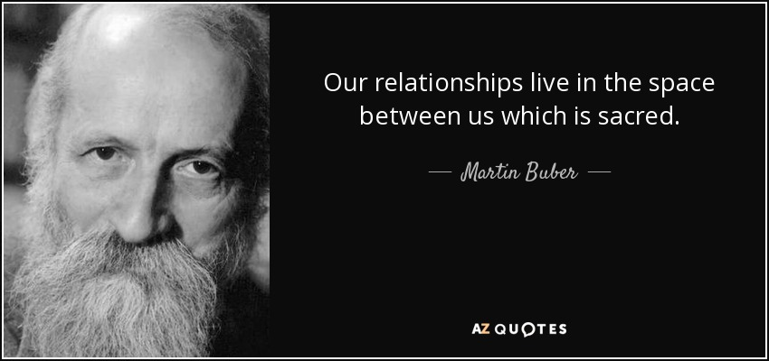
Notes:
Presentation looks at the various components of therapy through an object relations framework.

Slide 4
The art therapist, space, materials, and product all serve as multiple self objects in the space. The opportunity to work with multiple self objects allows for various experiences of symbolization, internationalization, and relationships.
Notes:
Killian & Pretorious, 2009

Slide 5
Art Therapy space, process, and product
Transformational Object
Transactional Object
Transitional Object

Slide 6
Transformational Object
Christopher Bollas
Understood by the infant experientially as transformative and symbiotically known
In adulthood, individuals seek experiences that will “transform” their current situation and support a self-altering process
  Examples: new job, partner, vacation, ideology, belief system
Therapeutic space and process invites the emergence of the transformational object
Liminal Space

Slide 7
Transactional Object
Ditty Dokter
Transaction- implies that that the object is negotiated for or in exchange for something else
Art materials are the negotiated “currency” between the therapist and the client. Ability for a non-threatening connection to the therapist.
Art created as temporary transactional objects may facilitate the beginning of movement from an unconscious, fused state, where magical thinking is activated to separation and differentiation
Art mediating the inner and outer world
Art process may symbolize the inner conflict; acting out; or enactment
Space between the ‘utterance and performance’- revealing of the art is owned and may or may not be shared by the client
Allows for the metaphor, flexibility, and safety
Picture protects the transitional space between client and therapist

Slide 8
Transitional Object
D.W. Winnicott
Imagery created mediates the space for the client and provides the tangible container to relate to the therapist
Picture is an object through which unconscious transaction may be acted out and channeled
Art product enables the individual to sustain the relationship to the therapist in their absence

Slide 9
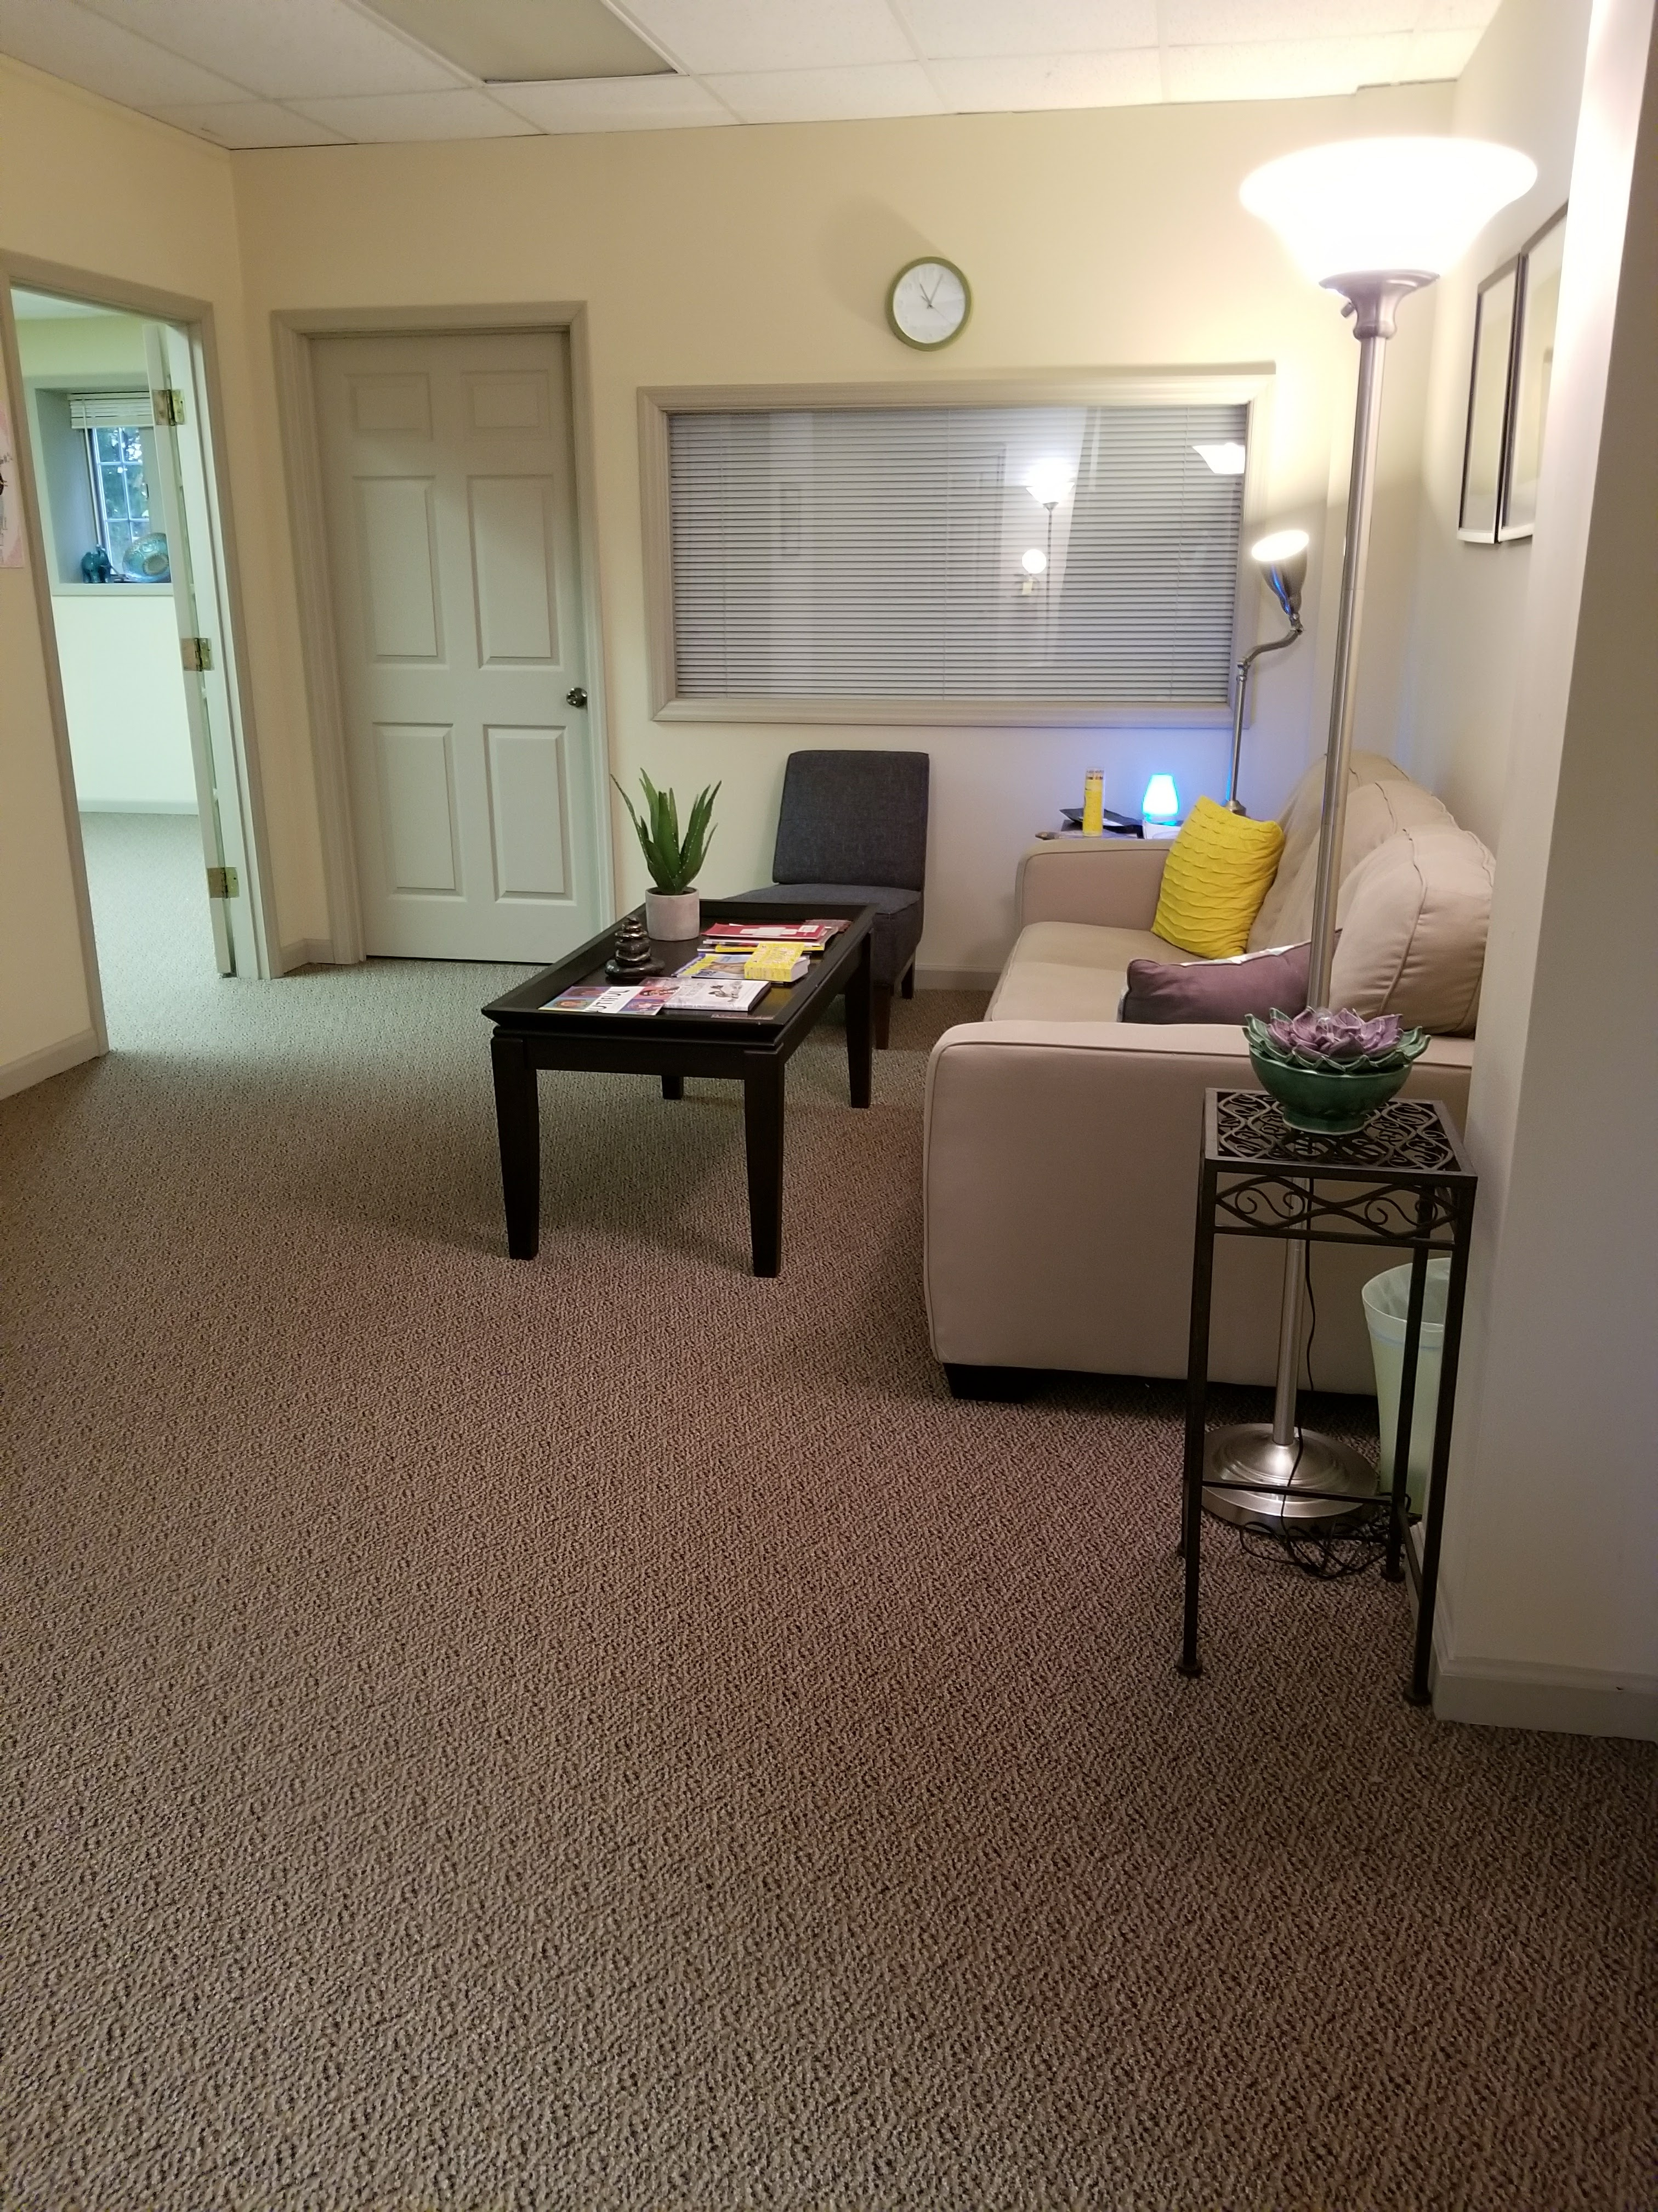
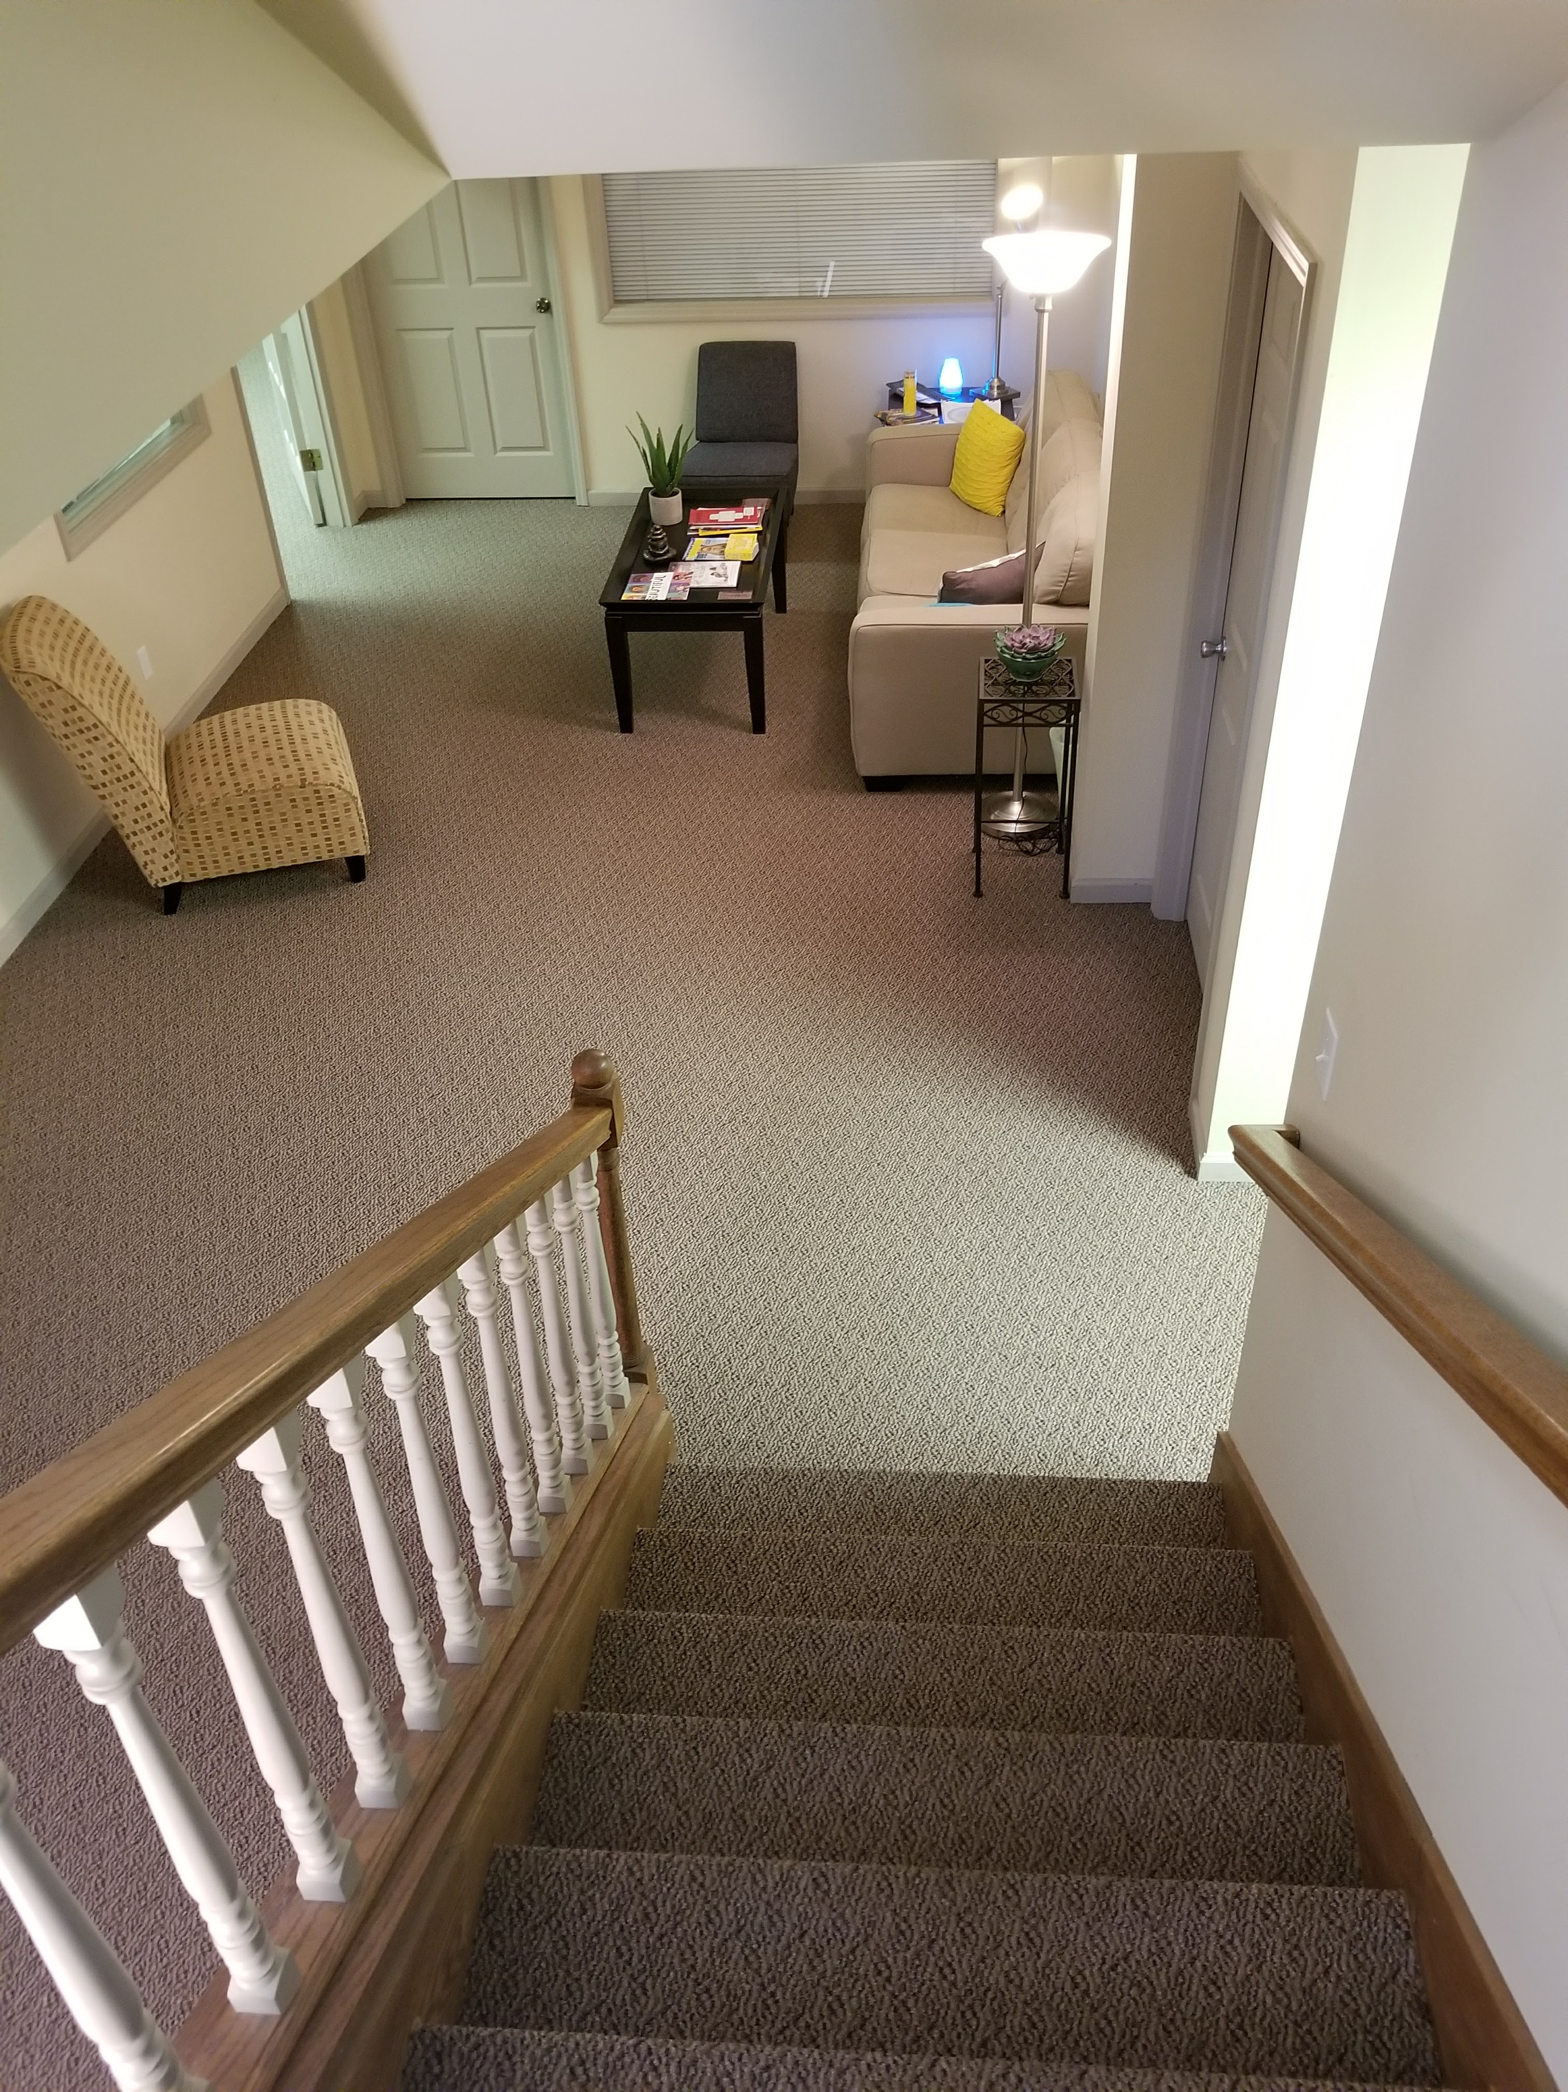
Waiting Area as Transformational object
Notes:
On numerous occasions clients have talked about our waiting room. Particularly was a nice holding space it is.
For example, I exit my office with a few minutes between sessions and my client is spralled out on the couch. At the start of our session, I ask her what was happening. She explains that she often thinks about coming to the office and jus sitting in the waiting room. She is able to completely relax here, and she has never had that experience before not even at home. This space, that transitional space between the outside world and the therapeutic space becomes the transformational object; that thinking about the waiting room while work as a means of changing her current situation or finding comfort, containment is an experientially felt experience.
Internal Experience of Space- early with fusion and separation, differentiation, and individuation that in the psychological sense put space between infant and mother. Robbins
internal space; integration of movement in the body and space
“ By experiencing the innter representational world of patient, a transitional space is created which becomes the conduit for interpretative work in analytic therapy. “ p. 19 between therapists
Space- physical space of the office/studio
Ego boundaries and object constancy

Slide 10
“It is a place outside of one’s personal field where unconscious motivations can be externalized and held out for review by conscious thought. Transformed into acceptable representations of one’s thoughts and motivations, they can then be reintrojected to strengthen a weak ego”
(Cavallo & Robbins, 1980, p. 119).
Notes:
Therapeutic space is . . .

Slide 11
In this space, art making serves as the both the catalyst and the container.

Slide 12
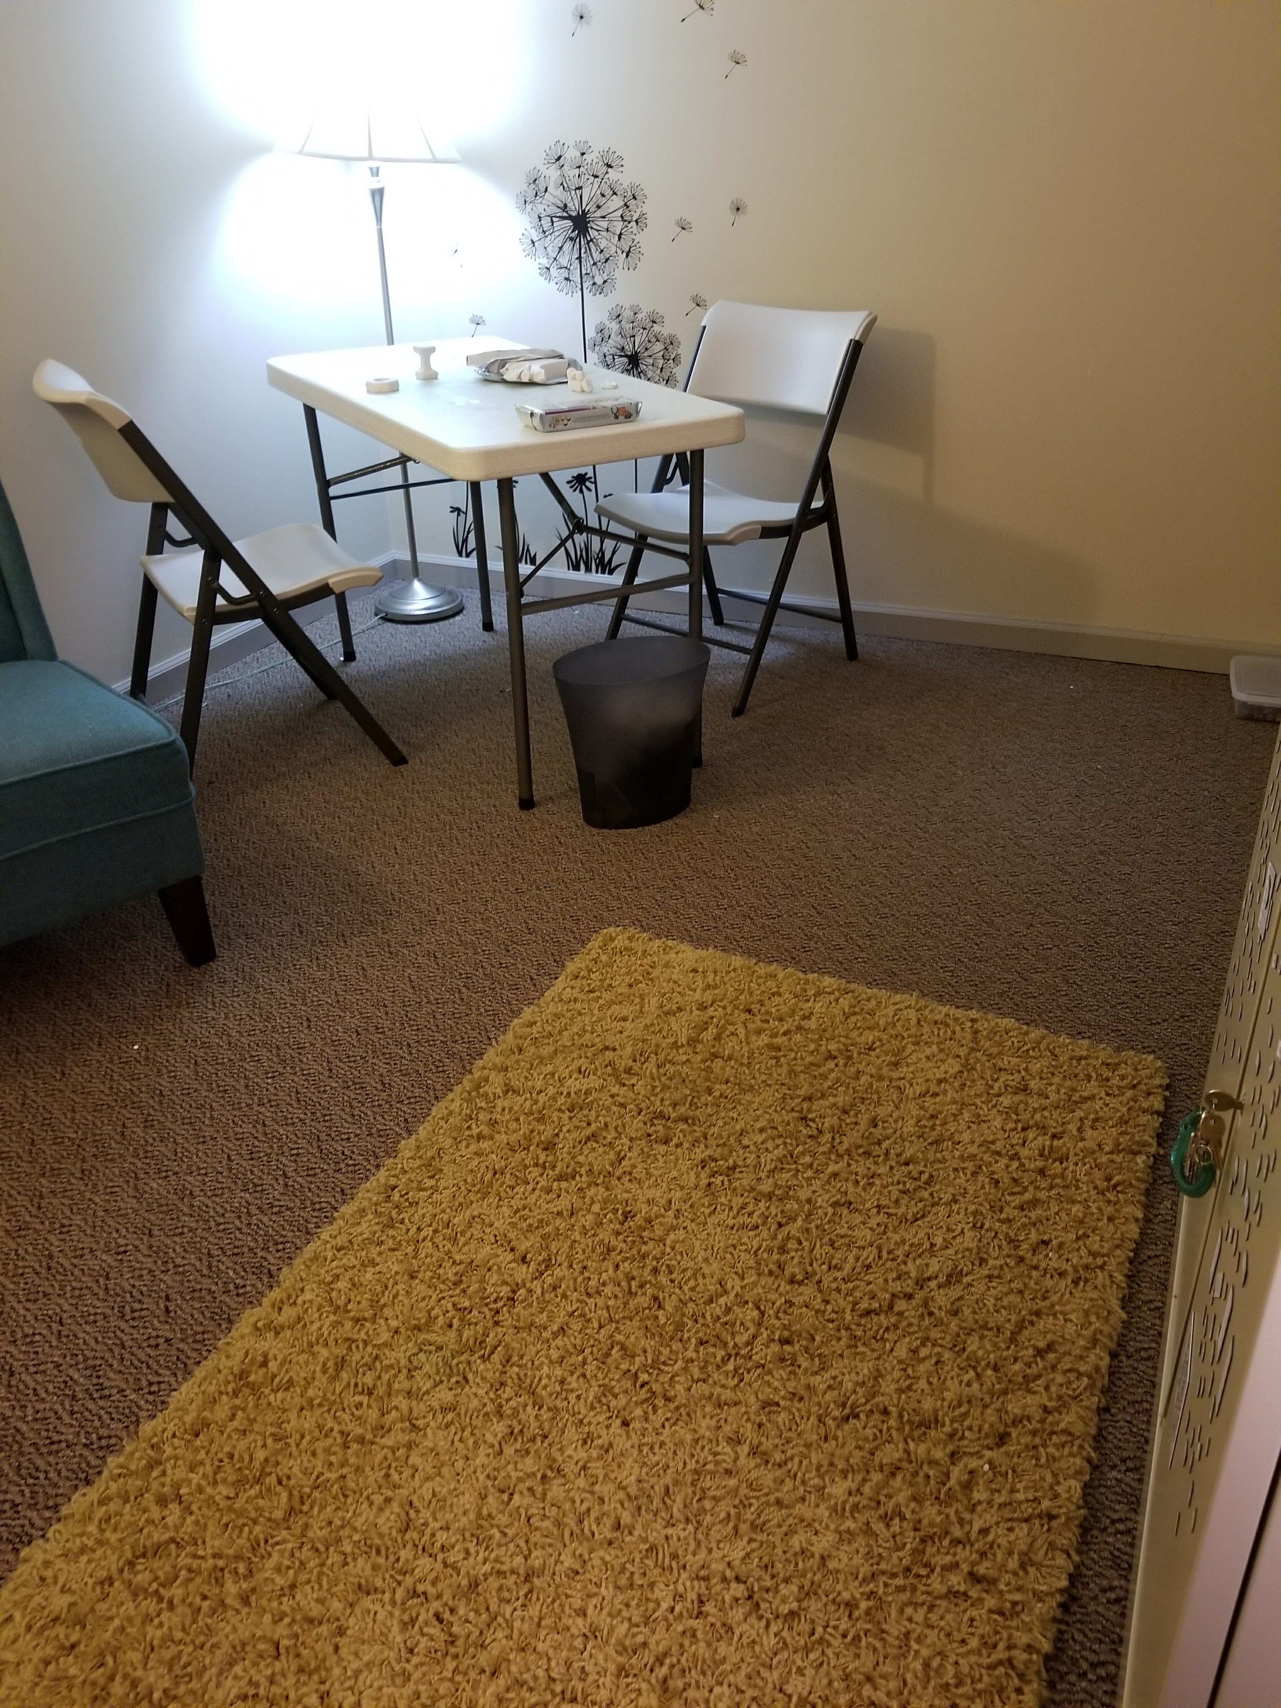
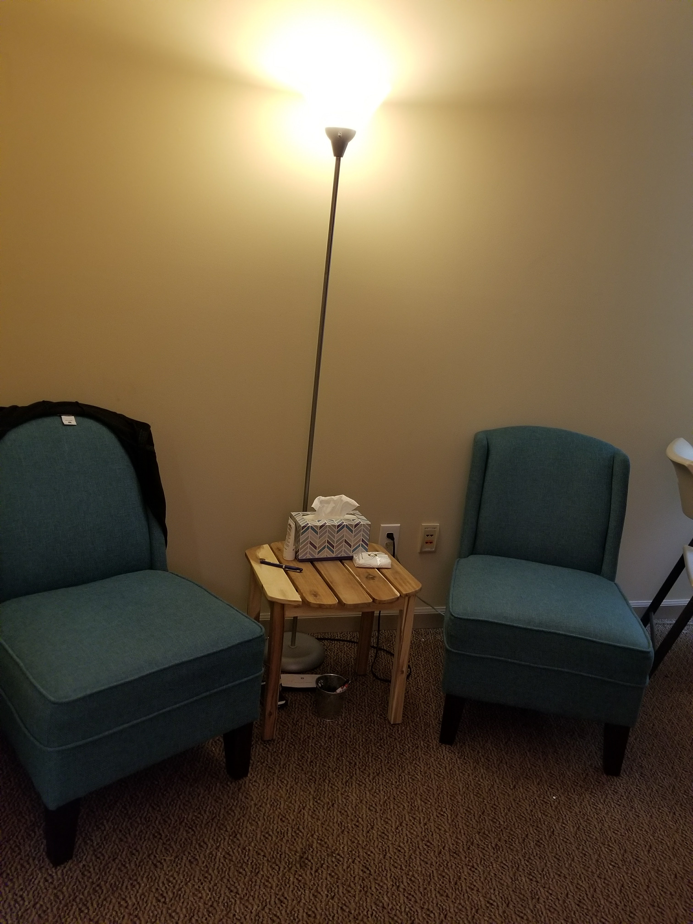
Therapy space as Transformational & Transactional Objects
Notes:
Space explored and created by the space provided
Space is so much more that lines on a paper, air around a sculpture, or the floorplan of our workspace.
The experience of space occurs on the opening of the office door, the space where your clients wait or the lack there of a “transitional space” between the outside of the art therapy space and the inside, to the physical space of the office.
Where we ask them to create. I have 4 distinct spaces in my office: Processing chairs, floor, table, and wall
Sacred dimension- includes ritual and ceremony- Viviien Speiser
Boundaries the media provide
Integration of movement in the body and space
Transitional Space
Art making space
Sacred Dimension

Slide 13
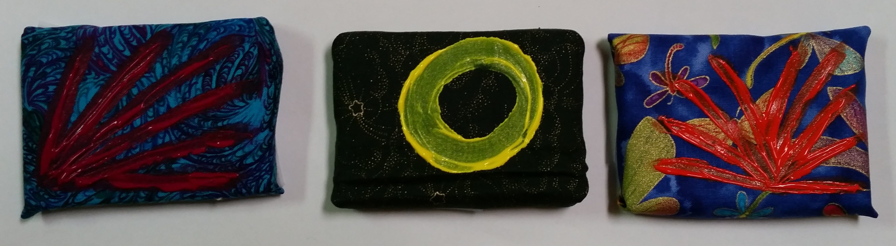
Imagery as transitional objects
Notes:
Imagery created can serve as all selfobjects and ultimately when all merge… the transitional object is created.
The vivid memory of the earliest object relation occurs in the aesthetic moment when the person feels in deep rapport with the aesthetic object.
They merge the transformational and transactional into the transitional object that symbolizes the entirety of the therapeutic experience. Tangible reminder of felt experiences.

Slide 14
Why or Why not… make art on the floor
Most on the body is grounded and supported by a solid surface
Exploration of space with a reduced amount of vulnerability
Different kinesthetic experience
Adaptive regression in serve of the ego (ARISE)
Element of play, less threatening
Regressive
Challenges spatial boundaries between people
Issues around safety and impulse control
Notes:
ARISE- Relaxation of cognitive acuity, ego capacity to reverse the regression, integration and meaning making of the experience.

Slide 15
Why or why not … make art at the table
Provides ample external support with the chair and table
Provides a clear boundary between therapist and client
Familiar location for “learning”
Visual container for the art making space

Slide 16
Why or why not … Make art standing
Least supported and grounded only in the feet
Physical body is taking up the most amount of space
Highly vulnerable position
Larger kinesthetic movements
Pulls on the “artist” identity

Slide 17
“… It is when you have left the tried and true, but have not yet been able to replace it with anything else. It is when you are between your old comfort zone and any possible new answer. If you are not trained in how to hold anxiety, how to live with ambiguity, how to entrust and wait, you will run…anything to flee this terrible cloud of unknowing.” - Richard Rohr

Slide 18
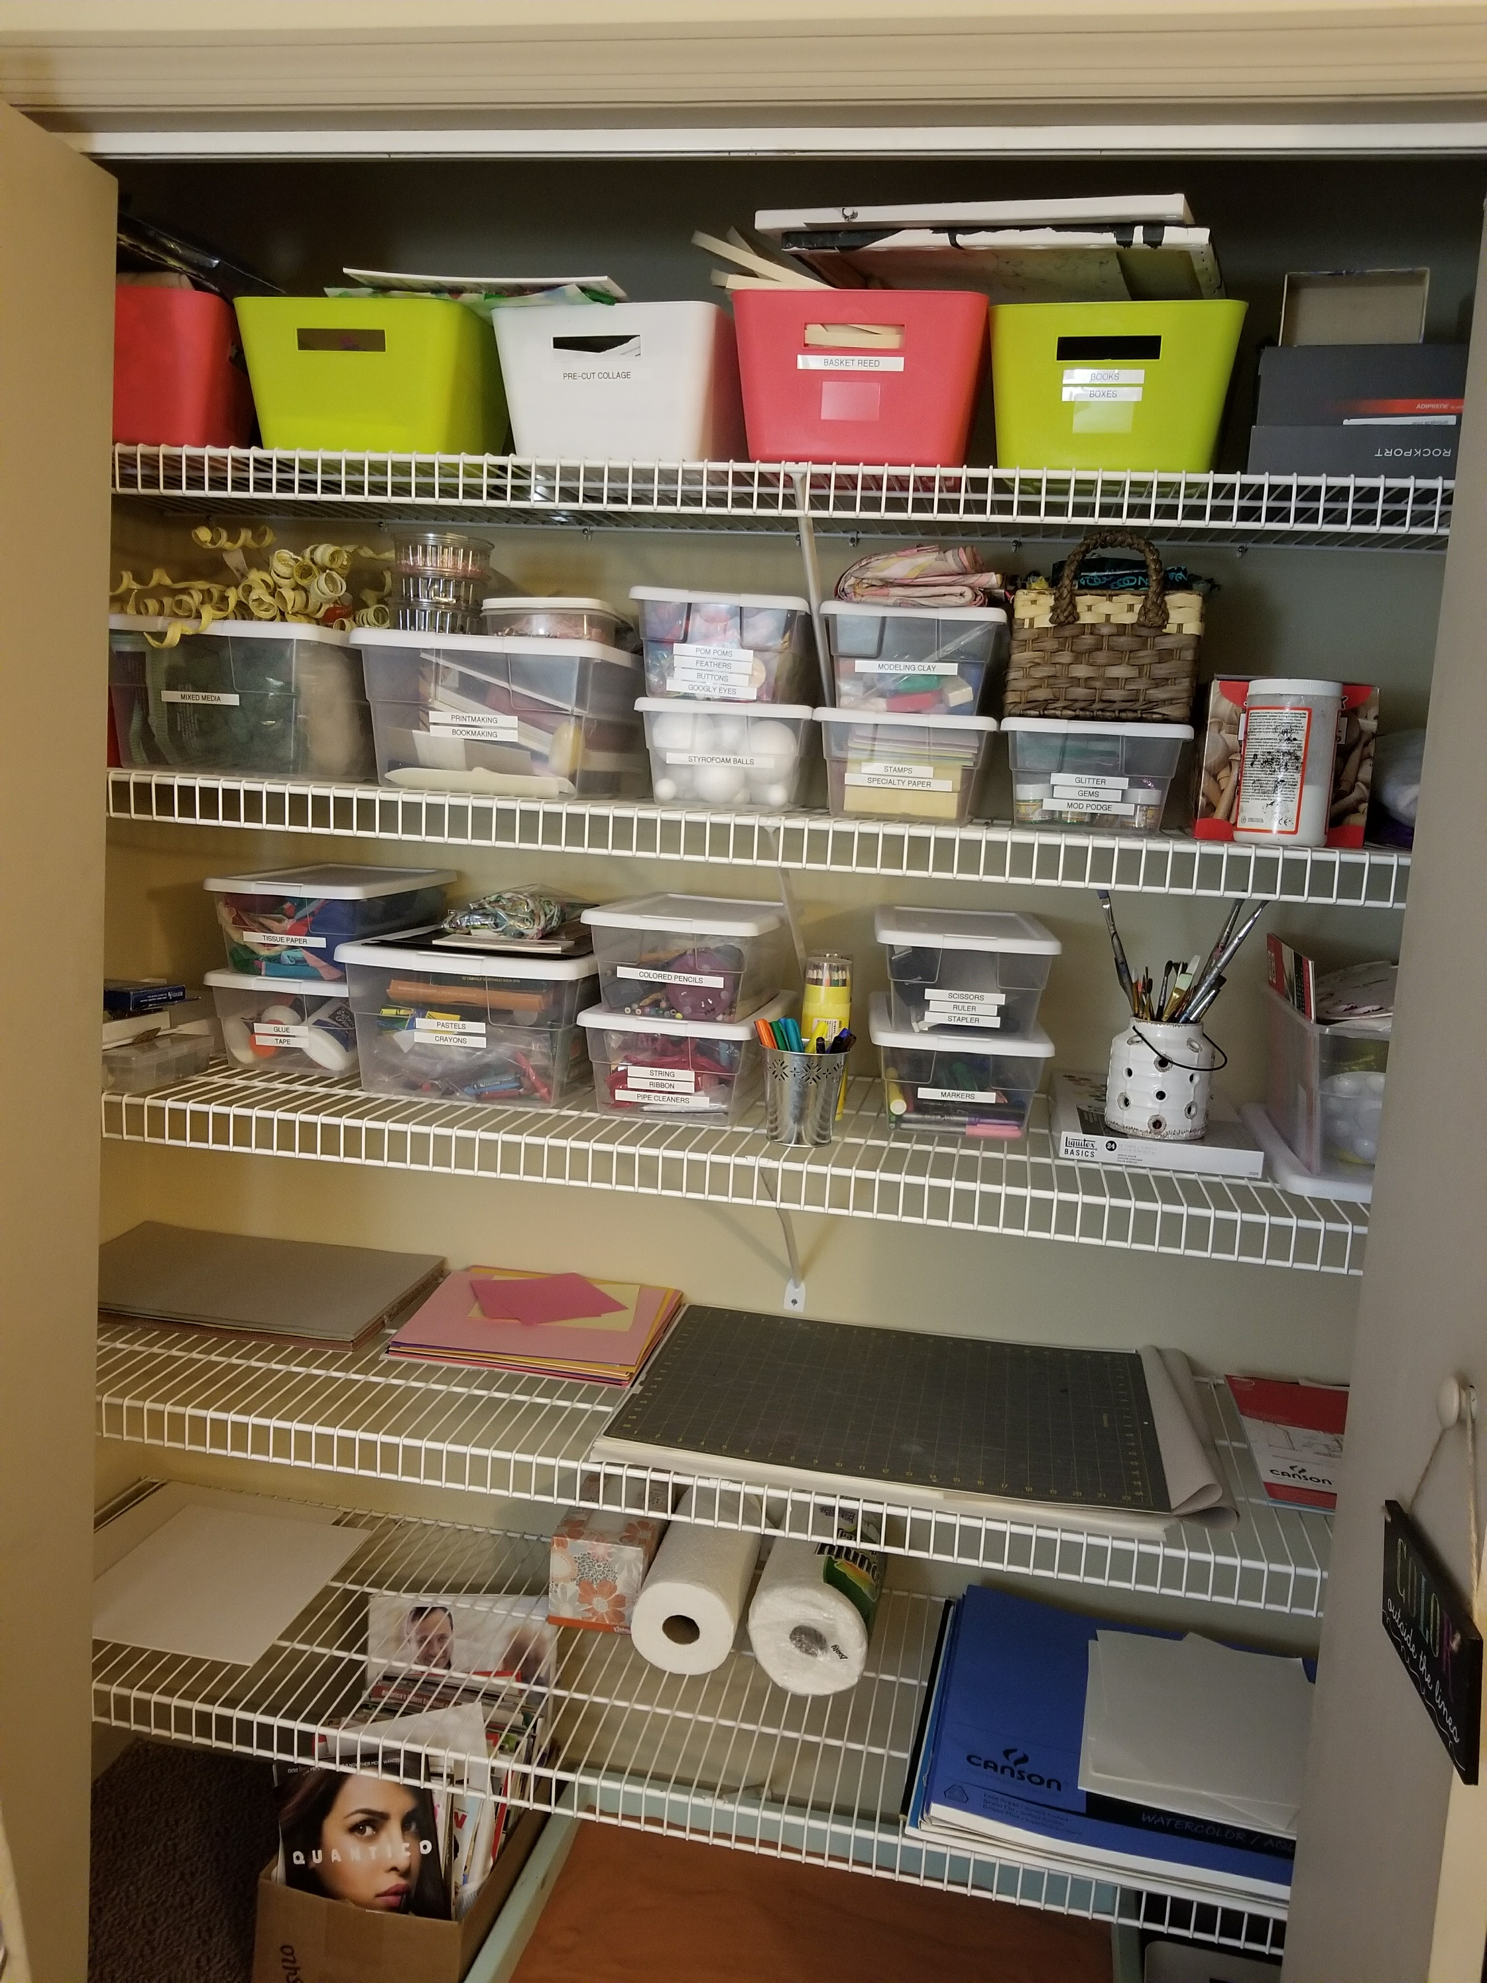
Sharing space to build rapport
“I don’t want to be here. I am shaking and can’t control it. Can you close those doors because that is really overwhelming.”
Notes:
CT
Anorexia purging type
Epilespy
Over exerciser
OCD
Only worked on the table. She would wear layers and take off her shoes, sweatshirt and it would be on the floor or covering her mid section
Returned from treatment and needed daily support. Art therapy was added to build her a supportive team.

Slide 19
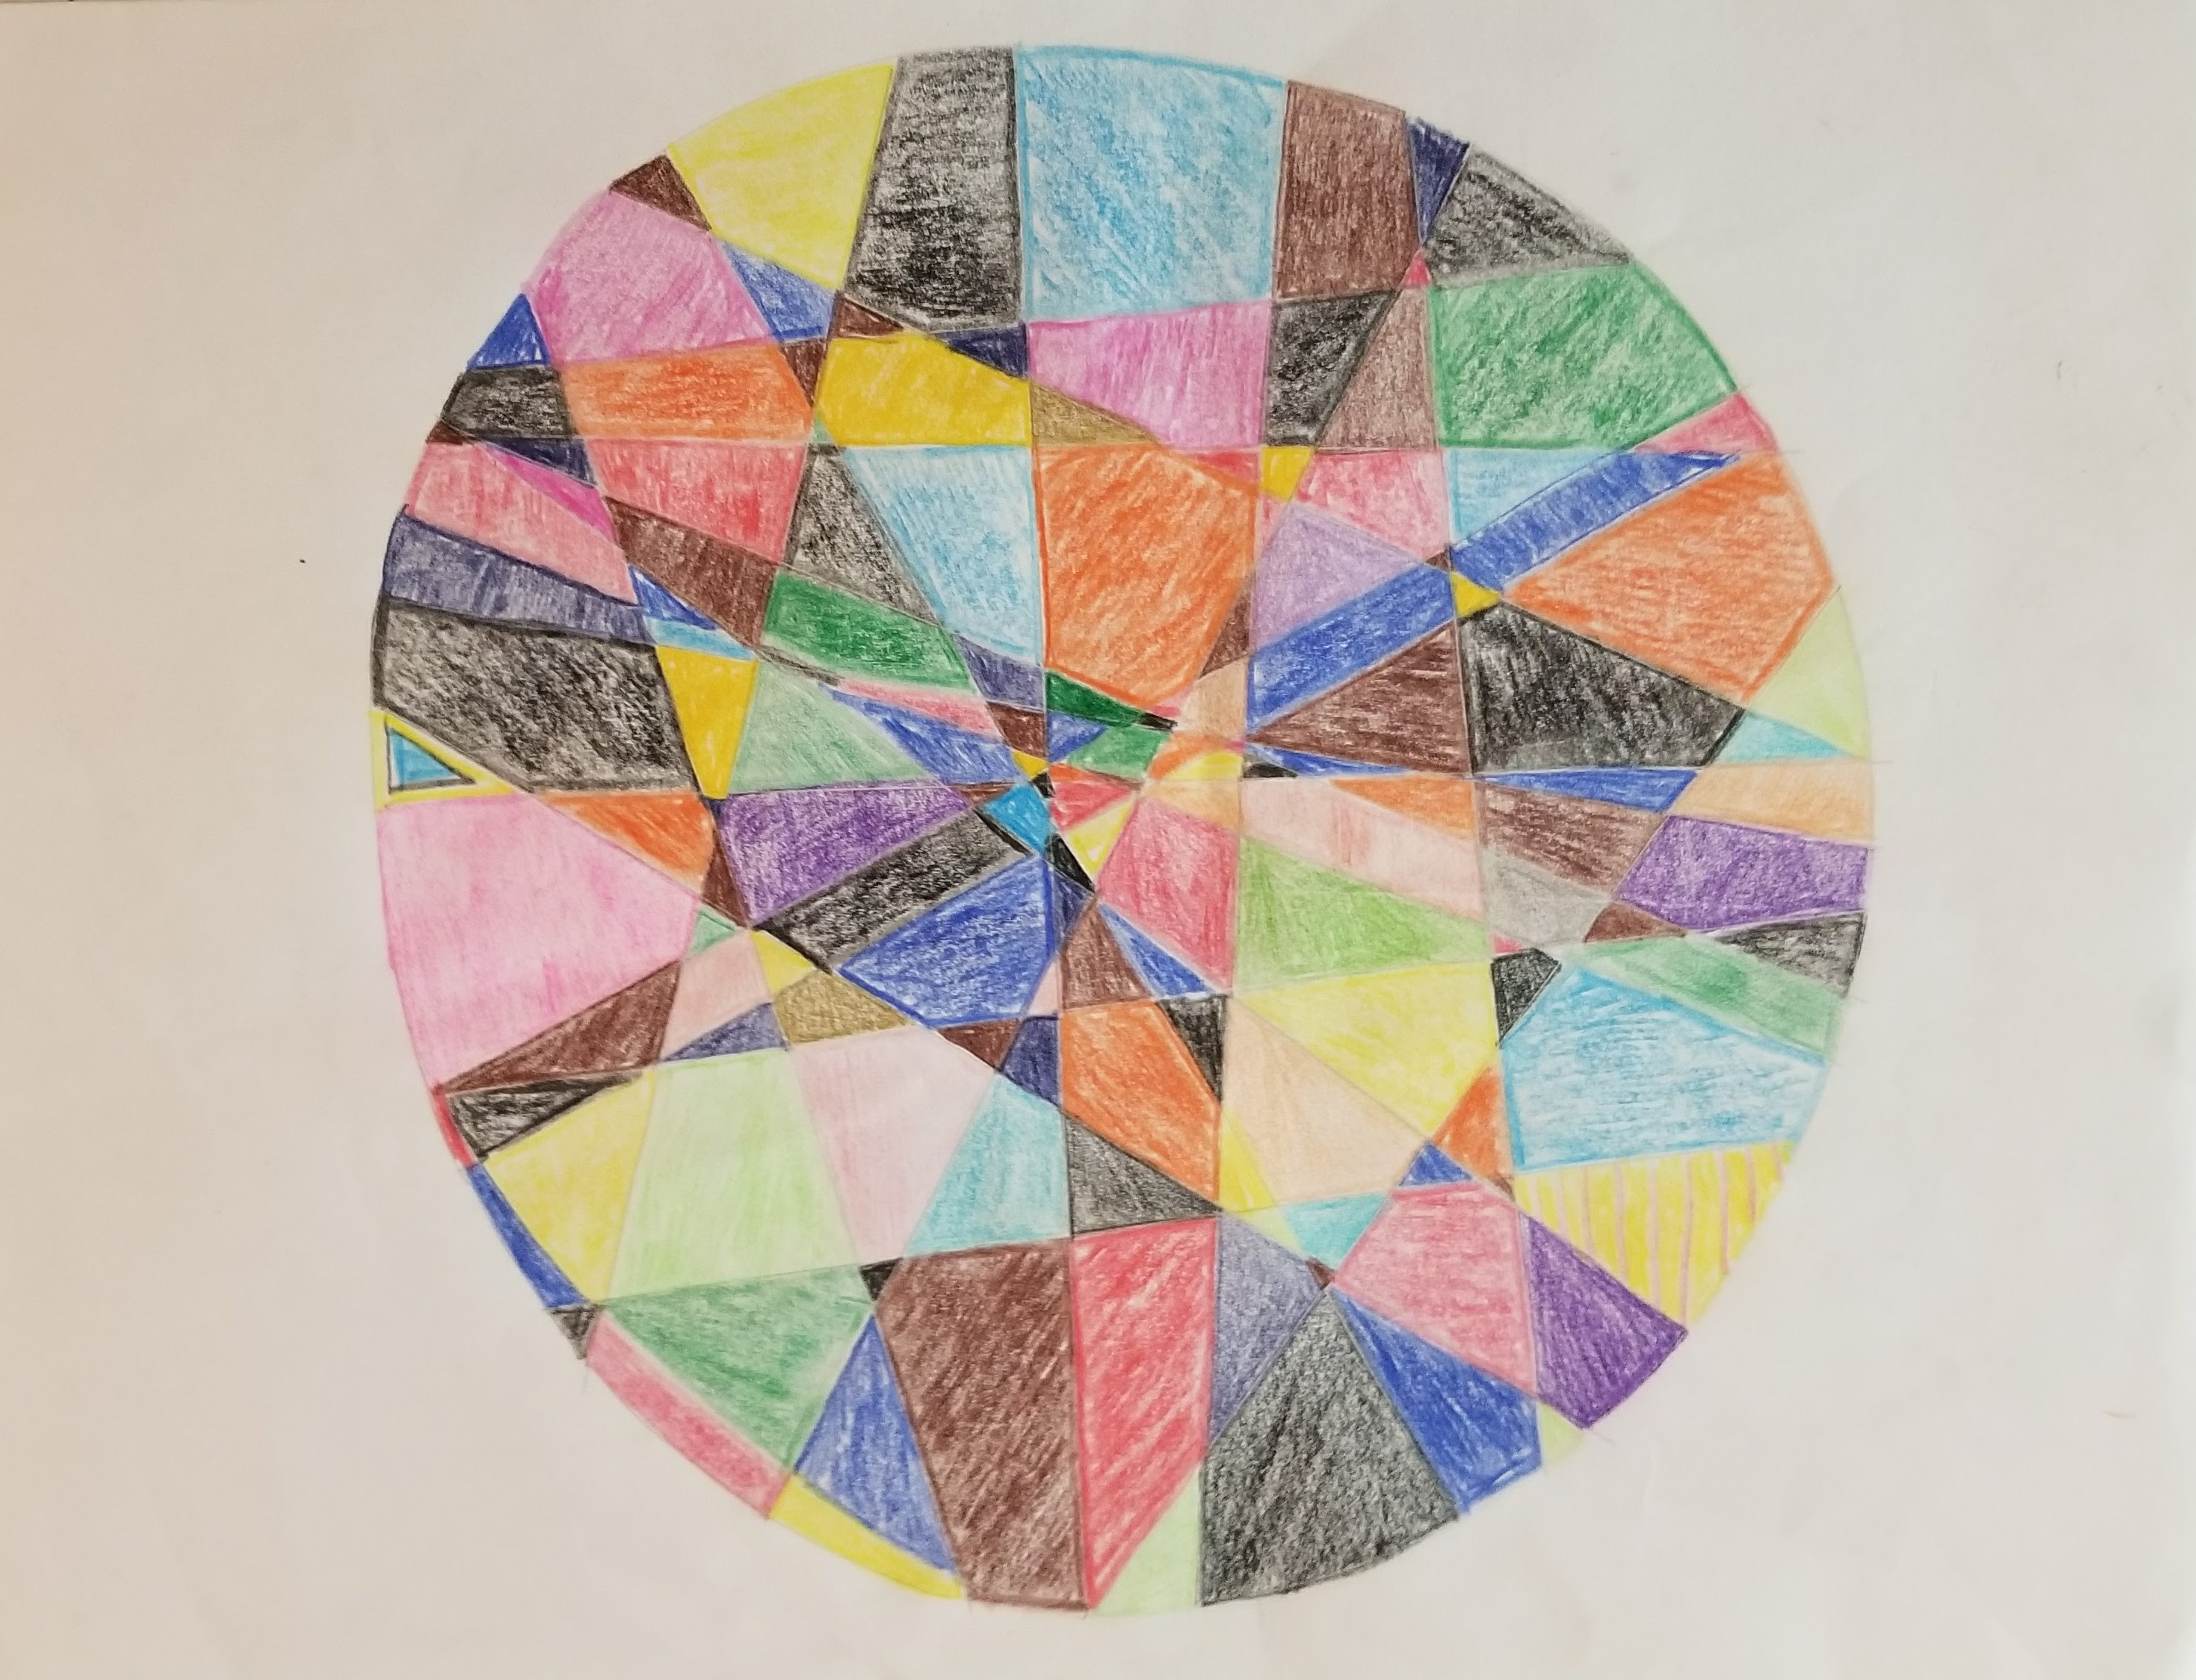
Notes:
Just to be clear, I refuse to draw, collage, or make anything that means anything. I never went to art therapy and treatment because I thought it was stupid. I thought all of those people, coloring pictures and mailing them home to their families and kids were ridiculous. I couldn’t even imagine doing that!
So, what do you want me to do?
I provided her a circle with the goal of this therapy space being a place where she can feel safe, contained, held. She also “had” to see me so time was the transactional object. I asked her to draw a continuous line inside, outside…
Do you have a ruler?

Slide 20

Notes:
She is the tissue paper and I am the glue.

Slide 21
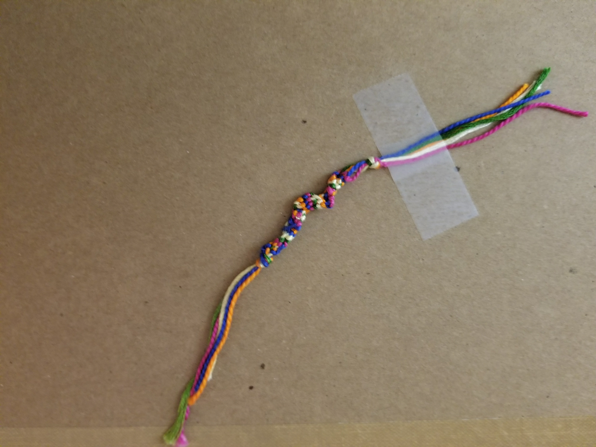
Notes:
Bracelets, hopefully that it may represent the transitional object. She returned to treatment…

Slide 22
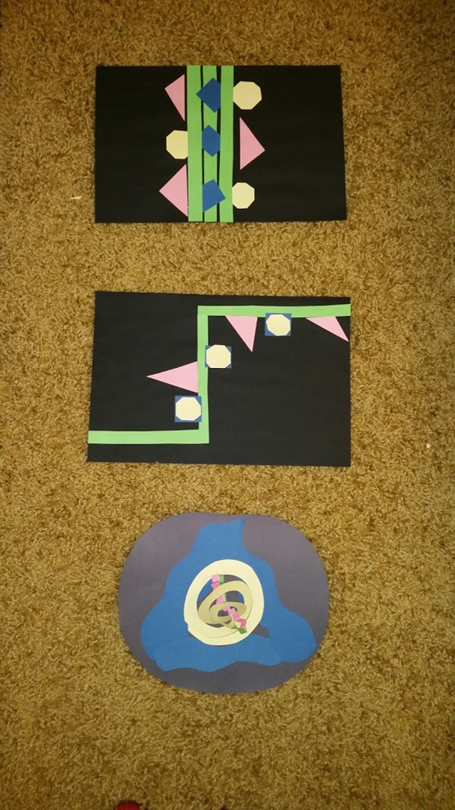
Eating disorder as the transactional object
“I do recovery for everyone else.”
Notes:
Eating disorder in the past, present, future/recovery
Created at the table after the return of restrictive behaviors and self-harm.
Symbolic language- blue = healthy, yellow= anxiety, green = eating disorder, pink= self-harm
Use of materials may mirror the use of food, and it did for this client. She selected paper, a ruler, an x-acto knife, glue stick.

Slide 23
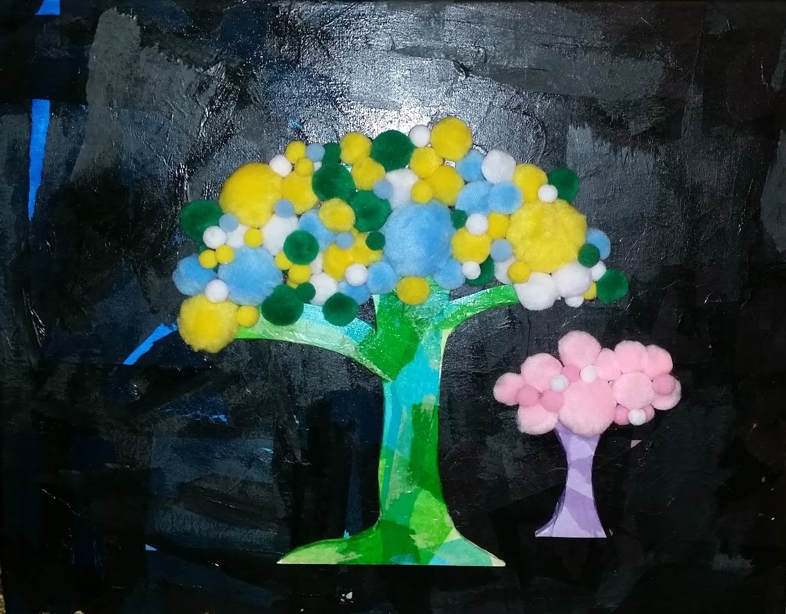
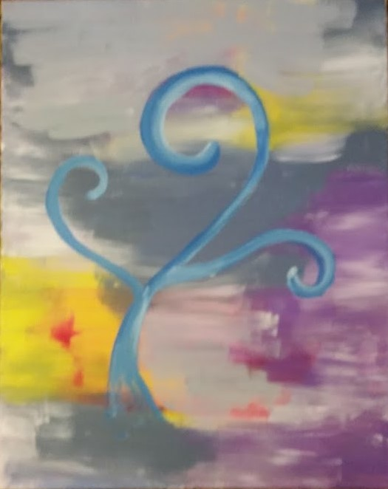
Notes:
Food serves as the transactional object for many clients with eating disorders. Negotiating the rules around food with themselves and their treatment team is a constant concern.
Shift from the table to the floor. The exploration of the healthy self. The transitional object is created.

Slide 24
Taking up Space as a Clinical treatment Goal
“I realized that I had to become energetically smaller, take up less space so that I didn’t fill the space that she was not occupying.”
Notes:
AR demo info.
Mother reached out to our practice in March terrified at the physical appearance of her daughter. A 19 year old former gymnast who in her freshman year of college survived on apples and running. 5’10 90 lbs… 14 BMI. Our recommendation was treatment but the family found a nutritionist who agreed to work with her 2x per week, track her weight, so she could complete her Freshman year. When I met her she was cleared medically by the doctor, had gained about 20 lbs, now a 16 BMI. She would not make eye contact and answered my questions with mere utterances…yes, no, I don’t know, ok. She barely breathed, physically taking up no space, and sat without making an indent in the chair.
At this moment, I knew that the presence I carry in a space was going to drastically change. We start this session, like I do every intake, at the table. The most externally supported space in the room.

Slide 25
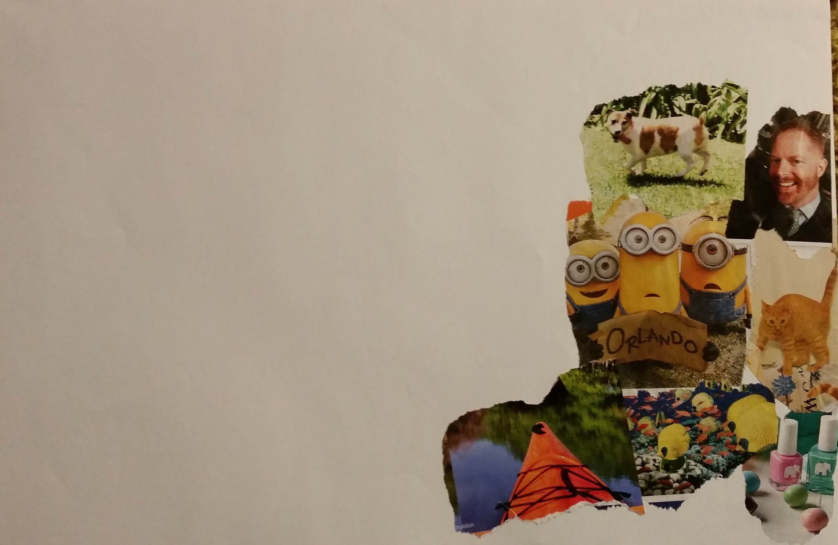
Notes:
A
19
BMI 14 at first contact 16 at intake
5’10 90 ilbs
Introduce yourself to me…

Slide 26
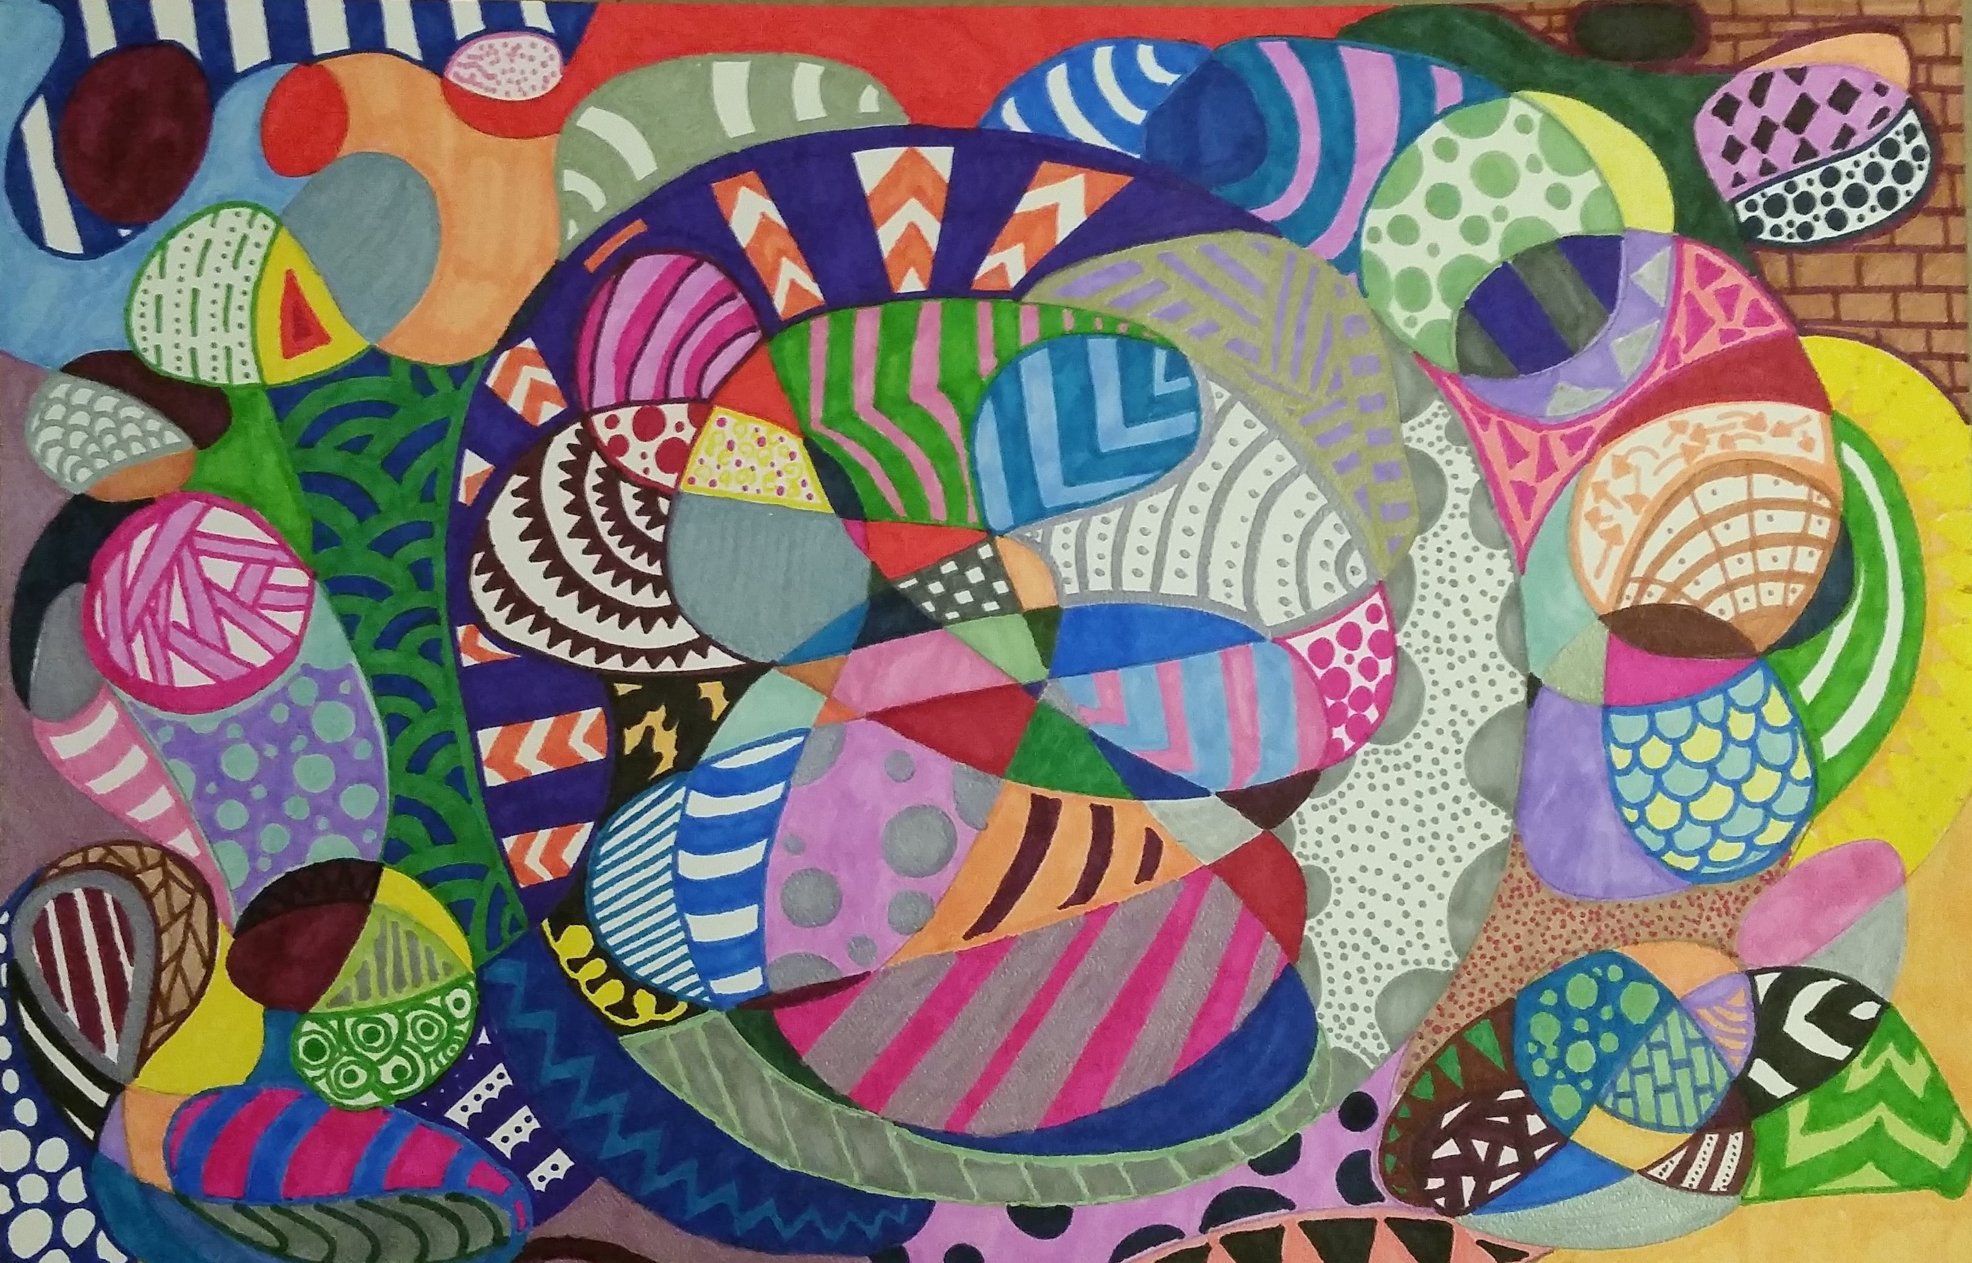
Notes:
After several sessions, I suggest we move to the floor, sitting on the golden shag with a hard board as our creating surface. where we work silently as a mirror her as she works with a variety of medium. She says very little, everything is “fine” or “ok.” One session, I provide her a circles and ask her to draw a line, it can be inside or outside, wherever the only rule is to start and stop on the edge of the circle provided. I direct her to just use lines, shapes, colors, patterns to fill in each section. She begins and invites me to work with her. This mandala takes us weeks to complete, but during the time, we talk and we don’t talk but we actively engage in a safe negotiation of space.

Slide 27
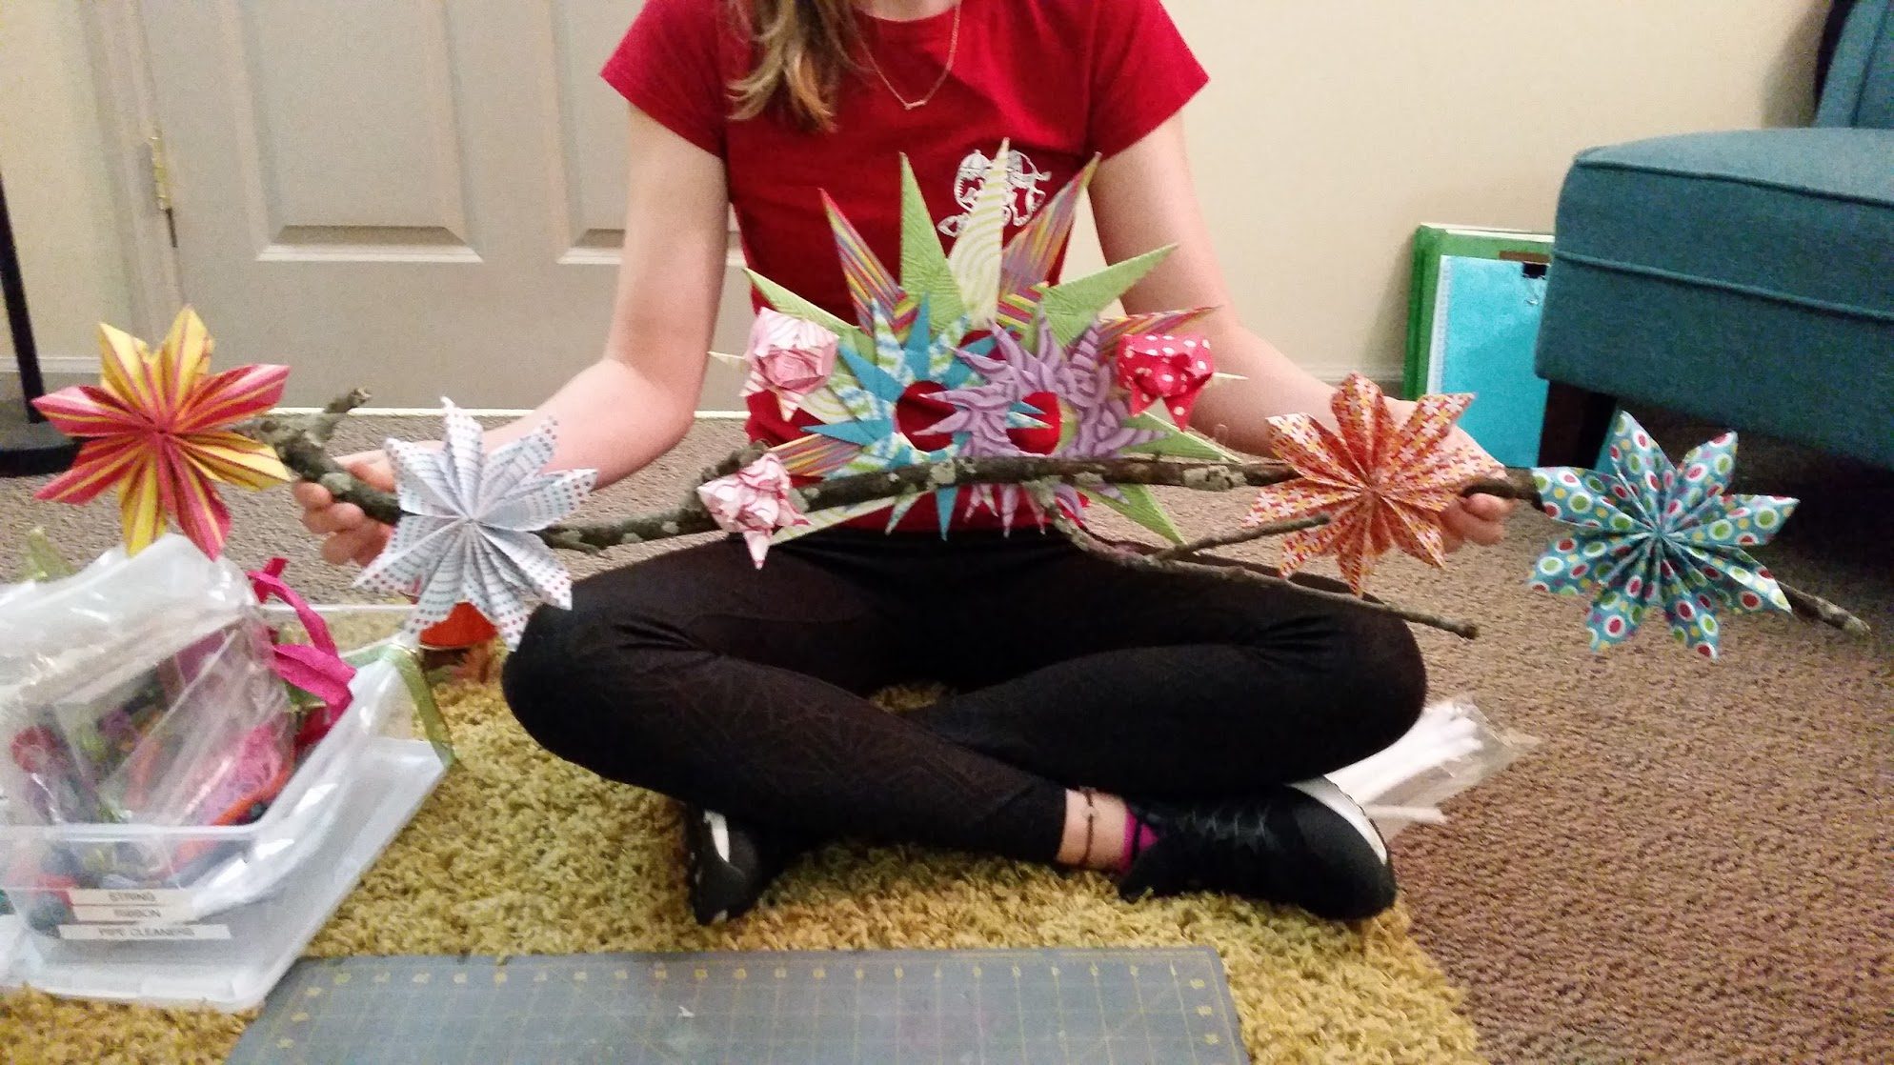
Notes:
We create origami together, our paper pieces equally balanced to create stars.

Slide 28
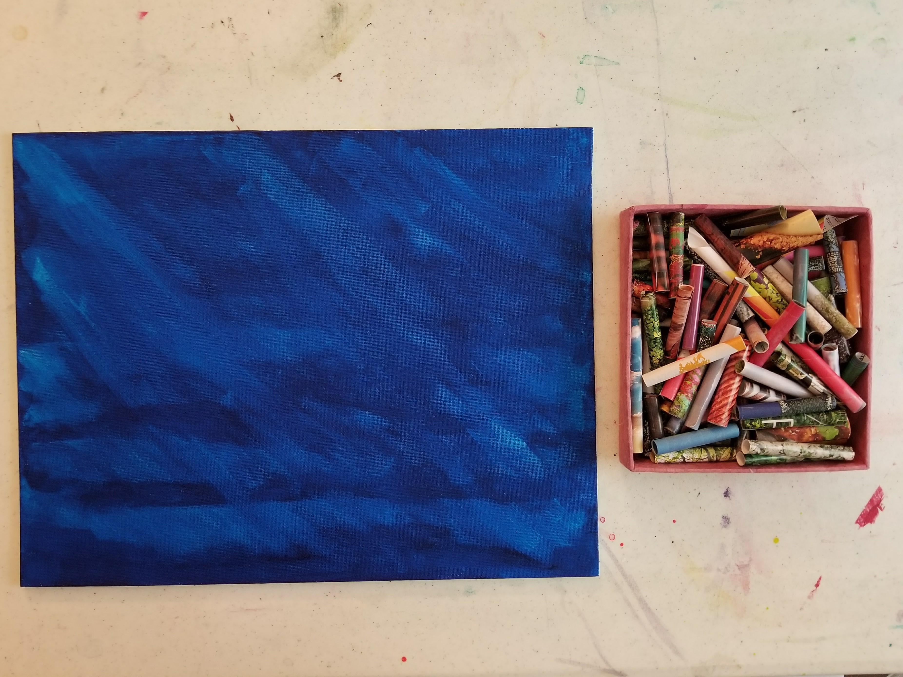
Notes:
Playing in the metaphor…. The transitional object emerges as we sprawl on the floor, spilling off the “golden shag” boundaries and she begins to create, to take up more space,.
I have been waiting all week for this appointment! I have no one else I can talk to about this and I am really freaking.
Ah!!! Space as a clinical goal has been achieved. It was not fast and at times seemed like it was not going to happen. But a year and a half later, she entered therapy and owned it. She took up space.

Slide 29
Where do we go from here?
Exploring how we can use our therapy space to help our client explore internal and external space.
Using an object relations framework to discuss the continuum of space, relationships, and art making.
Gaining a deeper understand of our own presence in space and the ways that different spaces evoke different experiences for the therapist/artist.
What, if any, are the benefits of exploring space relationships and dynamics as a clinical treatment goal.

Slide 30

Questions…
Eileen Misluk-Gervase
emisluk@iupui.edu

