Slide 1

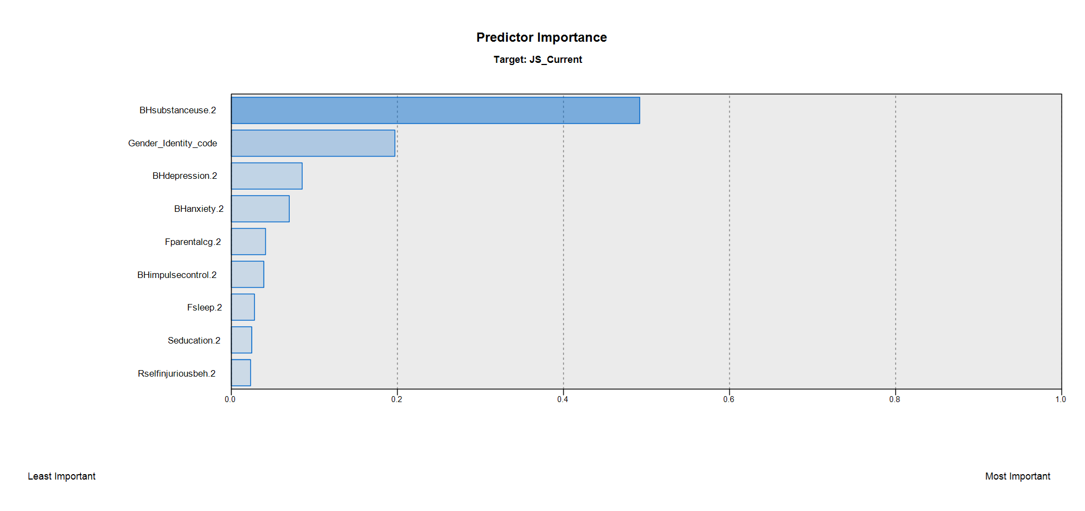
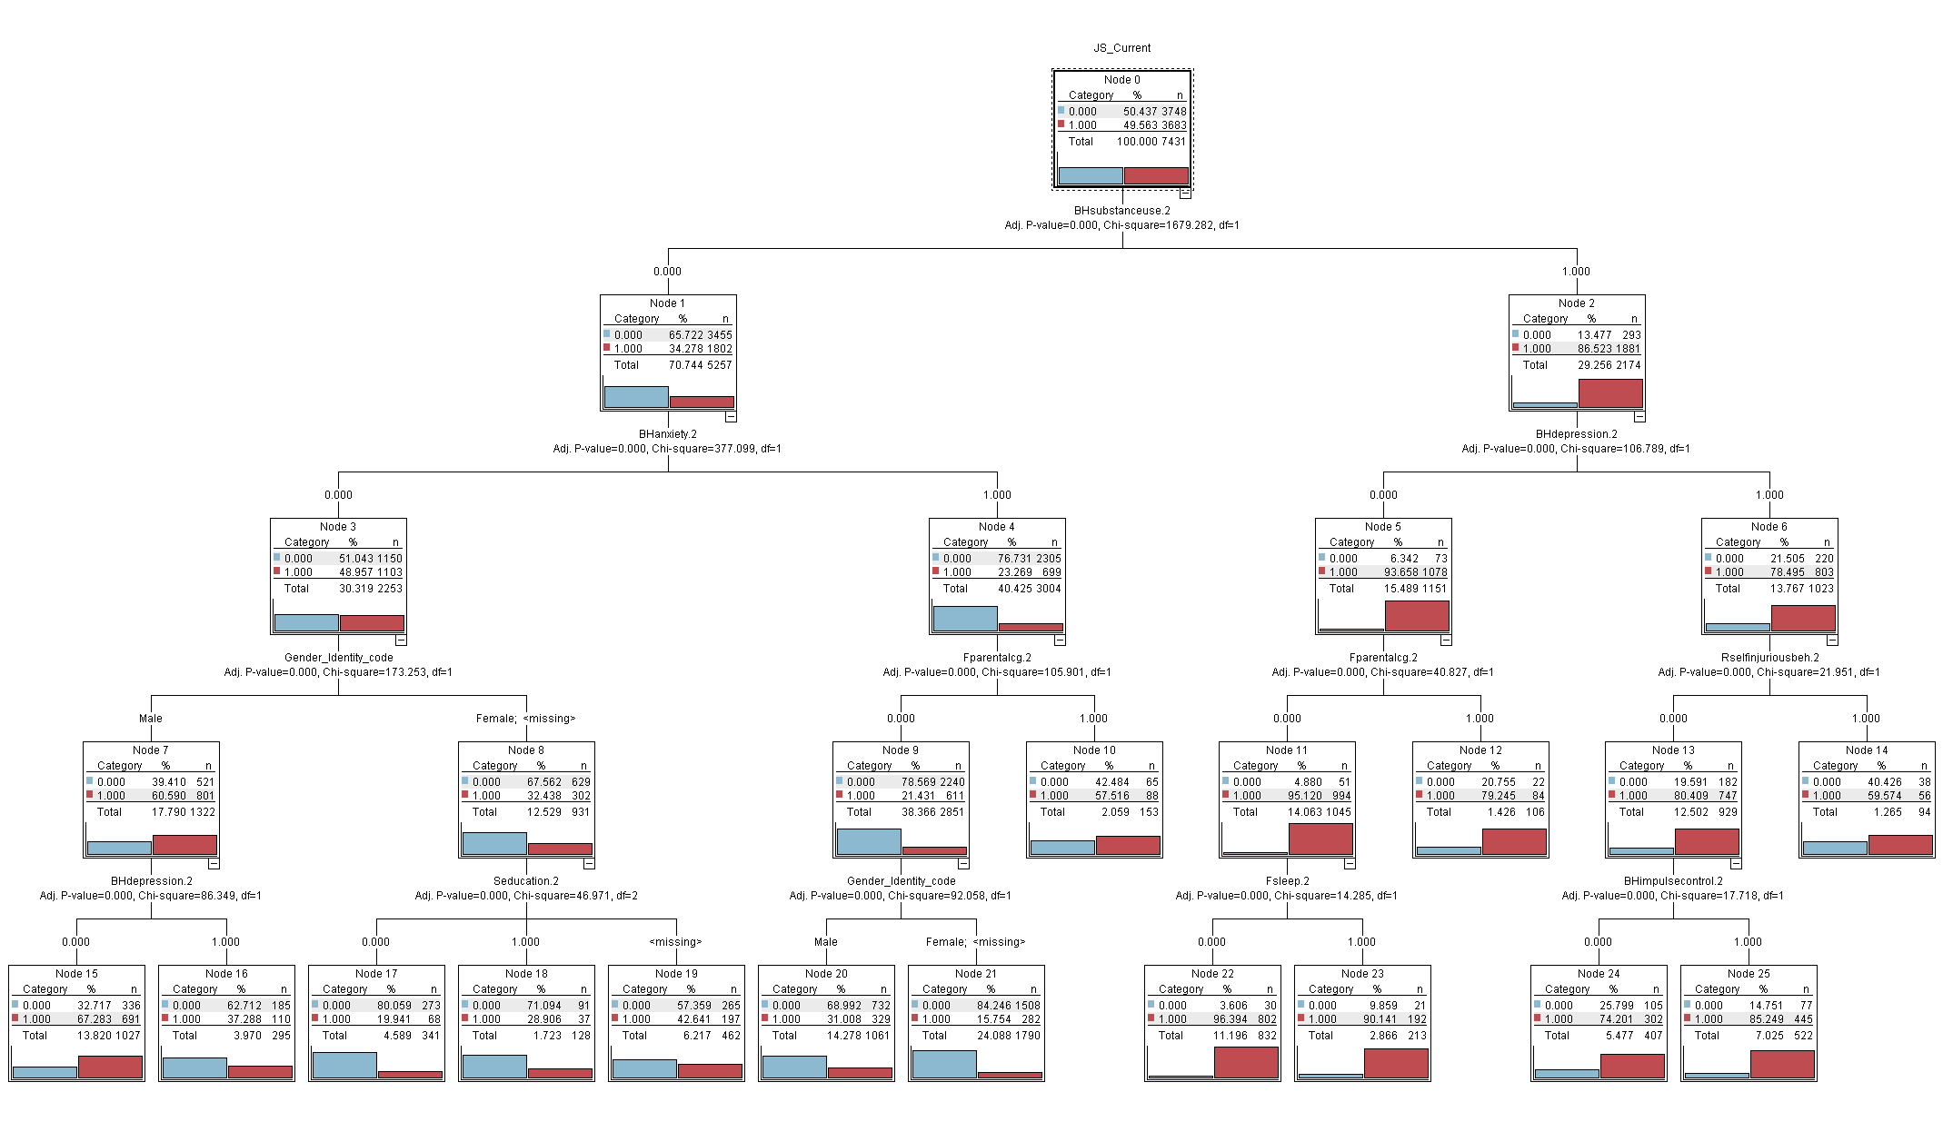

Managing Recovery with Adults Involved in Behavioral Health
and Criminal Justice Systems
Saahoon Hong, Ph.D., Assistant Research Professor • Betty Walton, Ph.D., Associate Research Professor
Indiana University School of Social Work
ABSTRACT
RESULTS
Figure 3. Predictor Importance for the target variable of Current Dual System Involvement
Background
  Young adults with mental health needs experience increased criminal behaviors, peaking at 16-25 years.
  Lack of support for young adults' behavioral health needs increases the likelihood of further involvement in the justice system.
  In one Midwestern state, the third highest referral source for adult behavioral health services was the criminal justice system, following self and health care referrals.
  Little is known about individuals’ needs, challenges, and successes after they were involved in dual justice and behavioral health systems.
Study Aims
  To predict dual behavioral health and justice system involvement for adults participating in publicly funded treatment and support services needs
  To explore implications for practice
Figure 1. Mean TAI differences between BHS and Current dual system involvement
Table 1. Hierarchical Linear Regression Results for TAI Improvement
 | Model 1 |  |  | Model 2
 | B | SE | p | B | SE | p
(Constant) | 4.13 | 0.21 | 0.00 | 5.61 | 0.23 | 0.00
Gender | 0.05 | 0.13 | 0.72 | -0.48 | 0.13 | 0.00
White (Reference)
Native_A | 0.62 | 1.33 | 0.64 | 1.08 | 1.31 | 0.41
Asian | -1.93 | 0.84 | 0.02 | -1.86 | 0.82 | 0.02
Black | -0.10 | 0.21 | 0.62 | -0.03 | 0.21 | 0.89
Hawaiian | 0.76 | 2.57 | 0.77 | 0.62 | 2.53 | 0.81
Other_Single | -0.43 | 0.47 | 0.36 | -0.53 | 0.46 | 0.25
Hispanic | 0.17 | 0.24 | 0.48 | 0.12 | 0.24 | 0.62
multi_race | 0.50 | 0.41 | 0.22 | 0.54 | 0.40 | 0.18
Current JS: Dual System |  |  |  | -2.18 | 0.14 | 0.00
a. Dependent Variable: Acntabl_Count_Impr.2
DISCUSSION
METHODS
TAY with dual behavioral health and justice system involvement experienced fewer actionable needs and lower rates of clinical improvement.
Substance Use (SUD) was the strongest predictor of dual system involvement, associated with depression, self-injurious behavior, and impulse control.
Without SUD, anxiety was associated with parental functioning challenges.
For young men, anxiety was associated with depression; for young women, anxiety was related to fewer educational strengths.
Identified variables and their intersections were well-posed to predict dual system involvement of adults.
This could eventually be a foundation for further in-depth analysis of dual-system involvement and cross-system collaborative efforts that supports infrastructure to better manage behavioral health needs.
Sample and Inclusion Criteria
  ANSA Legal Functioning (criminal justice system involvement) item and the legal basis of referral indicator were used.
  For state-funded adult behavioral health services in 2019, 30.4% of 6,726 transition-age adults (TAY), aged 18-25, had current justice system involvement. Male (45%), White (82%), Black (10.2), Hispanic (7.5%), Male*Current JS (65%); Black*Current JS (12.1%)
Data Analysis
  Chi-squared automatic interaction detection (CHAID) with a balance node was used to detect the current dual system involvement-related factors among demographic information and ANSA items for which the current dual system involvement was coded as “1.”
  A hierarchical linear regression model was conducted to examine the unique associations of the dual system involvement, gender, race/ethnicity, and behavioral health needs and strengths with the most recent TAI.
Figure 2. CHAID Decision Tress for Current Dual System Involvement
CONTACT
Saahoon Hong, Ph.D., saahong@iu.edu
Betty Walton, Ph.D., beawalto@iu.edu

