Slide 1

ACRL Science and Technology Section Panel Presentation:
Engaging with Virtual Instruction in the Sciences
Eric Snajdr
Indiana University–Purdue University Indianapolis
June 16, 2021

Slide 2
Asynchronous Online Science IL Lab
Example layout of assignment
Overall intro
    Overall purpose
    Overview
        Intro video/text
Notes:
During the pandemic, I converted several information literacy based science labs to online formats. Some shorter labs I converted to synchronous sessions. Other longer and more detailed labs, I converted to asynchronous. I’ll discuss an asynchronous example, which was originally two, two-hour in-person organic chemistry lab periods focusing on chemical information.
For each lab I first I provided an overall written introduction, including the big-picture overall purpose of the learning experience, as well as a short introductory video.

Slide 3
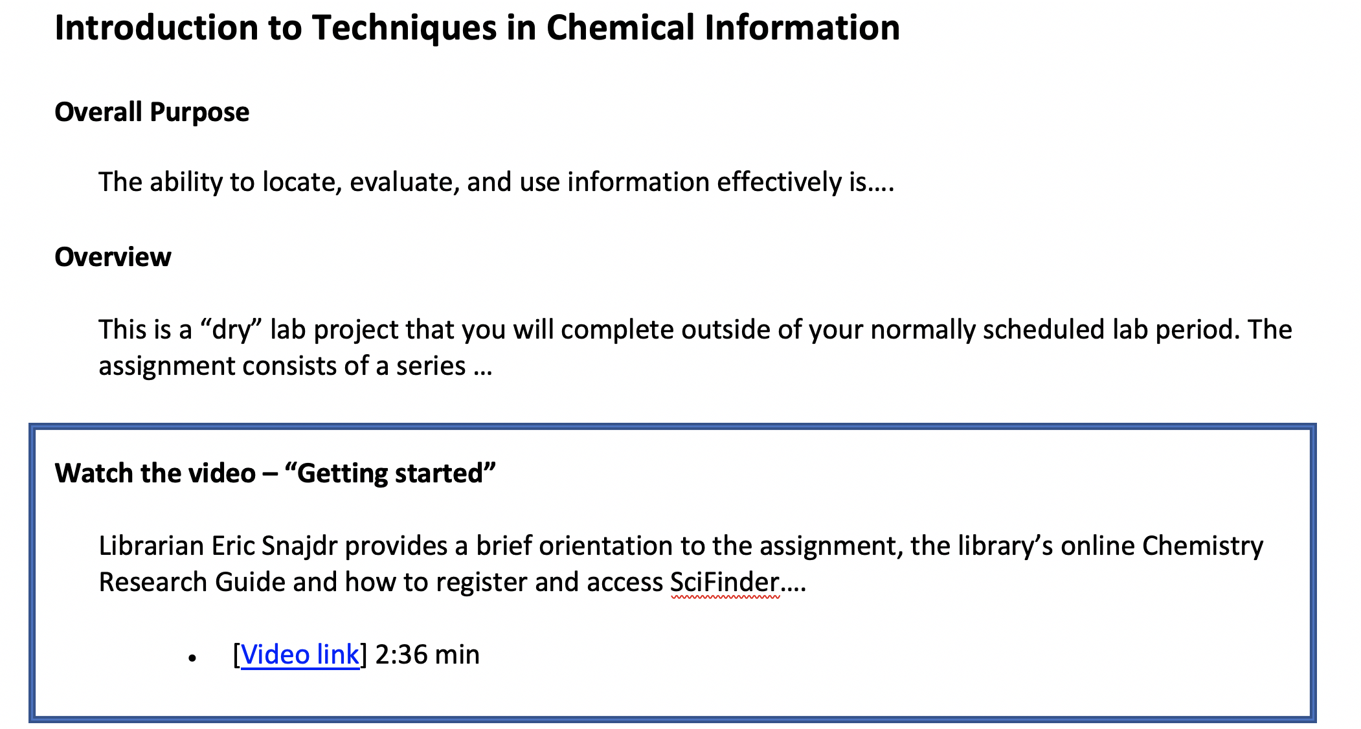
Notes:
Example

Slide 4
Asynchronous Online Science IL Lab
Example layout of lab work/assignment (cont’d)
Part 1
    Purpose
    Task
        Video and instructions
    Criteria – examples
Part 2…
Part 3…
Notes:
I chunked the asynchronous learning experience into several subsections. Each of these contains 3 modules including: librarian demos, written instructions, and student activities/assignments.
I implemented the Transparency in Learning and Teaching in Higher Education (TILT) principles. TILT can improve assignments by making explicit the purpose of the learning activity, the tasks (what students are to do), and the criteria for success. Examples of assignments and resources
https://tilthighered.com/tiltexamplesandresources

Slide 5
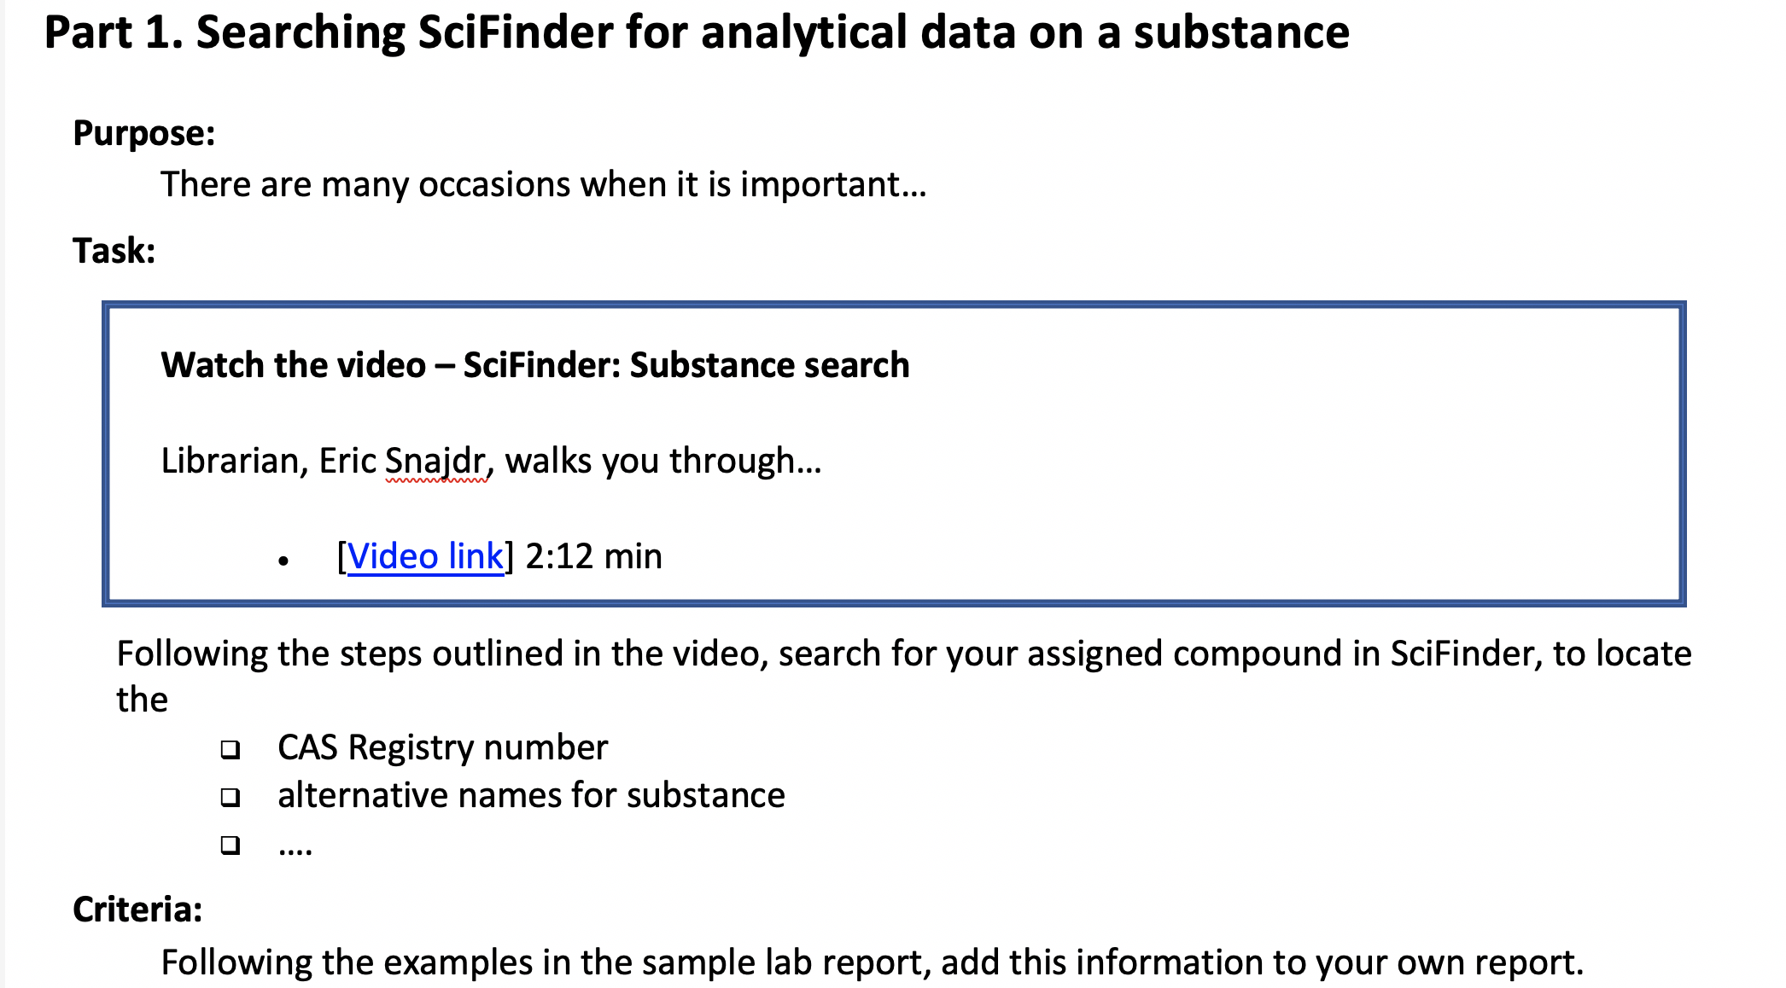
Notes:
Example

Slide 6
Asynchronous Instruction Post Pandemic
1. Modules for large volume classes
written instructions / short video / assignment
2. Modules for pre-class work (flipped classroom)
video and short assignment --> prep for F2F
3. Pre-class assessments
example: pre-class discussion q’s (assess prior k.)
Notes:
After the pandemic, I plan to continue to use some asynchronous learning experiences. I’ve made a slide outlining 3 examples.
First, during the pandemic, I added instructional involvement that would not have been feasible for me to do face-to-face, In this example, it was an organic chem lab with over 20 sections per year, each with 20 students. I hope to keep that going even after the pandemic ends. I worked with the course’s lead instructor in developing an asynchronous module with written instructions, a 5 minute video, as well as an assignment (on citing and avoiding plagiarism).
Second, for some classes I plan to continue to use asynchronous modules for pre-class work in a flipped classroom approach. For example, for one class, prior to a face-to-face session with me, I plan to have students view a video on search logic, and complete a pre-search assignment, so the face to face session can focus more on fine tuning their searches and learning to use more in-depth features of science databases.
Finally, for more advanced classes, I plan to continue to assess student prior knowledge through pre-class discussion questions through the course’s online learning management system. This has been a huge help in assessing what students already know as well as identifying gaps in their prior knowledge. This allows me to fine tune my session and make the content more relevant and meaningful to the students.

Slide 7
Thank you
Eric Snajdr
Associate Librarian
University Library
Indiana University – Purdue University, Indianapolis
esnajdr@iupui.edu

