Slide 1
Using metrics to change the narrative
The Charleston Conference
November 3, 2016
Heather L. Coates, MLS, MS | @IandPangurBan | #changethenarrative
Notes:
Slide 0: I’m delighted to be here today.

Slide 2
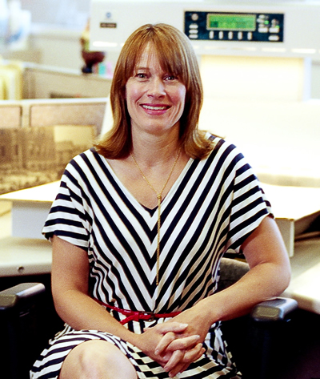
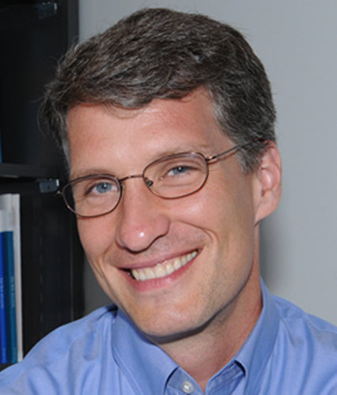
Kristi Palmer
Associate Dean of Digital Scholarship
https://ulib.iupui.edu/digitalscholarship/people/kristipalmer
Jere Odell
Scholarly Communication Librarian
https://ulib.iupui.edu/digitalscholarship/people/jereodell
Notes:
First, I have to acknowledge that much of what I will talk about today was done by my colleagues.

Slide 3

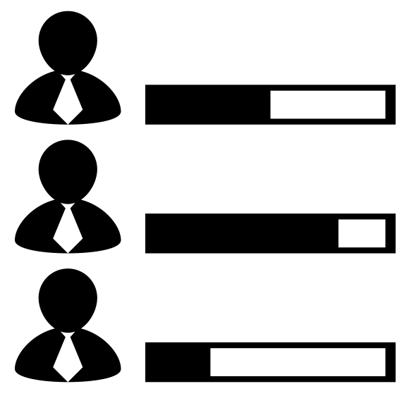
Notes:
I want to talk (briefly) today about how metrics have helped us to expand the conversation, change policy, and change practice at IUPUI. Metrics have been both a way to start the conversation and evidence for the benefits of changing practices. These activities are helping to change the narrative about what counts as scholarship & how we value it. More specifically, what products, evidence, and impact can be used in P&T dossiers and how they should be evaluated by committees.

Slide 4
Open Access =/= poor quality or lack of peer review
Publications are the only product that counts for getting a job and P&T
Publications are our scholarly record
Impact =/= Journal Impact Factor
Metrics measure the quality of scholarship
Metrics alone measure the value or impact of scholarship
Professional practice and service are not real scholarship
Notes:
This is the narrative we have been working to change over the past several years.

Slide 5
Open Access is a way to ensure everyone has access to scholarship
All the scholarship we produce has value
All the scholarship we produce is part of the scholarly record
Metrics are useful indicators for different flavors of impact
Metrics + expert review can the speak to the value and impact of scholarship
Impact is complex and best indicated by a mix of metrics & qualitative evidence presented in context
Professional practice and service enhance scholarship and expand its value
Notes:
This is the rather pragmatic narrative we would like to see prevail in the next 3-5 years.

Slide 6
IUPUI Values
Civic Engagement
Collaboration
Economic Development (Indiana)
Diversity, Equity, Inclusion
Interdisciplinary Work & Publication
Open Access
Public Scholars/ Scholarship
R&CA in Urban Environment
RISE
Translational Research
Notes:
Much of our success at IUPUI has been facilitated by local support. Our context may be very different than yours. What you see here are some of the values espoused in our P&T guidelines. We are supporting faculty and administration in reporting and evaluating scholarship in ways that promote and demonstrate our commitment to these values.

Slide 7
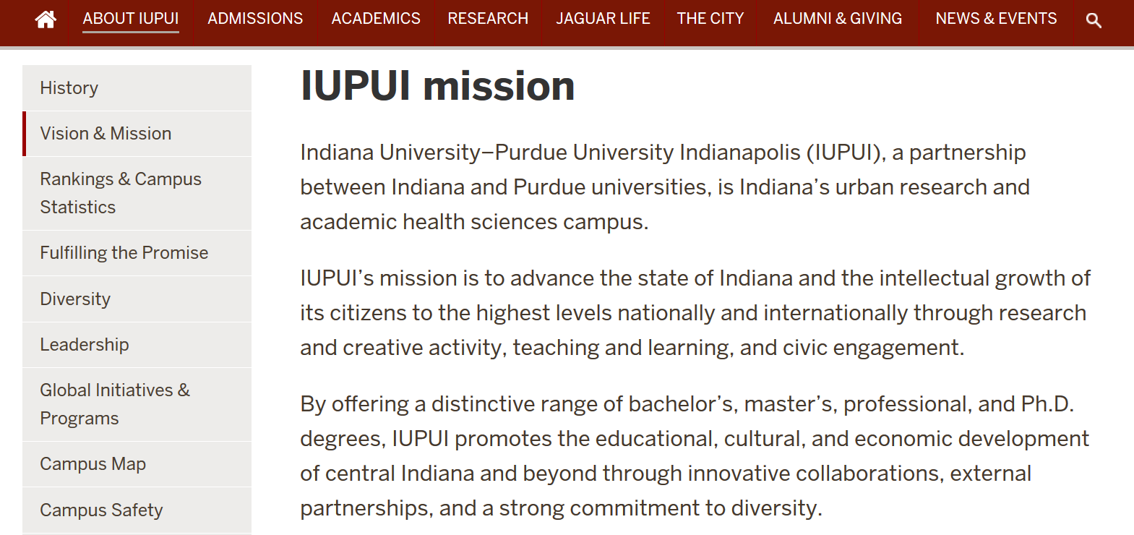
https://www.iupui.edu/about/vision-mission.html
Notes:
You can learn more about these values from our campus mission

Slide 8
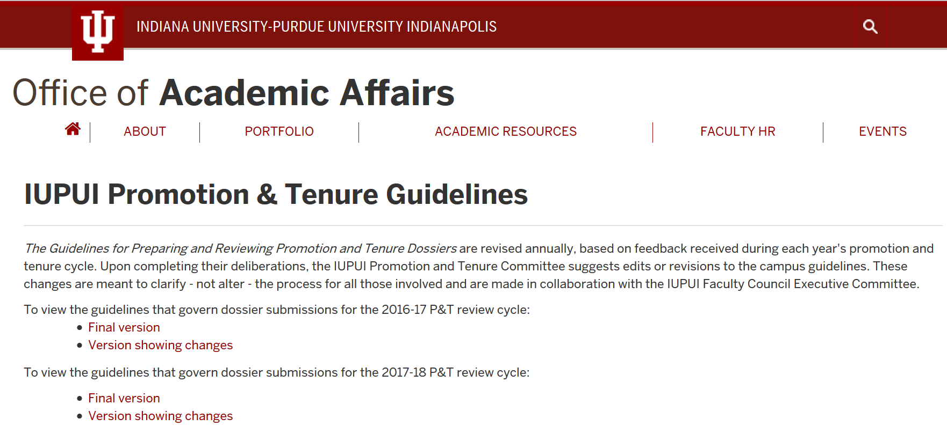
https://academicaffairs.iupui.edu/PromotionTenure/IUPUI-Guidelines
Notes:
and our P&T guidelines.

Slide 9
Faculty Governance
Promotion & Tenure Guidelines – campus, school, & departmental levels
Open Access Policy (Fall 2014)
Education
Workshops
Consultations
Practice
Modelling the practices we want to see
Discuss impact on professional advancement
Open Access Fund
Notes:
How have we changed practice to support and perpetuate this narrative? Engagement in faculty governance has led to addition of OA as a campus value and we are collaborating with specific schools and departments to revise guidelines at those levels. Our education efforts include workshops & consultations to help faculty make a stronger case for promotion and tenure. We have been able to change practice by modelling the practices we advocate for, openly discussing how those practices are affecting our own professional advancement, and by establishing an Open Access Fund.

Slide 10


















Notes:
Through our education and practice efforts, we are helping faculty to make their case for P&T using a broader list of products (beyond the publication) and a richer selection of evidence, including altmetrics and qualitative evidence to supplement citation-based metrics. There are links to slidedecks and other materials related to this area at the end.

Slide 11
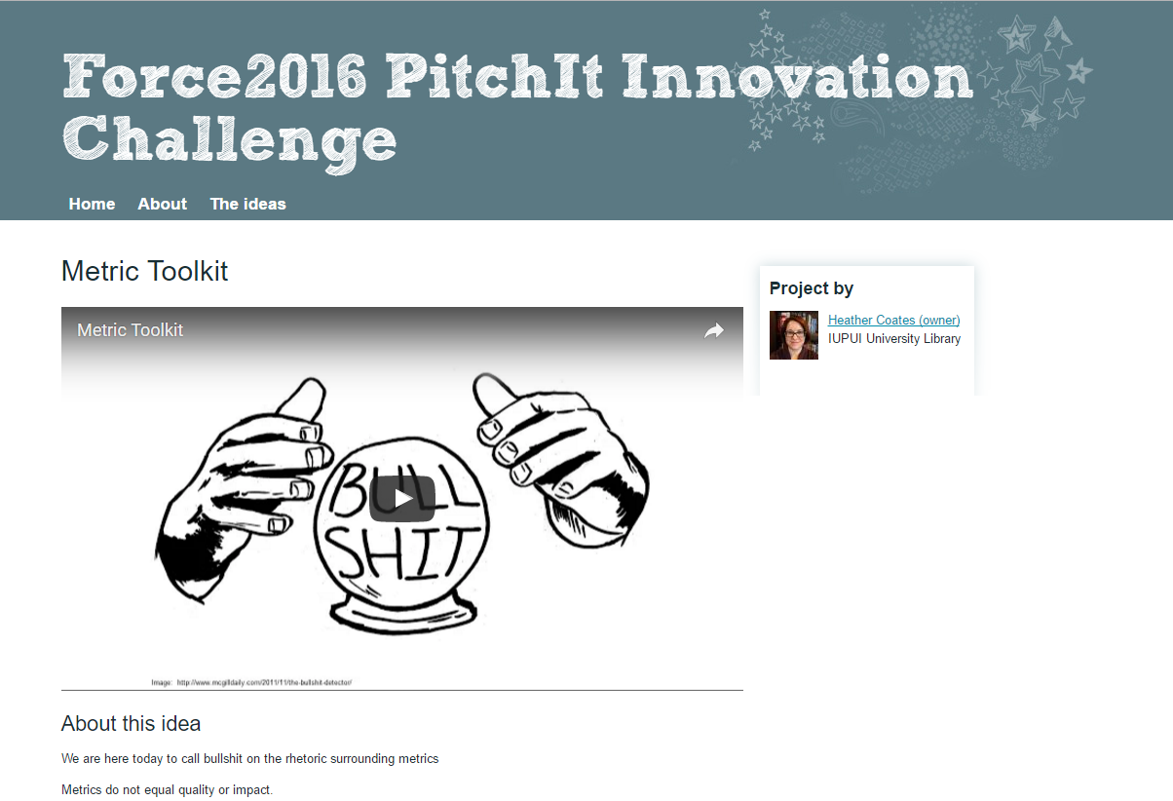
Notes:
This year, two collaborators and I began developing a Metrics Toolkit with the support of FORCE11. The goal of this project is to support the responsible use of metrics by scholars, hiring committees, and P&T committees in evaluating individual scholars.

Slide 12
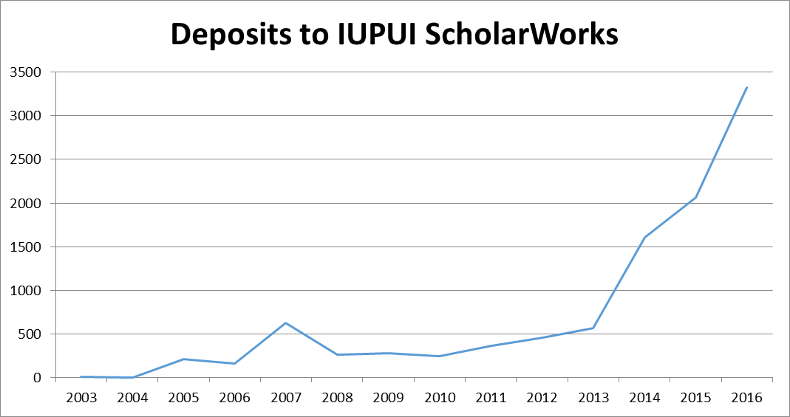
IUPUI ScholarWorks
10,000 items deposited
48,022 downloads
70,261 abstract views
OA Policy Participation Rate
2015-2016 | 2582/4914 | 53%
2016 (projected) | 1936/2800 | 69%
Notes:
Our governance and practice efforts have led to significant growth of open access at IUPUI.

Slide 13
Personal Good
Public Good
  Increase your visibility
  Control dissemination of your scholarly products
  Get credit for all your scholarship
  Select from a broader and richer array of evidence to indicate the attention, discussion, engagement, and reuse
  Transparency
  Public participation and engagement
  Improved or new products and services
  Innovation
  Enable validation of published findings
  Improved efficiency of public services
  Evaluation of public policy
  New knowledge
Notes:
Open Access & Open Data are not the end goals. Openness is a means to build a scholarly commons that ensures equitable access, balances rewards for processes with products, integrity with novelty, and enables attribution without obstructing reuse. We can argue about how far we have to go and how to get there, but let’s remember why openness matters. The challenge is that the priorities of researchers vary greatly. We have to be able to articulate how openness enables them to achieve their professional advancement goals. Metrics are one way to do that.

Slide 14
Heather L. Coates
Digital Scholarship & Data Management Librarian
IUPUI University Library Center for Digital Scholarship
@IandPangurBan
coateshl.wordpress.com
http://ulib.iupui.edu/digitalscholarship/
Notes:
Thanks for your attention. If you want to continue the conversation after this session, you can find me on Twitter.

Slide 15
More Information
Odell, J., Coates, H., & Palmer, K. (2016). Rewarding open access scholarship in promotion and tenure Driving institutional change. College & Research Libraries News, 77(7), 322-325.
Altmetrics for Team Science: http://www.slideshare.net/goldenphizzwizards/metrics-for-team-science
Coates, Heather (2016): Heather Coates dossier for promotion & tenure at IUPUI (figshare). doi:10.6084/m9.figshare.3413698.v2
On the “inevitable rise” of gold OA at IUPUI: http://ulib.iupui.edu/digitalscholarship/blog/gold-open-access-rise-iupui-leads-indiana-oa-articles
IUPUI Open Access Publishing Fund Report: July 2013-June 2015: http://hdl.handle.net/1805/10179
Why Open Research? http://whyopenresearch.org/
FOSTER EU Project: https://www.fosteropenscience.eu/

Slide 16
Image Credits
Publish: https://thenounproject.com/search/?q=article&i=74762
Evaluate: https://thenounproject.com/search/?q=peer+review&i=210141
Article: https://thenounproject.com/search/?q=article&i=74762
Book: https://thenounproject.com/search/?q=book&i=547809
Binary code: https://thenounproject.com/search/?q=binary+code&i=177042
Data stream: https://thenounproject.com/search/?q=data+stream&i=160443

