Slide 1
Practitioner Perspectives: NIH Data Management and Sharing Policy
Infrastructure
Nicole Contaxis
Data Librarian & Lead of Data Discovery
NYU Health Sciences Library
Heather Coates
Digital Scholarship & Management Librarian
IUPUI University Library

Slide 2
Agenda:
Infrastructure & the NIH Policy
Where we want to be
Where we actually are
Moving forward

Slide 3
What is infrastructure?
Series of complex and interrelated systems (e.g., physical, technological, economic, etc) that support human activities
  Example: Research infrastructure can include things like lab space, e-lab notebooks, grant application platforms, etc.
Notes:
-get the relevant information to the right people at the right time

Slide 4
What is infrastructure?
Series of complex and interrelated systems (e.g., physical, technological, economic, etc) that support human activities
  Example: Research infrastructure can include things like lab space, e-lab notebooks, grant application platforms, etc.
Easy to ignore when it is working well; impossible to ignore when it is working poorly
  Example: You drive to work everyday but don’t notice the road unless there is a big pothole in it.
Notes:
-get the relevant information to the right people at the right time

Slide 5
What is infrastructure?
Series of complex and interrelated systems (e.g., physical, technological, economic, etc) that support human activities
  Example: Research infrastructure can include things like lab space, e-lab notebooks, grant application platforms, etc.
Easy to ignore when it is working well; impossible to ignore when it is working poorly
  Example: You drive to work everyday but don’t notice the road unless there is a big pothole in it.
Infrastructure impacts communities as well as individuals
  Example: A closed road keeps you from traveling easily, as well as your neighbors
Notes:
-get the relevant information to the right people at the right time

Slide 6
Infrastructure and the NIH Policy
Infrastructure relevant to the NIH Policy:
Data repositories
Data standards
Persistent identifiers
Institutional grant support systems
DMP creation support systems (DMPTool)

Slide 7
Infrastructure and the NIH Policy
Infrastructure relevant to the NIH Policy:
Data repositories
Data standards
Persistent identifiers
Institutional grant support systems
DMP creation support systems (DMPTool)
This infrastructure is:
Built by different stakeholders (universities and research institutions, third parties, NIH)
Addressing different needs (e.g., exchange of data vs. long-term storage of data)
At different levels of ‘completeness’

Slide 8
Infrastructure and the NIH Policy cont’d
What we are going to focus on today:
Machine Actionable Data Management Plans (maDMPs)
Why?
maDMPs could help tie these diverse systems together to help researchers navigate the rather complex data and research ecosystem

Slide 9
maDMPs
maDMP is a conceptual framework that turns DMPs from free text, static documents into machine actionable information.
It leverages tools like unique identifies (e.g., ORCID id’s), common data models (RDA DMP Common Standard for maDMP) and controlled vocabularies to more readily exchange information in a DMP across the diverse systems that constitute our research data infrastructure. It can help:
Better guide researchers through different tools and services they rely on
Better track data provenance, attribution, and publication

Slide 10
maDMPs
maDMP is a conceptual framework that turns DMPs from free text, static documents into machine actionable information.
It leverages tools like unique identifies (e.g., ORCID id’s), common data models (RDA DMP Common Standard for maDMP) and controlled vocabularies to more readily exchange information in a DMP across the diverse systems that constitute our research data infrastructure. It can help:
Better guide researchers through different tools and services they rely on
Better track data provenance, attribution, and publication
Michelle Yee
DMP
0000-0003-3756-6780
DMP
ORCID
or…
DataCite
Institutional Resources

Slide 11
Where we want to be
Notes:
What are our goals in getting ready for this new policy?
Considerations or things to think about for your institution

Slide 12
maDMPs at NYU Langone Health
How I want it to work:
Using DMPs generated as a part of the grant application process to:
Ease communication between research support departments (e.g., the library, IT, Office of Science and Research, Office of Sponsored Projects) by generating automatic alerts and tasks when grants are funded
Ease communication between research support and researchers by alerting researchers to tools, trainings, and workflows for their research and data practices

Slide 13
maDMPs at NYU Langone Health
How I want it to work:
Using DMPs generated as a part of the grant application process to:
Ease communication between research support departments (e.g., the library, IT, Office of Science and Research, Office of Sponsored Projects) by generating automatic alerts and tasks when grants are funded
Ease communication between research support and researchers by alerting researchers to tools, trainings, and workflows for their research and data practices
I think we can do this by:
Understanding and leveraging legacy systems wherever possible
Prioritizing what gets made ‘machine actionable’ and when
Demonstrating to departments and leadership the value of maDMPs within their own realms

Slide 14
Research Processes & maDMPs at NYU
Current Process for Request Research-Related Software
Researcher contacts Research IT requesting a specific piece of software
Research IT begins process of acquiring and implementing the software, an average 35 business day process
  Involves legal if contacts are involved as well
Researcher complains because they need the software within a week
No one is happy

Slide 15
Research Processes & maDMPs at NYU
Current Process for Request Research-Related Software
Researcher contacts Research IT requesting a specific piece of software
Research IT begins process of acquiring and implementing the software, an average 35 business day process
  Involves legal if contracts are involved as well
Researcher complains because they need the software within a week
No one is happy
Future Process for Request Research-Related Software
Researcher notes required tools for accessing and manipulating data in their NIH DMP
Relevant sections from that NIH DMP are sent to Research IT, as well as other research service departments, when the grant is funded
Research IT contacts the researcher with questions on their specific needs to get started on IT acquisition ahead of the 35 business day turnaround

Slide 16
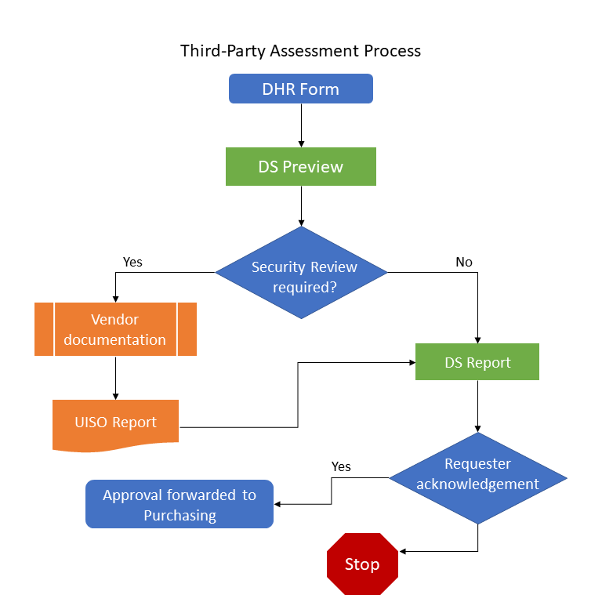
Research processes at IU
SSSP
3PA
Purchasing
Notes:
Typical duration = 25-50 business days

Slide 17
Research processes at IU
SSSP
3PA
Purchasing
Software & Services Selection Process (SSSP)
  Guide users to already approved and licensed tools
  Gather information about new use cases
Third-Party Assessment (3PA)
  Identify & prioritize high-risk scenarios
Purchasing Process
  Include data protection tools like Data Security Addendum, Master Services Agreement, Business Associate Agreements, etc.
Pain points
  Processes are built for all data domains
  Researcher expectations
  Terminology is unclear
  Data classification is not always obvious; inaccurate information frequently submitted
  Form does not elicit the information needed
  Describing key details about use case and data workflows is challenging

Slide 18
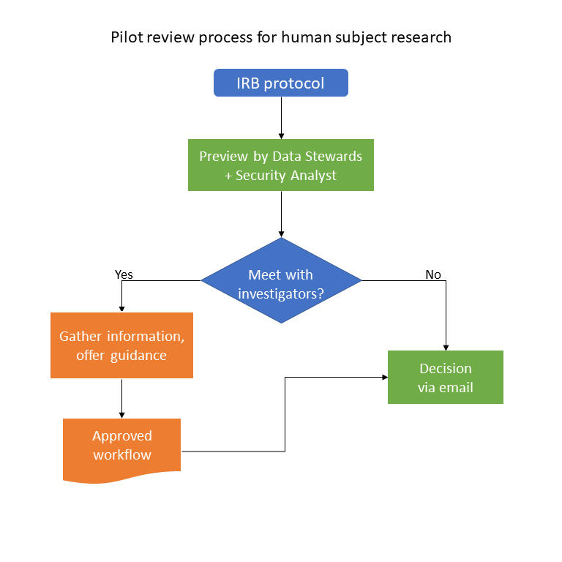
Research processes at IU

Slide 19
Research processes at IU
How does this pilot process for research & health data differ from the standard 3PA?
Not requester-initiated > Human Subjects Office sends information to Health Data Steward
Allows us to connect with researchers much earlier in the study startup process
High-touch approach improves communication and reduces delay

Slide 20
maDMPs at IU
DMS Planning
Assign PID to DMS Plans in FireForm
  Integrate PI ORCID
  Integrate ROR
Routing draft DMP to appropriate service groups for review & support (upon request)
Notify service groups of potential users & use cases to support more accurate long-term planning
DMS Implementation
Notify service groups of awards and associated commitments
Make commitments more visible to PI (and Department Chairs, AD/VC for Research)
Provide customized action-oriented prompts when the Notice of Award is received
  Match PID of DMS Plan associated with NoA to populate Denodo dashboard for services

Slide 21
Where we actually are

Slide 22
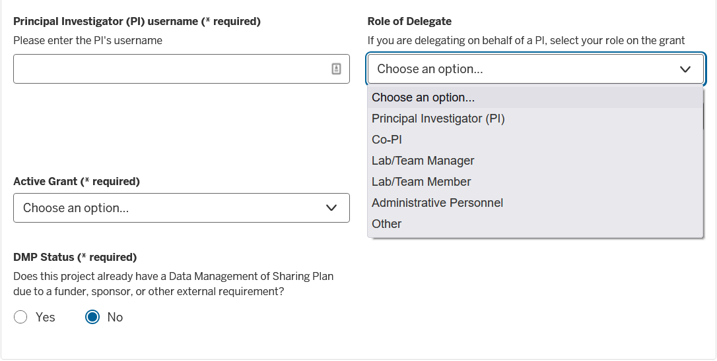
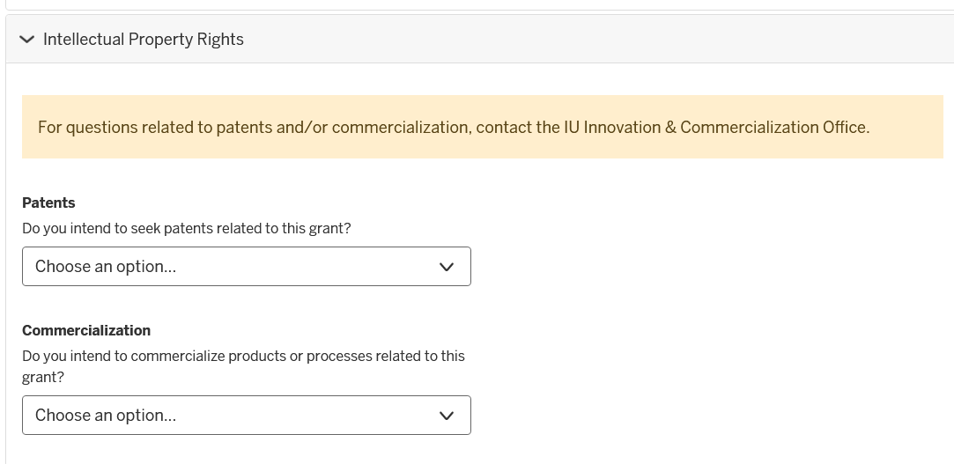
IUSM DMP 2020-2022

Slide 23
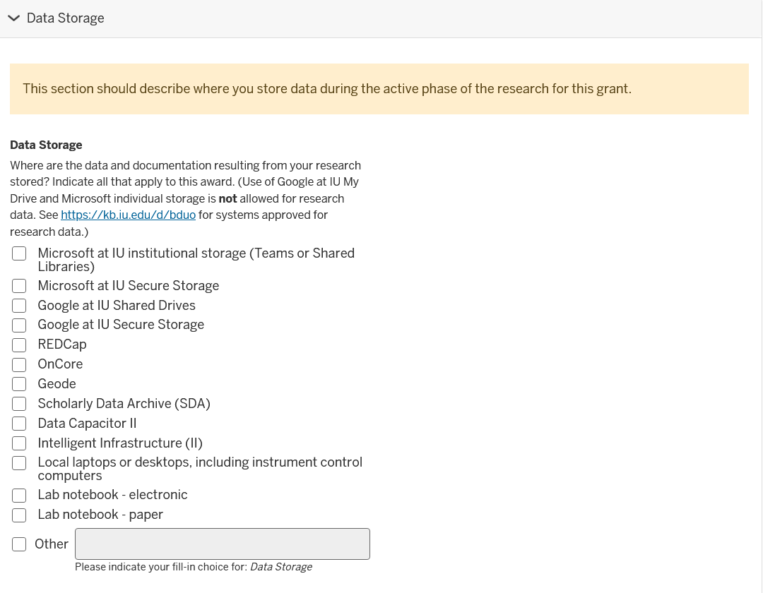
IUSM DMP 2020-2022
Notes:
Currently capturing structured information that could be actionable

Slide 24
maDMPs in order to…
Refer researchers to appropriate support services in a consistent, timely, and efficient way
Provide researchers with information they need to be successful
Enable service providers to learn from information provided in the DMS plans

Slide 25
IU NIH DMS 2023 and beyond
Free text fields | Structured fields
Data type - general summary of the types and estimated amount of scientific data to be generated and/or used | If IU Data Storage platforms selected > push DMS Plan to appropriate service lead upon Notice of Award
Data Preservation, Access, and Associated Timelines - name of the repository(ies), how data will be findable & identifiable, when data will be made available | If review is requested > push DMS Plan for review by campus data librarian
Access, Distribution, or Reuse Considerations - Describe any applicable factors affecting subsequent access, distribution, or reuse of scientific data & whether access will be controlled | Create Denodo dashboard accessible to HSO, ORA Research Contracting team, General Counsel, Data Stewards, ICO
Notes:
-consider out loud how we can structure this very loose template from NIH to provide clear guidance and enable machine actions
-end on data storage to set up Nicole

Slide 26
Where NYU Langone is Now
Building the team
Coordinating across many departments including: Office of Science and Research, Legal, Research IT, Compliance, Sponsored Programs Administration, Informatics, and the Cores
Notes:
End on providing some ‘visioning’ — my ideas for the future of this.

Slide 27
Where NYU Langone is Now
Building the team
Coordinating across many departments including: Office of Science and Research, Legal, Research IT, Compliance, Sponsored Programs Administration, Informatics, and the Cores
Assessing what to make machine actionable first
Systems currently under consideration include: Research IT request forms; Repository submission support through the library; Cores systems used for things like requesting EHR data, requesting slide images, etc
Notes:
End on providing some ‘visioning’ — my ideas for the future of this.

Slide 28
Where NYU Langone is Now
Building the team
Coordinating across many departments including: Office of Science and Research, Legal, Research IT, Compliance, Sponsored Programs Administration, Informatics, and the Cores
Assessing what to make machine actionable first
Systems currently under consideration include: Research IT request forms; Grant submission system; Cores systems used for things like requesting EHR data, requesting slide images, etc
Developing guidance alongside infrastructure issues
Generating guidance (in the shape of interactive decision trees) to help researchers better choose repositories and data analysis tools
Working with our institutions Cores to develop guidance that mirrors their pre-existing data management protocols
Notes:
End on providing some ‘visioning’ — my ideas for the future of this.

Slide 29
Moving Forward
Notes:
End on providing some ‘visioning’ — my ideas for the future of this.

Slide 30
Moving Forward
Key Points:
Never let a good crisis go to waste
Aim for partially machine actionable (“pamaDMP”) and expand as it is proven helpful
  Intermittent evaluation and strategy adjustment will (probably) prove crucial
Consider how legacy systems can talk to new systems
  One system seems implausible; interoperability remains ambitious but perhaps attainable
Understand that inefficiencies sometimes have their own benefits
Leverage the work done by the larger community (e.g., DMPTool) to serve your institution
Create space for innovation and experimentation moving forward

Slide 31
Moving Forward
Key Points:
Never let a good crisis go to waste
Aim for partially machine actionable (“pamaDMP”) and expand as it is proven helpful
  Intermittent evaluation and strategy adjustment will (probably) prove crucial
Consider how legacy systems can talk to new systems
  One system seems implausible; interoperability remains ambitious but perhaps attainable
Understand that inefficiencies sometimes have their own benefits
Leverage the work done by the larger community (e.g., DMPTool) to serve your institution
Create space for innovation and experimentation moving forward
Possible space for NLP and further experimentation:
A ‘corpus’ of DMPs from funded NIH projects would provide could provide us with an extensive resource to learn more about our researchers and experiment on ways to further automate institutional processes

Slide 32
Questions
Do you have clarifying questions about maDMPs?
Do you have questions about our visions for maDMPs?
Do you have questions about the ongoing processes for implementation at our institution?
Questions to consider at your own institutions:
What are communication challenges that you may be able to address is maDMPs?
What are some pre-existing systems at your institution that you may be able to leverage (e.g., grants application systems)
Who else at your institution supports researchers/proposals and could be helped by a maDMP?

