Slide 1

Big Data
Midwest Medical Library Association 2015
Louisville, KY
Heather Coates | @IandPangurBan

Slide 2
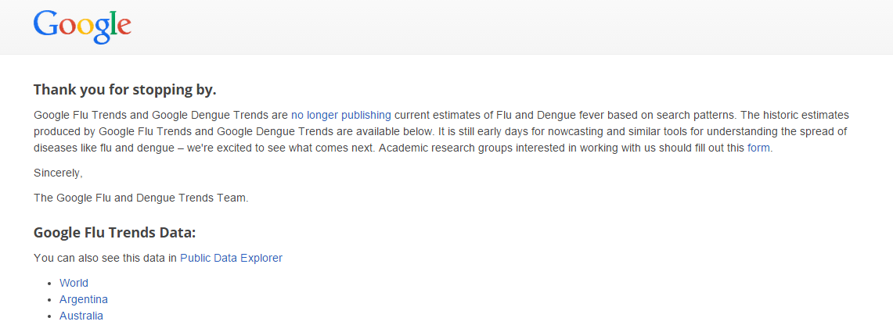

Slide 3
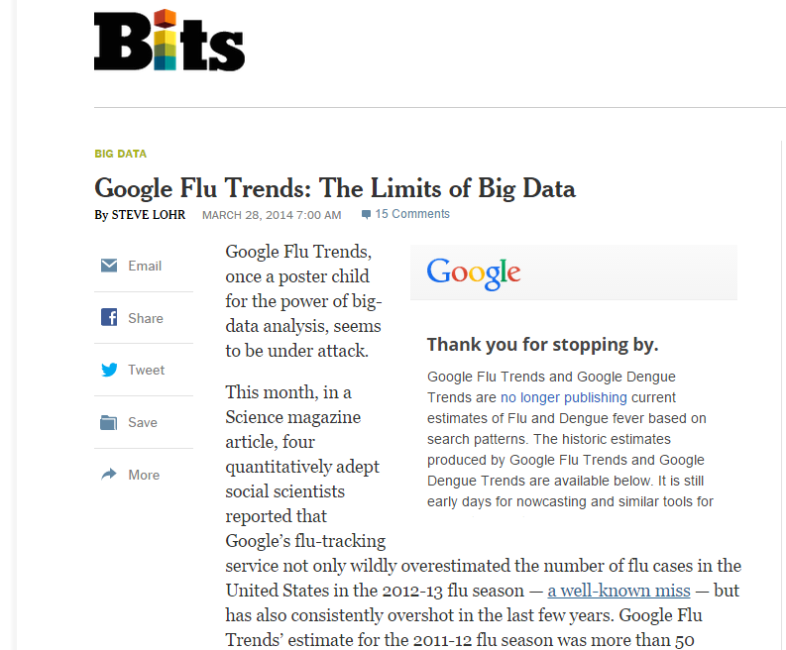
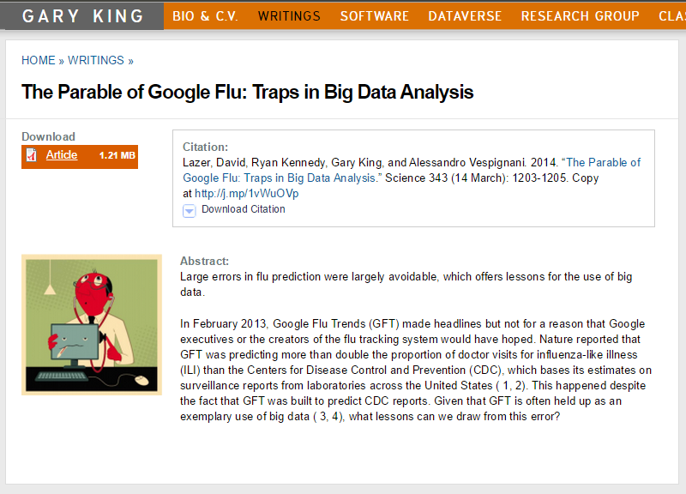

Slide 4
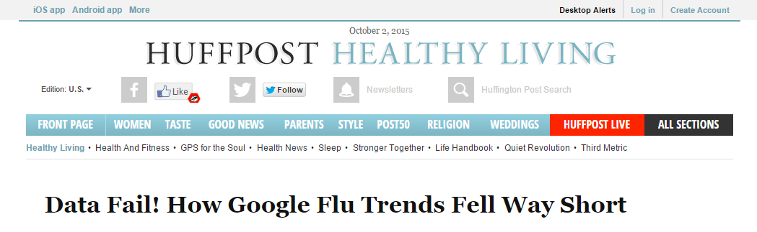
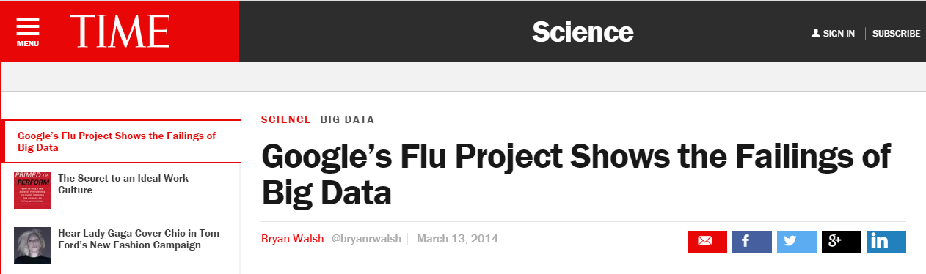

Slide 5

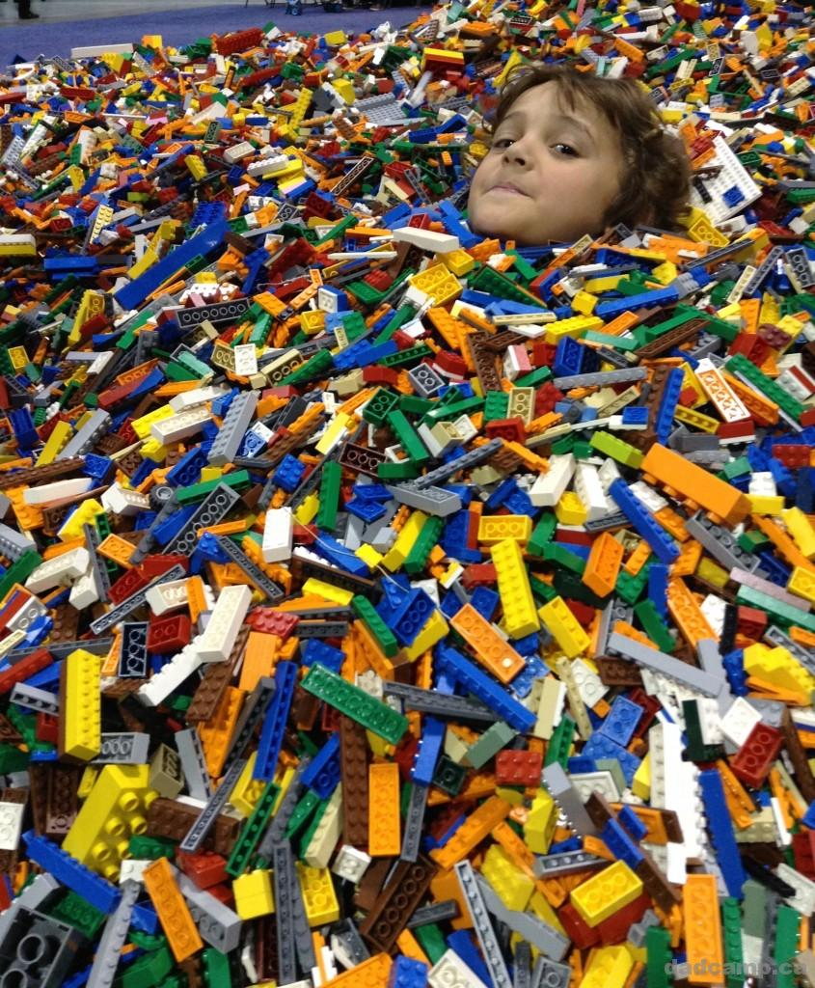

Slide 6
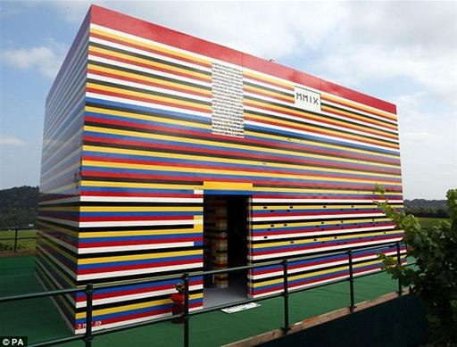

Slide 7
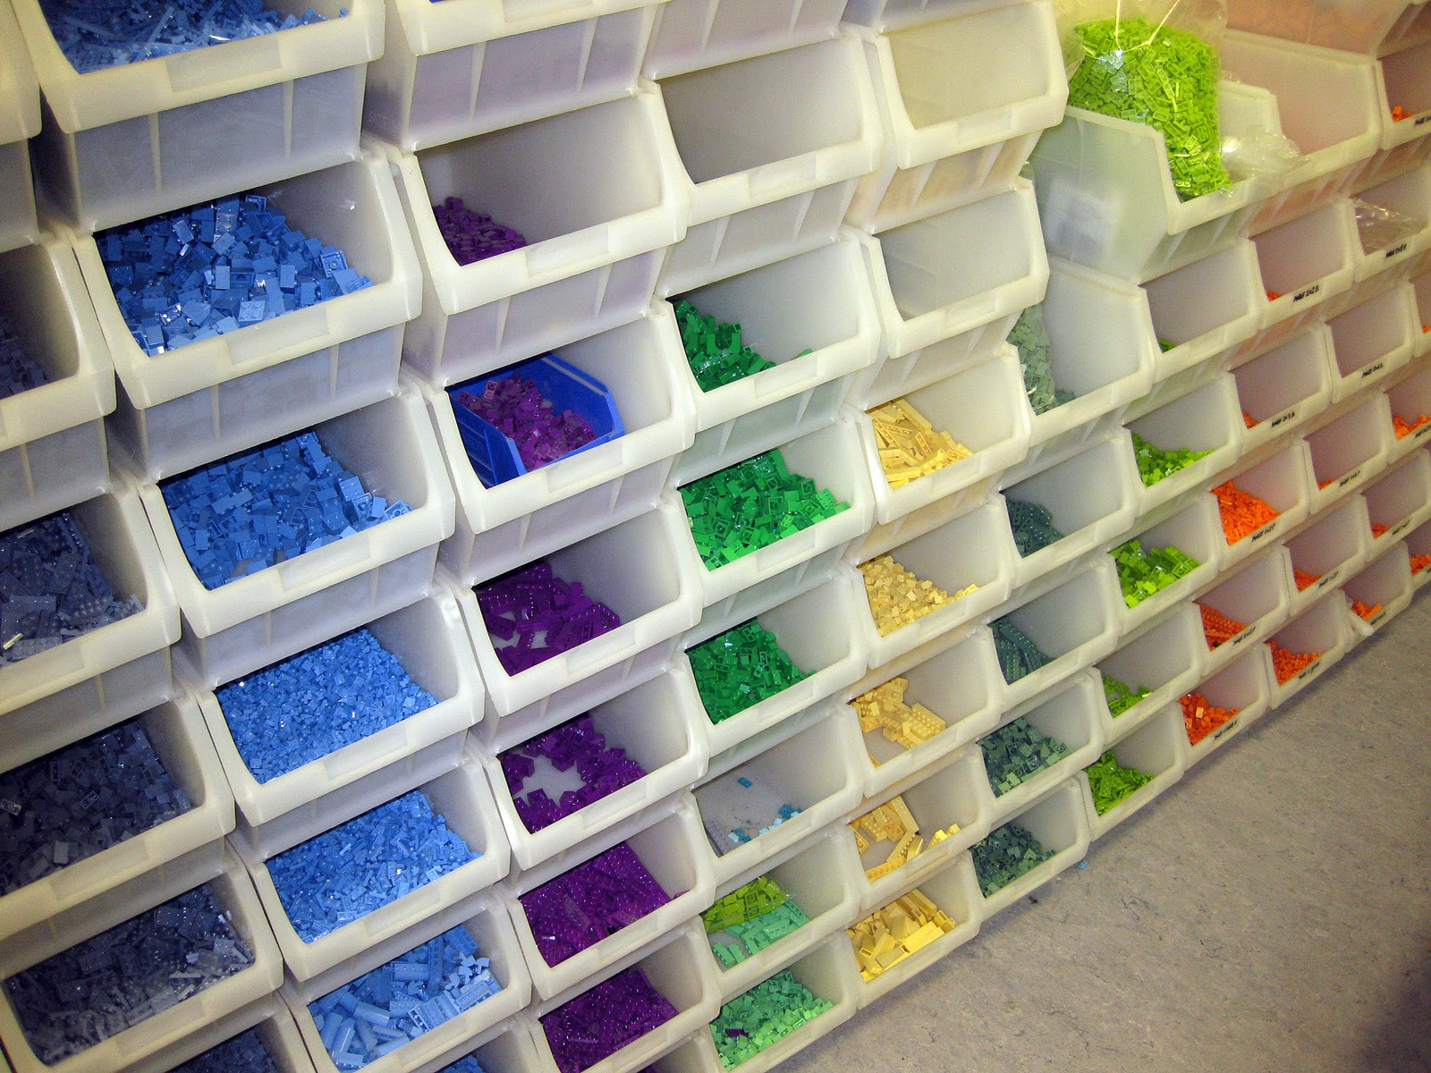

Slide 8
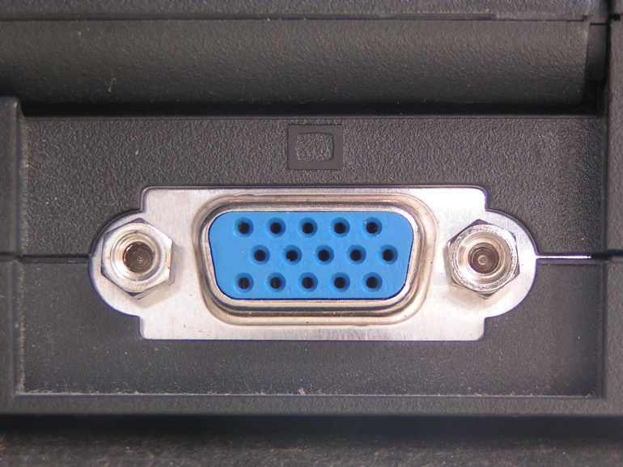
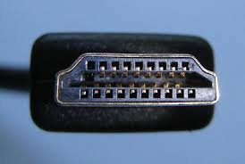
!

Slide 9
Good research needs good data
Purpose
Provenance
Documentation
Structure
Order
Machine-readable format
good data have

Slide 10
Enabling reuse requires
Management & curation services
  Planning – from the inception of the project
  Incentives – provide data for recognition
  Licensing – communicate what is allowed
  Description – enable discovery through metadata
  Persistent identifiers – for tracking
  Interoperability – enabled by standards applied to the procedures, data, documentation, & metadata
  Access – accessibility & long-term preservation
  Training
  Meeting DMP requirements
  Practical DMPs & planning
  Mapping data outcomes
  Documentation strategies
  Data storage & archiving
  Data quality
  Ethical & legal obligations
  Finding data for reuse
  Consultations
  Developing & reviewing data management plans
  Developing a digital strategy for disseminating research products
  Tracking & presenting impact metrics

Slide 11
Enabling reuse requires
Management & curation resources
  Planning – from the inception of the project
  Incentives – provide data for recognition
  Licensing – communicate what is allowed
  Description – enable discovery through metadata
  Persistent identifiers – for tracking
  Interoperability – enabled by standards applied to the procedures, data, documentation, & metadata
  Access – accessibility & long-term preservation
RDM guide
[Tutorials]
[Data reference & citation guide]
[Research data policy]
[Classroom exercises]

Slide 12
Enabling reuse requires
Infrastructure
  Planning – from the inception of the project
  Incentives – provide data for recognition
  Licensing – communicate what is allowed
  Description – enable discovery through metadata
  Persistent identifiers – for tracking impact
  Interoperability – enabled by standards applied to the procedures, data, documentation, & metadata
  Access – accessibility & long-term preservation
IUPUI DataWorks
Enables discovery
Provides access
EZID
Create & assign unique identifiers
Facilitates indexing of data citations
Scopus & Web of Science
Facilitates tracking of citation metrics
Altmetrics tools (Altmetric, PlumX, ImpactStory)
Aggregate altmetrics from various platforms

Slide 13
small data
small data
small data
small data
small data
small data
small data
small data
small data
small data
small data
small data
small data
small data
small data
small data
small data

Slide 14
BIG DATA
small data
small data
small data
small data
small data
small data
small data
small data
small data
small data
small data
small data
small data
small data
small data
small data
small data

Slide 15
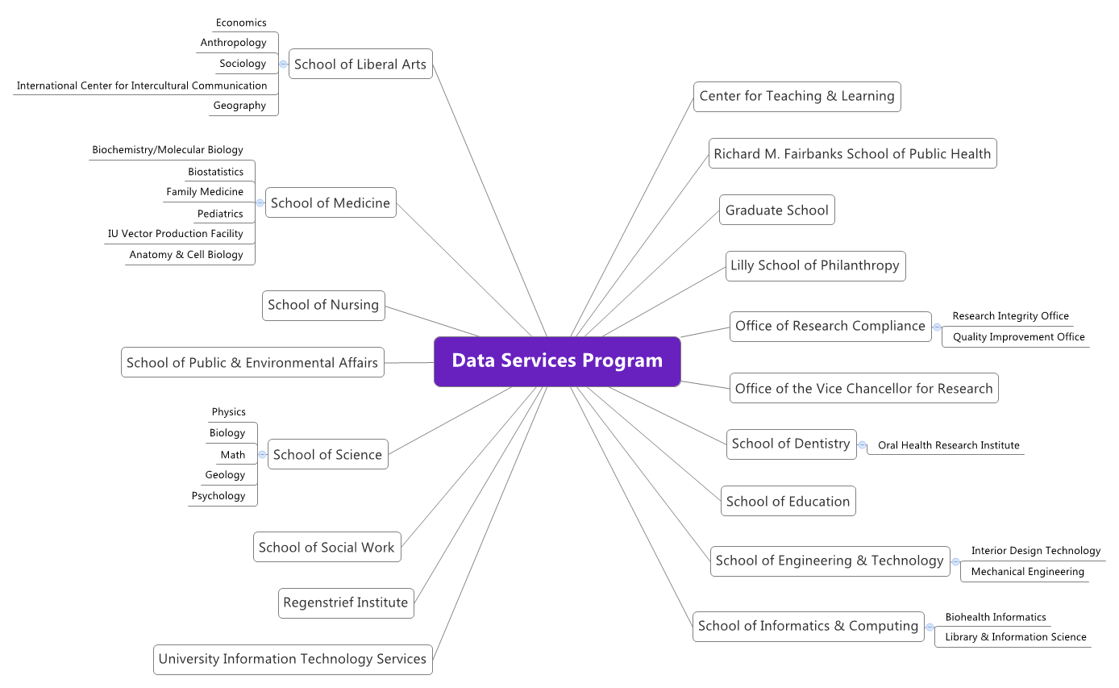
Office of the Vice Chancellor for Research
Office of Research Administration– Research Integrity Office
IUB Libraries
UITS – Research Storage Team
Ruth Lilly Medical Library
HIPAA Privacy Officer
Indiana CTSI – Data Management Team
Human Subjects Office

Slide 16
Resources
Images
http://www.hsph.harvard.edu/news/magazine/spr12-big-data-tb-health-costs/
http://dspacecris.eurocris.org/bitstream/11366/320/1/Keynote_WF1_Ashley_CRIS2014.pdf
http://www.slideshare.net/larsga/introduction-to-big-datamachine-learning?qid=504198c7-51c3-4ca0-be80-d99b048e3fea&v=qf1&b=&from_search=12
http://www.slideshare.net/kuonen/a-statisticians-big-tent-view-on-big-data-and-data-science-version-8
McCallum, Q. E. (2012). Bad data handbook. Beijing: O'Reilly.
http://www.familyfuncalgary.com/a-family-fun-visit-to-lego-kidsfest-in-calgary/
http://dad-camp.com/survive-the-worldwide-lego-shortage/
http://www.hongkiat.com/blog/35-lego-mega-constructions-you-probably-havent-seen-before/

Slide 17
Heather Coates
Digital Scholarship & Data Management Librarian
Liaison to the Richard M. Fairbanks School of Public Health
IUPUI University Library Center for Digital Scholarship
hcoates@iupui.edu
http://www2.ulib.iupui.edu/digitalscholarship/dataservices
[under construction - check back in Spring 2016 for a whole new look!]
coateshl.wordpress.com
http://www.slideshare.net/goldenphizzwizards
@IandPangurBan

