Slide 1
Navigating Institutional Research Information Management Priorities: Rolling out of an Institutional Data Management Plan (DMP) Requirement
Elizabeth C. Whipple, MLS, AHIP
Gabriel R. Rios, MLIS
May 3, 2021

Slide 2
Learning Objectives
Describe the information management priorities
Identify the stakeholders involved in the data management plan (DMP) requirement
Recognize the pressure points of this strategic initiative
Summarize current progress of the required DMP plan

Slide 3
Agenda
Background on a required Data Management Plan (DMP)
Version 1 roll out
Improvements/changes to the DMP
Version 2
Challenges/Next Steps

Slide 4
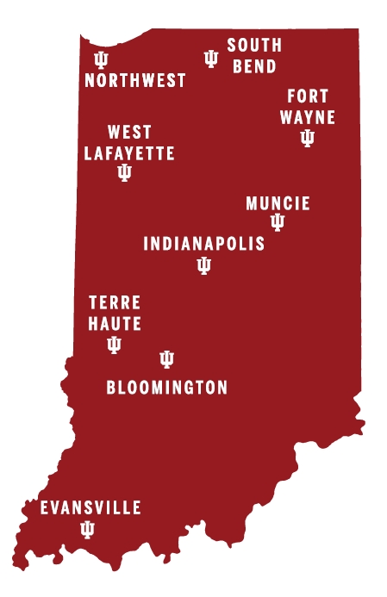
Indiana University School of Medicine (
(IUSM)
Academic medical center
9 regional campuses
1 medical library
1,441 medical students
2,914 full time faculty

Slide 5
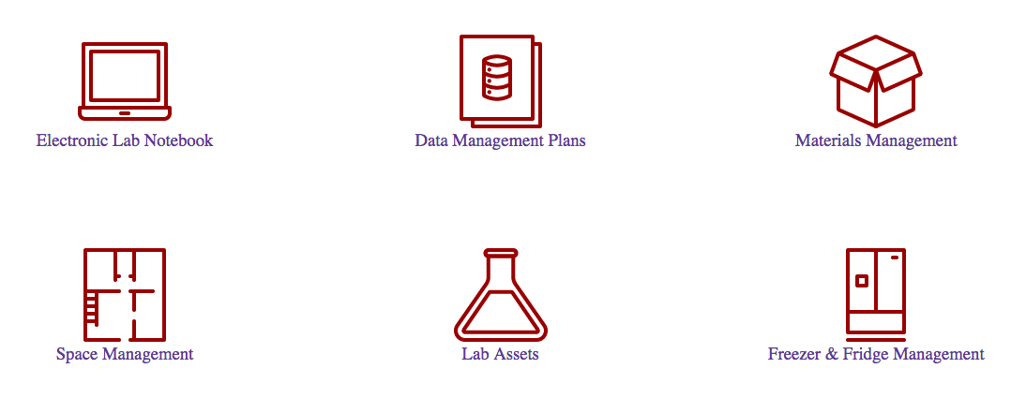
Whole scope of Information Management

Slide 6
Why a DMP requirement?
“Our new Data Management Plan Program is strengthening the integrity and usability of our data and research and strongly positioning IU School of Medicine for the changes taking place at the national level.”
--Anantha Shekhar, MD, PHD, Executive Associate Dean for Research Affairs
Requirement of Data Management Plan (DMPs) employed as a preventative measure to:
Guard against research misconduct
Prevent repayments to funders due to misconduct finding
Prevent retractions
Better align with funder requirements coming

Slide 7
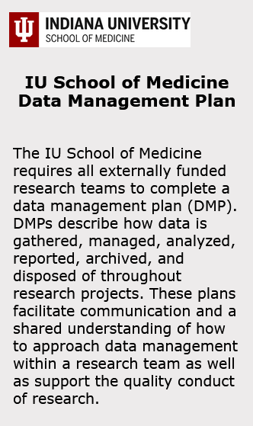
Version 1 considerations
PI-based or Award/project-based
Scope: Externally funded-what does that mean?
  Federal/private/NIH only
  Certain dollar amount
Platform

Slide 8
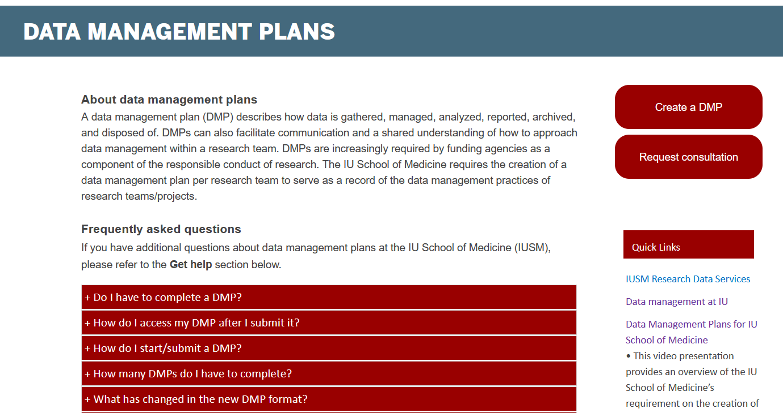
Version 1 behind the scenes
Website
FAQs
Blank Template
Video Walkthrough
Communications Plan
https://mednet.iu.edu/RLO/Pages/dmp.aspx

Slide 9

Version 1 Roll Out
Deadline to submit DMP—March 31, 2020
  Communicated twice in the School’s weekly newsletter
Updated Deadline—August 31, 2020
  Bcc’ed faculty still needing to submit
Updated Deadline—January 21, 2021
  Individually emailed faculty, copied Research Affairs, Vice Chair for Administration and Finance, Vice Chair for Research
  Priority clearly on PIs with active NIH awards
Image: Car by Pencil from the Noun Project

Slide 10

Observations from Version 1 Roll Out
Confusion in “who” this DMP requirement applied to
Priorities for many shifted in March of 2020
Personnel section was a pain point in the form
Communication with individual departments to keep up to date lists
Image: observation by tezar tantular from the Noun Project

Slide 11
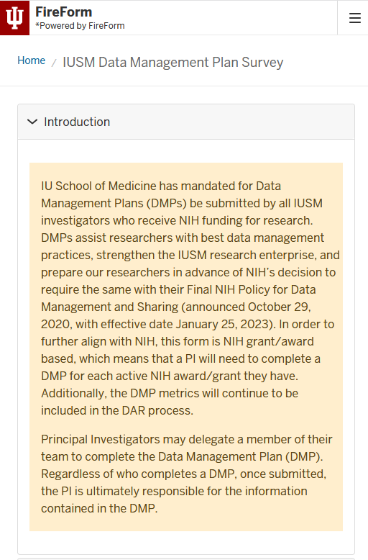
Changes for Version 2
Award-based!
Scope: ALL federal, no VA, Direct and
  Pass Through Open Accounts
Platform change!
  APIs and dynamically-generated data
  Hopefully address personnel pain point

Slide 12
Lessons Learned/Next Steps
Collaborate with institutional folks – ORA, Research Affairs, IT
Communicate – Involve someone with expertise on venues, timing, and language (e.g., marketing and communication department)
  Customize message to research faculty to promote their ROI
Create a model that will survive changes in leadership and advisory board (i.e. tied to school or institutional goals/values)
Align institutional requirements with upcoming national requirements (e.g., Final NIH Policy for Data Sharing and Management)

Slide 13

Thank you!
ewhipple@iu.edu | 0000-0002-0103-6318
grrios@iu.edu | 0000-0002-4479-8670

