Slide 1
Building a sustainable future for academic libraries:
How business librarians can help

Slide 2

Hello!
Slides Available at: http://hdl.handle.net/1805/25706
I AM KATHARINE V. MACY
Subject Liaison to Business & Economics /
Collection Assessment Librarian
IUPUI University Library
Twitter: @kvmacy upui.edu
ORCID ID: 0000-0002-6283-7143
Notes:
Thank you Rahn. Hello! I want to thank SOUCABL for inviting me here today and especially Sheila Devaney who has worked so tirelessly to make sure this conference is successful. I’ve known her since I was an MBA student at Kenan-Flagler Business School, where she was my business librarian and she inspired me to make a change in my own life’s path several years later. Business librarianship is my second career after spending more than a decade in business analyst roles working in marketing, sales, operations, and finance.
I graduated with my MBA in 2008 and was one of the lucky ones. Despite being almost immediately laid off, I landed on my feet being hired at a paper mill which had been operating in the red having previously been used as a tax write off by the prior owners who generated their profits from their timberlands and had a history of hurting people. I was one of several people hired to come in and help turn that business into a profitable enterprise that prioritized safety and the environment. We as an organization were successful at making it one of the most profitable mills in North America.
While in that role I realized my favorite part of my job was helping people find, understand, and use business information for data-driven decision making. Understanding this, led me to decide to go back to library school. I wanted to teach business information literacy and help other business students think through the information and data they find and use it in an ethical manner. I also discovered that I desired to support academic libraries move toward sustainability considering the dynamics and challenges facing higher education and libraries today. I strongly believe that as business librarians we can help move our entire organizations forward so we can ensure the work provided by all academic librarians is valued.

Slide 3
Academic libraries aren’t a business!
1
Yes, we know…but we can still learn from them.
Notes:
How many of you have heard this when trying to present an idea to your organizations?
I know I have.
A lot of people within academic libraries are distrustful of the business discipline due to fear of neoliberal principles and supporting capitalistic structures that have created systematic oppression. Many of our colleagues fear that libraries becoming solely about budgets and not valuing the important scholarly work that is happening within the university.
They are right in that academic libraries are not a business. However, you do not through away an entire social science that provides insights that can help us ensure our continued existence within higher education. There are useful information, data, research that can help us address the real challenges facing academic libraries and business librarians can help connect the entire library to this information whether via our expertise, our resources, or the people we know.

Slide 4
Not quite as cool as People Planet Profits but we are libraries.
People
Planet
Fiscal Management
Triple Bottom Line – Library Edition
Notes:
Triple bottom line was a concept coined John Elkington that refers to evaluating sustainability of a business by looking at people (social impact), planet (environmental impact), and profits (fiscal) impact. It is the model that was important when I worked at the paper mill.
Academic libraries aren’t about a profit or loss because we aren’t a business. But we are about responsible fiscal management. If we take care of our people, which includes ensuring University or College administration understand the value the library and its staff provide the entire community and that the library is not just about a building with books and databases, while fiscally managing our organization so we remain in budget with a look toward the long-term, we will be supporting our planet through ensuring scholarly collaboration through initiatives like open access, open data, and open science. I’m honestly still blown away when I think about the impact libraries and library professionals had in finding a COVID-19 vaccine within a year. Our organizations supported this by building necessary infrastructure. We can continue to do this solve other global issues, as long as we can demonstrate our value so that we maintain our budgets and our people.

Slide 5
Source: Survey study of Big Ten librarians and library staff in management positions in 2017 conducted by Heather A. Howard (Purdue University) and Katharine V. Macy (IUPUI)
Notes:
My colleague Heather Howard at Purdue and I conducted a survey study in 2017 using the skillsets and knowledge areas outlined in the AACSB 2013 standards to determine in what areas people particularly desire management skill and knowledge development. At the top is financial analysis & reporting, evidence-based decision making, organizational systems and processes. As business librarians we can connect those in library administration and management roles to resources to help develop these skills. I think many librarians and staff feel like budgets happen in a black box and financial transparency is lacking. However, I strongly believe when the entire organization understands their impact and how they fit into the larger scheme of operating the library we can all understand how our individual decisions contribute. It also allows for new and innovative ideas to generate from those throughout the ranks within our organizations.

Slide 6
Houston, we have a problem!
2
Academic libraries need change to ensure sustainability
Notes:
And we need creative solutions. We need to change if we want to thrive within higher education and support the larger education and research missions.

Slide 7
2%
5-6%
52.7%
5-YR CAGR of Collection Budgets(IPEDS data for FY2019 Doctoral and Masters granting institutions)
Projected annual increase for journal content (Library Journal 2020). A significant gap!
Portion of library budget spent on electronic materials at academic institutions. (Almanac 2018)
Notes:
First let’s talk about one of the biggest issues threatening our sustainability in supporting our research mission. Last week I pulled data on those classified as doctoral and masters granting institutions in the US. On average collection budgets have only grown 2% a year. And many of us are experiencing flat or declining budget as of FY2019. Then 2020 hit and faced significant budget cuts. Now we got a little relief in some vendors offering lower price increases or perhaps no increase this past year, but despite that the project annual increase of journal content still remains at between 5-6%...and it’s been closer to 6% for quite a long time. This is a problem, especially when over 50% of our budgets tend to support electronic materials. So to manage this gap, we have had to cut services and people.
I keep going back to what happened with COVID-19. How open science supported that work. Libraries contributed to that, through it’s people doing the hard work of building infrastructure that enable people across the world to access content. Academic libraries are facing an operations problem centered on how we as librarians manage procurement or our resources.

Slide 8
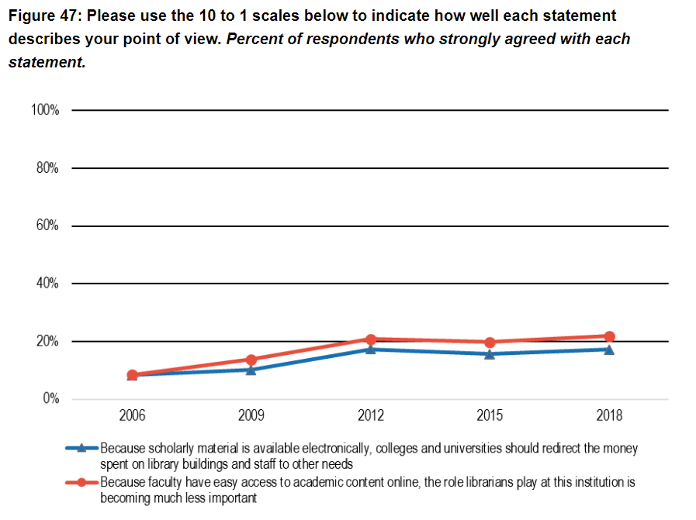
(Ithaka S+R US Faculty Survey 2018)
Notes:
We also have a perception issue. In the Ithaka S+R faculty survey almost 20% of faculty do not understand the value librarians and staff provide their institutions in regards to supporting research.

Slide 9
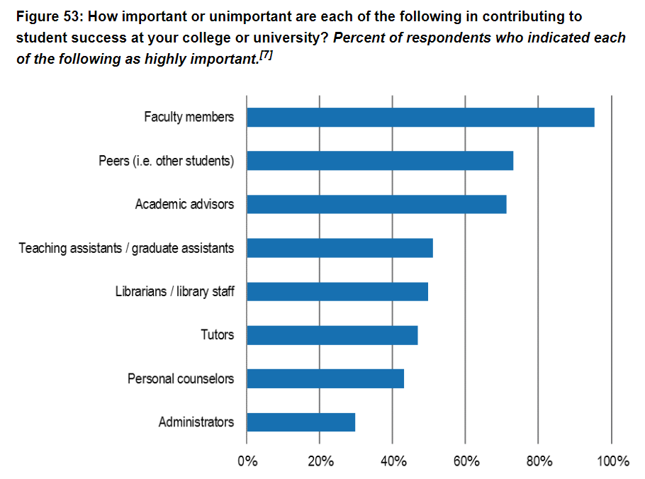
(Ithaka S+R US Faculty Survey 2018)
Notes:
This same survey showed about 50% of faculty do not think librarians/library staff are highly important to student success. Academic libraries have a significant marketing and communications problem.

Slide 10
What does teaching information literacy look like in a post-fact algorithmic driven information world?
Notes:
Now to make things extra-hard, we are having an existential crisis around information literacies and what teaching that means within academic libraries. We need to figure out what teaching these literacies look like in a post-fact algorithmic driven information world?
These past few slides are not meant to be a bummer. I want them to energize us because I think that

Slide 11
Business Librarians
4
The intellegence asset every academic library deserves
Notes:
Business librarians are the intelligence asset that every academic library deserves. They might not know they need us yet, but they deserve us and I think we can help address these real issues as we sit on committees, talk to our administrations both within libraries and at the larger campus level. I hope this can be a call to action for us all to inspire us in ensuring the future of academic libraries within our institutions. I want to provide you ideas on where we may be able to contribute.

Slide 12
Using business information, academic libraries can create relative bargaining power within scholarly publishing and business analytics can be used to support our libraries’ values.
Notes:
Business information in academic libraries can create relative bargaining power when working with our e-resource vendors and using business analytics can help us make evidence-informed decisions that support the values of our library organizations. I have written about or spoken about these things. And my organization is doing both collaboratively (it’s not just on my shoulders).

Slide 13
Connecting Porter’s Five Forces to Resource Evaluation & Negotiations
Analyzing price sensitivity!
Industry analysis and competitive intelligence
Some cool free resources from SPARC
    Big Deal Knowledge Base
    SPARC Landscape Analysis
    Coming Soon: Journal Negotiations Toolkit!
(Porter 2008, Macy 2018)
Notes:
One way that we can do this is to connect business theory to our work. For instance, Porter’s Five Forces analysis can be useful in understanding scholarly publishing industry. Understanding both the drivers of the larger industry by finding market research and business analysis, as well as analyzing our own price sensitivity for particular resources is incredibly useful for creating relative bargaining power and planning negotiations. It will allow academic libraries to build sustainable relationships with vendors.
I’d like to take a moment to point out some cool free resources that are available to help with this external industry analysis work offered by SPARC, the Scholarly Publishing and Academic Resources Coalition. The Big Deal Knowledge base tracks existing big deals, cancellations of big deals, and contracts. The Landscape Analysis is an industry report analyzing the financials and economics within the industry. Soon SPARC will release a new website centered on journal negotiations that focuses on providing tools to support analysis (I’ve been coleading this work), stakeholder communications, reinvestment strategies, and measuring impact.

Slide 14
Collection Scorecard 2.0*
*Fake data
Notes:
Within my own library I helped design a tool that brings together data from multiple sources to help us understand price sensitivity for a given resource. The data gathered also can be aggregated so we can understand how a resource fits into collection allowing for holistic collection assessment.
We gather quantitative and qualitative data that helps us understand history as well as the local context as to how a source is used. It helps us understand what is unique, duplicated, how much we have shown price sensitivity, what impact it has on the larger collection. It uses business analysis techniques like pareto analysis to understand how much impact a change in price might have our budgets. We are able to prioritize whether or not we should use our limited people and time to renegotiate.

Slide 15
How Business Librarians Can Help
Connect librarians and staff involved in negotiations with up-to-date information on vendors, the industry, and key business analysis frameworks such as Porter’s Five Forces
Help library personnel understand the business information available
Help prepare secondary data, news, and other business information that can be useful when negotiating significant contracts.
Notes:
Business librarians can help academic libraries find sustainability by connecting librarians and staff involved in negotiations with market research, company profiles and news for vendors, as well as help connect these staff with business analysis frameworks such as Porter’s Five Forces to develop analysis and tools to help assess collections and plan for negotiations.
We can also help our managers and administration understand the information available. Many people in administration do not necessarily have business backgrounds so understanding the financial and economic information published in reports such as SPARC’s landscape analysis may be more difficult. Consider perhaps bringing library administrators together when reports like this are published to read through and discuss, help them find answers to questions – like why did the IPO for Springer/Nature failed in 2018.
When negotiations are actively happening be willing to help prepare a portfolio of data on companies involved in the negotiation that can help the negotiation team.

Slide 16
PIL’s Information Literacy in the Age of Algorithms
Key Takeaways from PIL’s research:
College students have an ambivalent bond with algorithm-driven platforms
Students use defensive practices to protect their privacy
Trust is dead for many students, and skepticism lives
Discussions of algorithms rarely make it into the classroom
Project Information Literacy (2020)
Notes:
Another issue is the changing information landscape complicating how we teach information literacies. Project Information Literacy report Information in the Age of Algorithms had 4 key takeaway.
College students have an ambivalent bond with algorithm-driven platforms. They don’t remember life without smart phones or Google. For them it’s their normal and part of what needs to happen to have the services they have come to expect.
Students do use defensive practices to protect their privacy. However due to their ambivalence they may not really understand how intrusive platform technologies are in their lives.
Trust is dead for many students and they are skeptical of everything including traditional information platforms such as scholarly research. However, they do rely on their social networks for information. And the information bubbles created by algorithms on social media platforms reinforces belief systems and knowledge practices as explained by Chatman’s Small Worlds theory
Lastly, discussions of algorithms rarely make it into the classroom.

Slide 17
There’s no doubt that it will be difficult to shift the information-literacy narrative from an emphasis on finding, evaluating, and using information in an academic setting to something that addresses a broader understanding of how information flows through systems. Our information systems operate in a complex world in which messages take root in dark corners and spread rhizomatically through connections that are usually hidden from view, a world in which power users discover hacks to trip up algorithmic systems in ways the authors of the algorithms failed to anticipate, a world in which the rules of the game change constantly while the consequences of systems designed to share information virally pose a serious threat to democracy.
- Barbara Fister in The Atlantic
Notes:
Barbara Fister in a recent essay published in The Atlantic states, “There’s no doubt that it will be difficult to shift the information-literacy narrative from an emphasis on finding, evaluating, and using information in an academic setting to something that addresses a broader understanding of how information flows through systems. Our information systems operate in a complex world in which messages take root in dark corners and spread rhizomatically through connections that are usually hidden from view, a world in which power users discover hacks to trip up algorithmic systems in ways the authors of the algorithms failed to anticipate, a world in which the rules of the game change constantly while the consequences of systems designed to share information virally pose a serious threat to democracy.”
We have to rethink how information literacies are taught on college campuses.

Slide 18
How Business Librarians Can Help
How information flows in today’s world is easily tied to business practices and concepts which can be used in business classrooms.
We can find examples of algorithms use in practice and share beyond the business classroom.
Business resources can be used to show how personal information is aggregated (e.g. Data Axle’s Reference Solutions) all academic classrooms
We can share lesson plans we’ve created on centered social media and evaluating non-scholarly resources.
Notes:
But business librarians can help. One of the findings is that algorithms rarely are discussed in the classroom.
However, I would argue because of the nature of business information, many of us have been thinking about and discussing algorithms for years. As business librarians we can tie information flow in today’s world to business practices and concepts within our own business classrooms. Viral marketing, guerrilla marketing, business communication. We can find real life case studies that can be applied in the classroom. I often use anecdotes and business examples such as discussing how Pokemon Go really can make money by using big data on it’s users, package it up to understand pedestrian patterns and sell to marketing companies wishing to optimize signage, advertising, and promotions.
These examples can be used beyond the business classroom to understand the power of information and how it can influence things we encounter in our daily lives including our commutes home.
We can use available resources to show how personal information can be aggregated. I use the US Consumers database in Data Axle’s Reference Solutions to show how information on individuals who have shown interest in dogs as pets in Indianapolis. We can locate contact information, demographics, and social information social information that can be used in targeting marketing.
We have existing lesson plans focused on social media and evaluating non-scholarly resources – which are relied upon in the business classroom, These can be adapted and shared and with other disciplinary colleagues so that they may help teach about how information flows, privacy, and the impact of algorithms as well as traditional information literacy skills such as resource evaluation.

Slide 19
How is the value of an academic library determined?
Notes:
Lastly I want to discuss how value for academic libraries are determined. Are we a building full of books? Are we the people providing the support services to ensure access to the building of books? Or are we about connecting ideas and information with involves facilities, resources (physical and electronic), and the people who enable the access. I believe we are that final option, but we have a messaging issue.

Slide 20
Explaining Our Value to Stakeholders
Changing how libraries approach resource negotiations for materials that meet our community’s needs
Teaching information literacy with nimbleness within an evolving information landscape
Forming connections to resources and people
Notes:
We need to change how we approach resource negotiations for materials so that we do so to ensure sustainable vendor relationships while meeting our communities needs. Then we need to make sure that our key stakeholders understand that our people are critical for making this happen.
We need to remain nimble in teaching the different information literacies as the information landscape evolves so our students see the relevance of different types of information through all aspects of their lives.
We as academic libraries are there to form connections of people to resources which may be a physical book, and electronic database, or other people to support research teaching and learning.

Slide 21
How Business Librarians Can Help
Help managers within libraries find management resources.
  Books, databases, and people
Use your expertise, for instance…
  Data visualization of library assessment data
  Competitive intelligence of e-resource vendors and scholarly publishing
  Interdisciplinary lesson plans
Notes:
Business librarians can help this by helping library managers find management resources. We can use our own expertise to help take steps forward toward sustainability and craft messaging around our value to achieving the educational and research missions of our organizations.

Slide 22
Concluding Thoughts
5
Notes:
So I’ve covered a lot. Are any of you feeling overwhelmed? I know I do at times. Some of you may be thinking these are interesting ideas, but honestly I’m a bit overworked and under-resourced. You may be thinking I know how to help with some of these actions presented but I don’t really know much about….[fill in your blank].
The intention of this talk is not to walk away burdened with a giant to do list and areas that you think you need to develop. Rather it is to provide inspiration, and ideas on how you can look at your own practice as a business librarian and see how you might be able to help build a sustainable future for the academic library. Doing any one of the actions I’ve discussed moves us all forward.
Sustainability is also about people and groups and collaboration. We, as business librarians, are connectors who can help our own colleagues work toward a sustainable future, while managing our own bandwidths. We must take care and not just carry the weight on our own narrow shoulders. This is important meaningful work that cannot be done alone. However we can help our organizations to meet the challenges faced. 2020 was full of challenges and problems, that for academic librarians largely required managerial solutions. It put a spotlight on existing issues that we need to address.
Honestly, I’m here for this work – figuring out how to develop our organizational process and people for a better future and the promise that supporting our institution’s research and teaching missions brings.

Slide 23
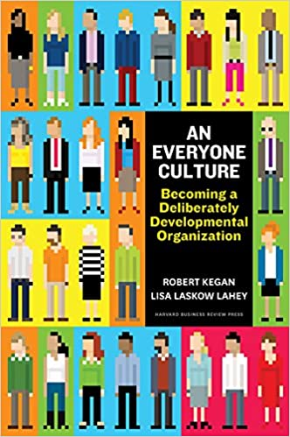
Business Book Recommendation
Notes:
Perhaps your first step is to just find a book to recommend to your organization to read and discuss. With that here is a book that benefited my own organization. An Everyone Culture by Robert Kegan and Lisa Laskow Lahey
I will be putting a discussion question up on the conference site where I’d love to hear about what management books you’d recommend academic library organizations read to build a better, sustainable future.

Slide 24
References
Almanac. (2018). “Library Spending, by Sector, 2015-16.” The Chronical of Higher Education, available at: http://www.chronicle.com/article/Library-Spending-by-Sector/244160 (accessed 17 October 2018)
Algorithm Study (January 15, 2020) – Project Information Literacy. (n.d.). Retrieved April 20, 2021, from https://projectinfolit.org/publications/algorithm-study/
Blankstein, M., & Wolff-Eisenberg, C. (2019, April 12). Ithaka S+R US Faculty Survey 2018. https://doi.org/10.18665/sr.311199
Fister, B. (2021, February 18). How Librarians Can Fight QAnon—The Atlantic. The Atlantic. https://www.theatlantic.com/education/archive/2021/02/how-librarians-can-fight-qanon/618047/
The Integrated Postsecondary Education Data System. (n.d.). Retrieved April 20, 2021, from https://nces.ed.gov/ipeds/
Macy, K.V. (2018). Information creates relative bargaining power in vendor negotiations. The Bottom Line, 31(2), 137-149. https://doi.org/10.1108/BL-12-2017-0033
Porter, M. E. (2008), “The five competitive forces that shape strategy”, Harvard Business Review, Vol. 86 No. 1, pp. 78–93
Romaine, S. B., Barbara Albee, &. Sion. (n.d.). Costs Outstrip Library Budgets | Periodicals Price Survey 2020. Library Journal. Retrieved April 18, 2021, from https://www.libraryjournal.com?detailStory=Costs-Outstrip-Library-Budgets-Periodicals-Price-Survey-2020
This slide template is made available for free via a creative commons license. Presentation template by SlidesCarnival

