Slide 1
Text KMACY731 once to 22333 to join, then text your message
Or respond at PollEv.com/kmacy731
How do you feel about negotiations?
Respond as many times as you like.
Notes:
While waiting for the meeting to kick off put up this slide or provide this information in the chat.

Slide 2
Negotiate Like An MBA:
How to conduct principled negotiations for library resources
Virtual Workshop Day 1
Notes:
Welcome to Negotiate Like An MBA: how to conduct principled negotiations for library resources. Today is day 1 of this 3 day virtual workshop.

Slide 3
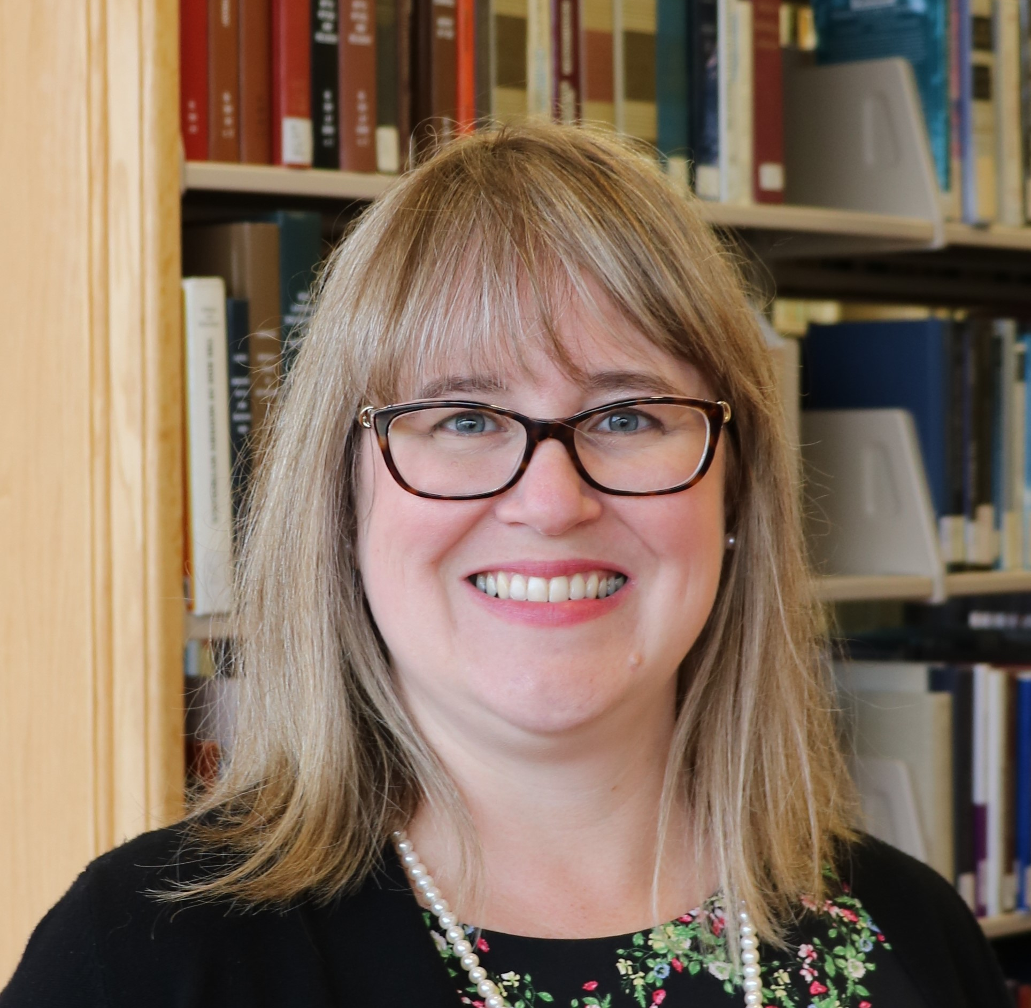
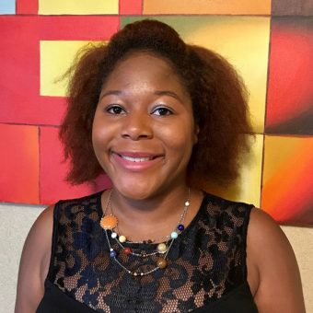
Mahasin Ameen MLIS
TEACHING & INSTRUCTION LIBRARIAN
mameen@iupui.edu
Twitter: @fivefootsmall
ORCID https://orcid.org/0000-0002-8640-4334
Katharine V. Macy, MBA, MLIS
COLLECTION ASSESSMENT LIBRARIAN
macyk@iupui.edu
Twitter: @kvmacy
ORCID https://orcid.org/0000-0002-6283-7143
Indiana University – Purdue University Indianapolis University Library
Notes:
We introduce ourselves.

Slide 4
YOUR EXPERIENCES
1
Poll Everywhere
Notes:
Share the Poll
Level set – how this workshop will address issues identified in word cloud
Today, we’ll give you a crash course on principled negotiation and best practices. During this session you will be paired up and prepare and execute a simple negotiation for a job offer to practice the skills we are discussing before we discuss your homework to prepare for day 2.
On Day 2 and 3 you will start each session by being put into a breakout room with another workshop attendee where you will have 30 minutes to negotiate a library case study. This will be followed by a debrief on the negotiation itself so that we can learn from each other.
Following that will provide additional negotiation best practices.

Slide 5
PRINCIPLED NEGOTIATIONS
2
Striving for Mutual Gain
Notes:
First off, I want to cover what it means to conduct a principled negotiation that strives for mutual gain in order to do that though we should discuss the two traditional roles that we want to move away from…

Slide 6
TYPES OF NEGOTIATORS – Two Traditional Roles
SOFT
Focuses on position
“Friends”
Values agreement
More likely to make concessions to avoid conflict
Yields to pressure
Too much trust
HARD
Focuses on position
Adversaries
Needs to “win”
Demands concessions to maintain relationship
Applies pressure
Distrustful
Fisher, R., Ury, W., & Patton, B. (1991). Getting to Yes: Negotiating Agreement Without Giving In (2nd ed.). New York: Houghton Mifflin Company.
Notes:
These roles are as soft and hard negotiators
Soft and hard negotiators both focuses on position and how the individuals are viewed as a result of the negotiation. It tends to turn things personal where there are more winners and losers and a higher likelihood of at least one party being highly dissatisfied.
Soft negotiators want to be viewed as friends with who they negotiate with and highly value agreement. They are much more likely to concede things they would rather not in order to find agreement. They tend to yield to pressure and trust too much.
Meanwhile hard negotiators are all about winning and view the other side as an adversary. They demand concessions to maintain the relationship and applies pressure and are distrustful of the other side.
I think we can all think of negotiations we’ve witnessed with soft and hard negotiators. I believe as librarians the high need to people please can lead us to being soft negotiators and when we encounter vendors who are hard negotiators it helps perpetuate the angst we feel when trying to ask for the things we really need in order to sustainably manage access to our collections.

Slide 7
A Third Way – The Principled Negotiator
PRINCIPLED
Focuses on interests
Relationships based on trust, empathy, and respect.
Sustainability
Not about the money, it’s about the utility!
Allows negotiators to adjust tactics
Fisher, R., Ury, W., & Patton, B. (1991). Getting to Yes: Negotiating Agreement Without Giving In (2nd ed.). New York: Houghton Mifflin Company.
Notes:
There is a third way, which is to approach negotiations as a principled negotiator. Principled negotiators work to not make it about their positions. You aren’t trying to be friends but you also aren’t adversaries. Instead this type of negotiator is focusing on the interests of both parties to try to come to a mutual agreement. This requires preparation and planning. It also means working to build a relationship based on trust, empathy, and respect. It’s about working toward a sustainable partnership. It’s not about the money but the utility. Value in a agreement is not just about the final dollar amount. It also allows those negotiating to adjust tactics to find a mutually satisfying agreement.

Slide 8
PRINCIPLED NEGOTIATORS
“Problem-solvers seeking a win/win situation…Hard on the issues, but soft on the approach to people”
Crawford, A. R. (2008). Licensing and Negotiations for Electronic Content. Resource Sharing & Information Networks, 19(1/2), 15–38. https://doi.org/10.1080/07377790802498523
Notes:
Amy Crawford stated in her article that “Principled negotiators are problem-solvers seeking a win/win situation…they are hard on the issues, but soft on the approach to people.”

Slide 9
FOUR ELEMENTS OF PRINCIPLED NEGOTIATION
People | Separate the people from the problem
Interests | Focus on interests, not positions
Options | Invent multiple options looking for mutual gains before deciding what to do
Criteria | Insist that the result be based on some objective standard
Fisher, R., Ury, W., & Patton, B. (1991). Getting to Yes: Negotiating Agreement Without Giving In (2nd ed.). New York: Houghton Mifflin Company.
Notes:
Fisher, Ury, and Patton in their classic Getting to Yes: Negotiating Agreement Without Giving In state that there are four elements of principled negation.
People – separate the people (and the personalities) from the problem
Interests – Focus on the interests of both parties, not positions. You don’t need to come out friends, but you aren’t adversaries either
Options – Invent multiple options looking for mutual gains before deciding what to do
Criteria – Insist that result be based on some objective standard – is there a way where you can value the options you present?

Slide 10
STRUCTURE OF NEGOTIATIONS
3
MOST OF THE WORK GOES INTO PHASE 1!
Notes:
To plan for a principled negotiation, you need to understand the structure of negotiations. And know that the majority of the work often occurs in phase 1. This is very true for traditional collection licensing deals.

Slide 11
STRUCTURE OF NEGOTATIONS
Pre-Game
Initiating and maintaining relationships
Preparation for the negotiations
In principled negotiations, this is where the most time is spent!
Game
The negotiation
Plan what strategies you can use during the negotiation in pre-game!
Post-Game
Following up and maintaining relationships
TRUST!
Thompson, L. (2013). The truth about negotiations. New Jersey: Pearson Education.
Notes:
There are three phases. Phase 1 where most of your work will occur in traditional resource licensing is the Pre-Game. This is where you initiate and establish relationships with your vendors and prepare a negotiation strategy. The second phase is the Game. The negotiation itself. This of this like chess. You execute your planned options and strategies you developed in the pre-game. Be prepared though that if you are ever negotiation a complex deal such as a transformative agreement you may need to occasional update your pre-game work during the game on information you find. The third and final phase of the negotiation is the follow up on your agreement and maintain your relationships, fostering trust.

Slide 12
PRE-GAME
4
The bulk of the effort!
Notes:
The pre-game is where the bulk of the effort should occur when planning a negotiation.

Slide 13
PRE-GAME PROCESS
Build & maintain relationships – Trust!
Collect & analyze data
Plan your negotiation strategies
Notes:
The first step is the build and maintain relationship. Build the foundation of trust through touching base with your vendor reps at conferences, annual meetings with the rep to discuss their resources (learn latest and greatest, discuss challenges, etc.) Having a prior relationship helps smooth the way to focus on interests. The second step is to collect and analyze data about the resource you are negotiating over as well as the vendor itself. Once this is complete you plan your negotiation strategies.

Slide 14

PREPARATION THAT DOES NOT WORK!
Psyching up!
It makes the negotiation more personal and makes the focus positional.
Image by rubyblossom
Thompson, L. (2013). The truth about negotiations. New Jersey: Pearson Education.
Notes:
The research is in and something that does not work is Psyching Up! It makes the negotiation personal and focus positional and not on interests. Whether or not you succeed becomes your identity! If things don’t go well or the way you want, then you feel bad about it.

Slide 15
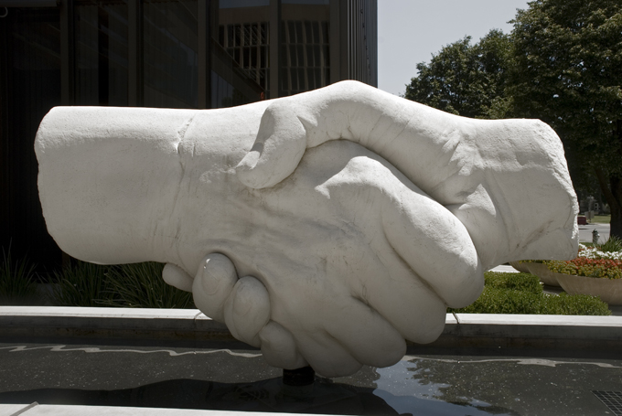
PREPARATION THAT DOES WORK
Planning that considers both parties’ interests
Image by Nicola Barnett
Notes:
What does work….preparation through analysis and planning strategies that considers both parties’ interests.

Slide 16
Own Your Terms
5
Negotiation Planning Vocabulary
Notes:
Pun intended
To plan for negotiation, it’s important to know certain negotiation concepts and vocabulary.

Slide 17
BATNA
Best Alternative to Negotiated Agreement
Notes:
What you would do if you fail to reach a negotiated agreement.
For vendor resources this may be to cancel
You always have a BATNA even if you don’t like it.
If you are unhappy but resubscribe to a resource it means you’ve reached agreement. What you need to do now is work to improve your BATNA by looking for alternatives, perhaps getting stakeholders on board to making the hard decision.
Be careful to not reveal your BATNA early, if at all.
During the negotiation you don’t want to reveal your BATNA (unless you have absolutely reached an impass) but you can signal at your BATNA. Don’t lie about your BATNA. I you say you walk away point is X but it is really Z and they talk you down to Z you will have a difficult time in future negotiations. The other party may ask about your walk away point – divert them away from this by emphasizing you are negotiating for the entire value of the package which can include other things such as support, authorized user access, removing NDAs, fixing price increases, etc.
BATNA can change over time. Open Access, PDA, and AOD is allowing libraries to change their BATNAs
Don’t just determine your own BATNA, research your other party’s. Are subscriptions down, sales flat, are there new competitive products….

Slide 18
Reservation Price
$
The bottom line, the point in the negotiation where you can go either way. Informed by the BATNA.
Notes:
The bottom line. The point in the negotiation where you could find agreement or go with your BATNA. It is often determined by your BATNA. Don’t reveal this.

Slide 19
ZOPA
Zone of Possible Agreement
$10,000
Min
Seller
$12,500
Max Buyer
Spangler, B. (2003). Zone of Possible Agreement (ZOPA). In Beyond Intractability. Retrieved from http://www.beyondintractability.org/essay/zopa
Notes:
The zone of possible agreement. The minimum the seller is willing to sell, and the maximum the buyer is willing to pay. Try to predict during preparation but be willing to adjust as you learn more information during the active phase of the negotiation.

Slide 20
CONCESSIONS
What you are willing to give up
Notes:
Plan carefully, or you risk giving up too much. Be sure to fully explore the interests.
Points the parties are willing to give up or compromise on in order to find agreement. Plan these carefully and when you will give them up, so you don’t give too much away. Generally speaking it’s good to plan in room for concessions.

Slide 21
PLANNING YOUR NEGOTIATION
Internal review – Determining your interests
Price sensitivity to the resource
Licensing requirements
  Library policy
  University policy
Other considerations
  Accessibility
Notes:
When planning your negotiation a place to start is an internal review that plans your own interests.
-Examine your price sensitivity to the resource (I’ll explain that in a bit!)
-What are your licensing requirements. Be sure to know Library and University policy.
-Are there other considerations such accessibility?
You must know what is important to you and think through priorities and value.

Slide 22
PRICE SENSITIVITY
The extent to which buyers are sensitive to price increases.
Porter, M. E. (2008), “The five competitive forces that shape strategy”, Harvard Business Review, Vol. 86 No. 1, pp. 78–93.
Notes:
Price sensitivity is the eBe careful to not reveal this early, if at all extent to which buyers are sensitive to price increases. Libraries historical shown to be not price sensitive because we have accepted price increases, lately on average of 5-6% while our budgets are flat or decreasing. As a result we cut programs and people. However, analyzing price sensitivity allows us to think about the value of the resource within our community. It allows us to find options to create relative bargaining power when conducting negotiations.

Slide 23
PRICE SENSITIVITY FACTOR METRICS
Price Sensitivity Factor | Metric
Proportion of total cost | Portion of spend
The level of differentiation between products | Content coverage (i.e. overlaps, uniqueness)
The importance of product/service to the buyer for offering a quality service or product to their own customers | Cost per use Cost per citation Stakeholder use in research or teaching (curriculum) Uniqueness within the collection Consortia agreements
The level of competition among end users (customers) | Competitive products Substitutes
Macy, K.V. (2018). Information creates relative bargaining power in vendor negotiations. The Bottom Line, 31(2), 137-149. https://doi.org/10.1108/BL-12-2017-0033
Notes:
The first factor is the proportion of total cost this can be determined by understanding a resource’s portion of the total collection spend.
The second factor is the level of differentiation between products. This is where understanding a resources content coverage, how it overlaps or is unique, is helpful.
The third factor is the importance of a product/service to the buyer for offering a quality service or product to their own customers. So this is about how important is the resource we are buying for us to be able to serve our patrons. Metrics that helps us understand this factor are cost/use, cost per citation, stakeholder use in research or teaching (curriculum), uniqueness within the collection or in the world (archives), and consortia agreements.
The final factor is the level of competition among end users (customers). This is the hardest one for many to wrap their arms around. A good example is the encyclopedia market. A competitive product from recent years is Wikipedia, which is gaining our users attention and completely diverting users from using library services for this type of information. Another example is users getting news information from Twitter or Facebook as opposed to traditional sources. Understanding competitive products and substitutes that our patrons may use in or outside the library to meet an information need helps us understand this factor.

Slide 24

LICENSING REQUIREMENTS - EXAMPLES
AUTHORIZED USE / RESTRICTIONS
How the database may be used. Often specifies not for commercial purposes.
PRICING AND TERM
May also include information on renewal and pricing at renewal. May include clauses to fix price increases.
TERMINATION
Clause specifies how vendor may terminate the contract if customer is in violation. It is in the customer’s best interest to be well defined.
👪
AUTHORIZED USERS
This includes specifying whether walk-ins have access to the resource.
NDAs/ CONFIDENTIALITY
Non-disclosure agreements on pricing. Vendors often want these, while libraries do not.
Other Terms
Product updates, Performance, Payment, Force Majeure, Applicable Law, Dispute Resolution, Indemnification, Entire Understanding, Amendment, Enforceability, Severability
Crawford, A. R. (2008). Licensing and Negotiations for Electronic Content. Resource Sharing & Information Networks, 19(1/2), 15–38. https://doi.org/10.1080/07377790802498523
Notes:
Examples of licensing requirements you ant to consider are:
Authorized use/ restrictions – how it is used and often specifies for academic and not commercial purposes
Authorized users – important to address particular if you want to offer walk-in access
Pricing and term – includes renewal information and pricing at renewal. Can you fix price increases? Does the subscription roll over automatically?
NDAs/Confidentiality – Non-disclosure agreements often focused on institutional pricing. Vendors want these, Libraries don’t.
Termination – Clauses specifies how vendor may terminate the contract if customer is in violation. It is in our best interest to clearly define this.
There are also several other terms you may desire to negotiate. For us personally, I know applicable law is one of those.

Slide 25
PLANNING YOUR NEGOTIATION
External review– Determine their interests
Financials
News & rumors
Competitive offerings (content and pricing)
Openly available pricing data
Price other acquisition models for content (e.g. on demand)
Notes:
It is also important to do an external review of your vendor to outline what you think their interests are. Information that can help:
Company financials
News & rumors (conference networking, online professional discussion groups can be great at gathering this)
Are there competitive offerings of similar products particularly for database resources (content and pricing)
Is there openly available pricing data?
What does the price and total cost of offering access to the resource via other acquisition models such as on demand

Slide 26
SUGGESTED DATABASES FOR RESEARCHING VENDORS
Bloomberg
Hoovers
Mergent Online
Factiva
Orbis
Privco
S&P Global Capital IQ or S&P Global Netadvantage
Article databases: ProQuest Central, Business Source Complete
Notes:
I have several business databases that are useful for finding information on vendors. I highly recommend reaching out to your business librarian they can help you find company and industry profiles. For smaller private companies: Hoovers, Orbis, and Privco are the most useful in my experience.

Slide 27
Awesome Free Resources Offered by SPARC!
Big Deal Knowledge Base
  Big Deal Tracker
  Contracts Library
  Cancellation Tracking
Landscape Analysis
  2021 Update
Data Analysis for Negotiations
Notes:
There are also awesomely available free resources offered by SPARC
The Big Deal Knowledge Base!
Big deal tracker has publicly available pricing on Big Deals of journal packages.
Contracts library is a repository of contracts so you can look for sample language
Cancellation tracking shows what universities have walked away from Big Deals.
The Landscape Analysis (published in 2018) and the 2021 update provides an industry analysis looking at finances and economics of scholarly communication. Again, I encourage that you reach out to your business librarian to understand information you have questions about within this report.
Data Analysis for Negotiations – a set of articles developed to help libraries analyze their collections and prepare for negotiations

Slide 28
KNOW YOUR POWER POSITION IN THE DEAL
Who is the target customer of the resource?
  Academic Resource vs Professional Practice
Can you benefit from consortia agreements?
  Agreements should increase your relative bargaining power
What are your alternatives?
  BATNA
  Competitive Landscape
What goals does this purchase help you achieve?
What values does it support?
Notes:
Doing both the internal and external review allows you then to think through your power position within the deal.
For the resource who is the target customer for that resource?
Is it an academic resource or used in professional practice? For instance the business database, Bloomberg, primary market is banks and financial institutions. The academic market is a secondary market so less power. However, the academic market provides training and is a very effective future sales mechanism so a bit of power is regained.
Can you benefit from consortia agreements? If negotiated effectively this will increase your relative bargaining power.
What are your alternatives?
Think through your BATNA and the competitive landscape
What goals does the purchase of this resource achieve?
Consider library goals, vision, strategy
Consider your institutional goals at departmental and university level
What values does this support? – This is the hardest. We have the ability to vote with our dollar as to what we accept. For example, if a vendor has a bad history with respecting privacy and that is important to us….we need to think about that.

Slide 29
Pre-Game When You Have Little Time
Identify Goals
Goals should reflect interests and explain why it’s important.
Brainstorm Options
What are your alternatives?
Plan Opening Move
Helps anchor your negotiation.
The why helps create solutions during negotiations.
What are
Represents ideal situation.
deal breakers
vs
deal makers?
Thompson, L. (2013). The truth about negotiations. New Jersey: Pearson Education.
Notes:
Sometimes you have less than an hour to plan (like today!) When you do have very little time what you want to do is
First identify your goals which should reflect your interests. Outline why these are important to you. Understanding why may help you create solutions during negotiations.
Brainstorm your alternatives and determine your BATNA. Are there any deal breakers or deal makers?
Plan your opening move. Opening moves anchor your negotiations and represents your ideal situation where you get everything your want.

Slide 30
THE GAME
6
Strategies to use during negotiations
Notes:
Now let’s talk about strategies you should plan for and use during actual negotiation.

Slide 31
FIRST OFFERS – ANCHORS YOUR POSITION
Your ideal offer that outlines
Price / Price Increases
Term
License Terms
Other (Support, Accessibility, Training)
Often vendors make first offer, trying to anchor changes in their favor. Libraries should determine value and derive a counteroffer when this happens. Or, when appropriate, be proactive by submitting a first offer based on determined value to the vendor.
Example: VIVA, Virginia’s Academic Library Consortium
Notes:
First offers anchor your position.
This should be your ideal offer that outlines price including price increases, term, desired licensing terms, and any other import aspect for your agreement. Often vendors make the first offer, trying to anchor changes in their favor. Libraries should determine the value and derive a counteroffer when that happens. But when appropriate, perhaps its time for us to be proactive and submit a first offer based on our determined value to the vendor. One example of this is the work that VIVA has done around planning journal negotiations for their consortia. There is an article about VIVA’s work in the resource list we are providing you with this workshop.

Slide 32
FRAMING
Plan carefully how you frame
Offers and counter offers
Concessions
Decisions can be framed as a win or a loss.
Remember humans are risk averse.
Notes:
Think about how you frame what you say around offers and counter offers and concessions. Decisions can be framed as a win or a loss and remember that humans are risk averse.
An example of framing something as a loss:
We need to keep prices flat but are willing to sign a two-year contract, otherwise we will only sign a 1-year agreement and based on our historical use which is declining we may be making the decision to cut this next year.
Now consider how this statement framed as a win. Perhaps:
We can sign a multiyear contract if you can meet us where we need to be for our budget. We are looking to keep price increases to 2%.
Can you hear the difference? Both could be useful depending on the conversations

Slide 33
NEGOTIATE ISSUES SIMULATANEOUSLY, NOT SEQUENTIALLY
The value of a deal is not just monetary
If you need to negotiate terms beyond pricing it’s best to do it simultaneously
Start with your ideal offer – where you win it all, knowing you will likely need to make concessions.
Plan concessions carefully and don’t reveal too early.
Thompson, L. (2013). The truth about negotiations. New Jersey: Pearson Education.
Notes:
Negotiate issues simultaneously, not sequentially,
The value of a deal is not just monetary
If you need to negotiate terms beyond pricing it’s best to do it simultaneously
Start with your ideal offer – where you win it all, knowing you will likely need to make concessions.
Plan concessions carefully and don’t reveal too early.
Doing this is particularly difficult when negotiating over email because often vendors try to address an issue at a time. It’s important to refocus the negotiation on the entire ask and that each piece brings value and must be considered holistically.

Slide 34
MAKE MULTIPLE OFFERS OF EQUIVALENT VALUE SIMULTANEOUSLY
Example
Willing to sign a 3-year contract
Determine value of contract with fixed price increase, fixed price per year, and pay all three years up front.
Determine what license concession you wish from the vendor depending on pricing agreement.
Thompson, L. (2013). The truth about negotiations. New Jersey: Pearson Education.
Notes:
Another offer is to make multiple offers of equivalent value at the same time. For example
Willing to sign a 3-year contract
Determine value of contract with fixed price increase, fixed price per year, and pay all three years up front.
Determine what license concession you wish from the vendor depending on pricing agreement.

Slide 35
TRUST DURING THE GAME!
FOUR KINDS OF REPUTATION
Liar-Manipulator
Tough but Honest
Nice and Reasonable
Cream Puff
Relationships are important!
Thompson, L. (2013). The truth about negotiations. New Jersey: Pearson Education.
Notes:
You need to work to maintain trust during the negotiation. Research shows that there are four primary types of negotiation reputation.
Liar-Manipulator
Tough but Honest
Nice and Reasonable
Cream Puff
Most of us want to target tough-but-honest and nice-and-reasonable. Planning principled negotiations allows you to get there. Also if you are a soft negotiator “cream puff” don’t expect to get to tough but honest over night. It’s also perfectly okay to be nice and reasonable….just always negotiate to your interests not position.
If you are negotiating with a Liar-Manipulator remember your strategies for managing unacceptable behavior.
Above all relationships are important.

Slide 36
POST-GAME
7
Maintaining trust
Notes:
Cement the deal, perhaps with an email that outlines the conversation, while you wait for a contract.
If the deal goes your way don’t gloat. If it doesn’t go your way remain cordial and don’t act out. Unless you are willing to burn that bridge and potentially other bridges.
Just a sidenote on timely response after the deal: remember you are negotiating with people whose performance and compensation is tied to their activity, so if you may an agreement in April/early May it is important to get agreements signed and perhaps make payment if appropriate before the end of that quarter as a good faith effort for your rep.

Slide 37
PRACTICE NEGOTIATING
8
After 5 minute break

Slide 38
New Job Offer
  Pairs in breakout rooms – if you are viewing as part of a group you have one role to prepare.
  Once in your room determine who has which role.
    1st person Alphabetically is Interview Candidate (Librarian)
    2nd person is the Hiring Manager
  Read only your half of the case – don’t spoil the fun!
  Use just the information in the case. No outside research.
  20 minutes: 5-10 minutes to prep, 10 minutes to negotiate, any leftover time use to discuss the experience.

Slide 39
NEGOTIATION DEBRIEF
9
How did it go?

Slide 40
YOUR HOMEWORK & TOMORROW
10
Plus the Negotiation Worksheet

Slide 41
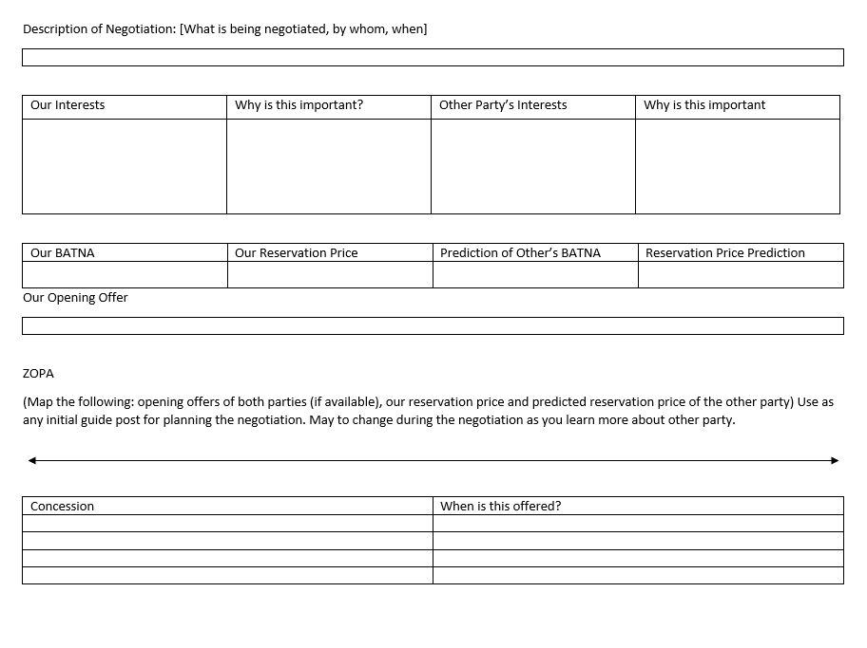
Negotiation Worksheet
Helpful guide for preparing for any type of negotiation
Notes:
We are going to provide you a negotiation sheet to use when planning your own negotiations that helps you think about you and the vendors interests, identifies BATNAs, reservations price, ZOPA, outlines concessions, when to give them, and plans the opening offer. This worksheet will also be used to guide the planning later in the workshop.

Slide 42
Your Homework!
Prepare to negotiate for ACES Database
Use only the information presented within the case
Read only your assigned half of the case – DON’T CHEAT
A big piece of negotiations is uncovering information you do not know.

Slide 43
Preview of Tomorrow’s Session
First 30 minutes will be negotiating for ACES Database.
  You will be paired up in breakout rooms
  Katharine will be available in main room to act as “the manager” whom you may ask questions or permission.
  Mahasin will play the vendor for one of you assigned the librarian role.

Slide 44
ACES DATABASE NEGOTIATION ROLE ASSIGNMENT
LIBRARIAN | VENDOR
Bennet, Rachel Calhoun, Erin Cunningham, Carolyn Daix, Erin Elliott, Amy Gaffney, Megan Hollar, Dani Knapp, Michele LeBeau, Chris Nguyen, Anne Pence, Deborah Probst, Sarah Ruenz, Megan | Brown, Jeremy Chau, Selena Chen, Yao Edwards, Sheri Gilbert Redman, Jessica Hess, Stephanie Kinney, Megan Murphy, Jana Napoli, Kyle Peebles, Emily Prucha, Christina Ramos, Marisol Seymour-Green, Marie

Slide 45
Preview of Tomorrow’s Session
Other topics tomorrow
  Negotiating from a place of low power
  Managing bad behavior mid-negotiations

Slide 46
Q&A & Discussion
11

Slide 47
CREDITS
Special thanks to all the people who made and released these awesome resources for free:
Presentation template by SlidesCarnival

